Slide 1
Excel: Formatting
Participation Project
Housing Problem
WV Mining Problem

Slide 2
Topics Covered
Format cells
Apply cell styles
Apply conditional formatting
Apply color scale formatting

Slide 3
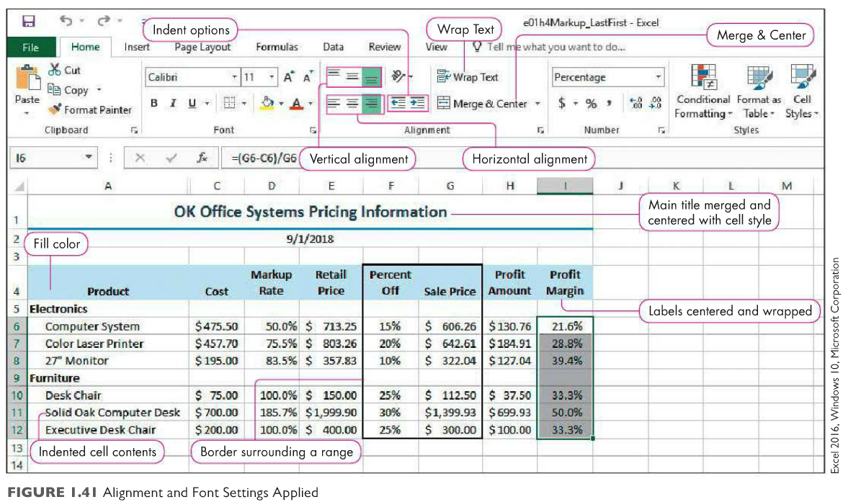
Formatting tools
M. A. Poatsy, K. Mulbery, J. Davidson, A. Rutledge, and R. Grauer, Exploring Microsoft Office Excel 2016 Comprehensive, 1st ed. Upper Saddle River, NJ: Pearson Education, 2016.

Slide 4
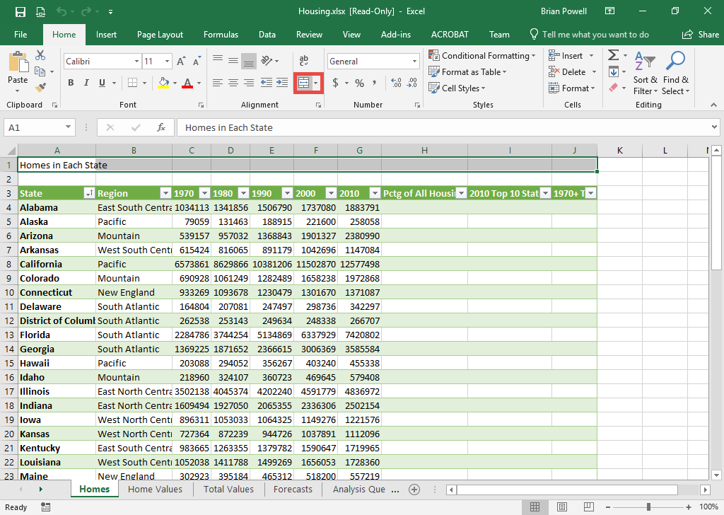
Format Cells:
Merge & Center
Select the range of cells you wish to merge and center.
Go to the Home ribbon.
In the Alignment section, click Merge & Center.

Slide 5
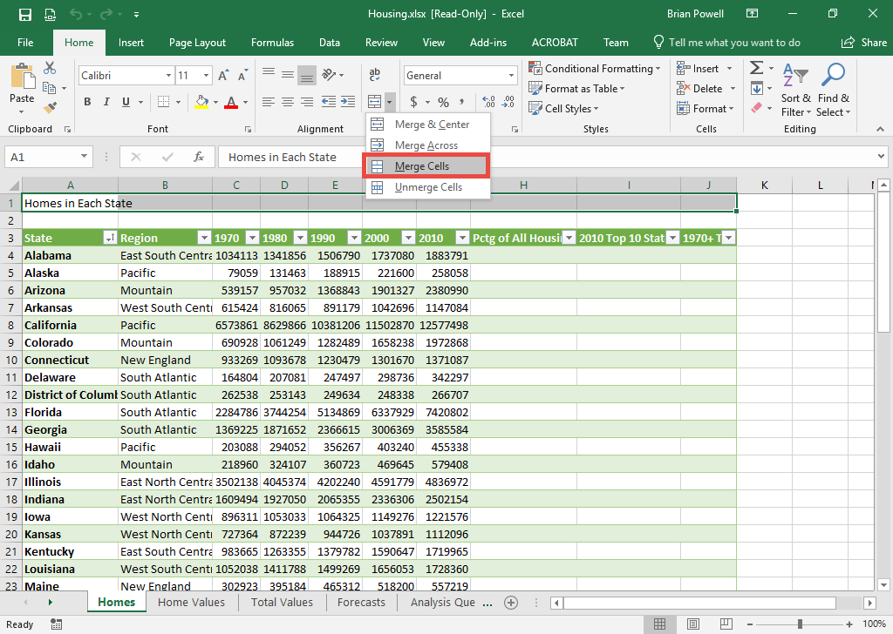
Format Cells:
Merge (but not Center)
Select the range of cells you wish to merge.
Go to the Home ribbon.
In the Alignment section, click the drop-down arrow and then click Merge Cells.

Slide 6
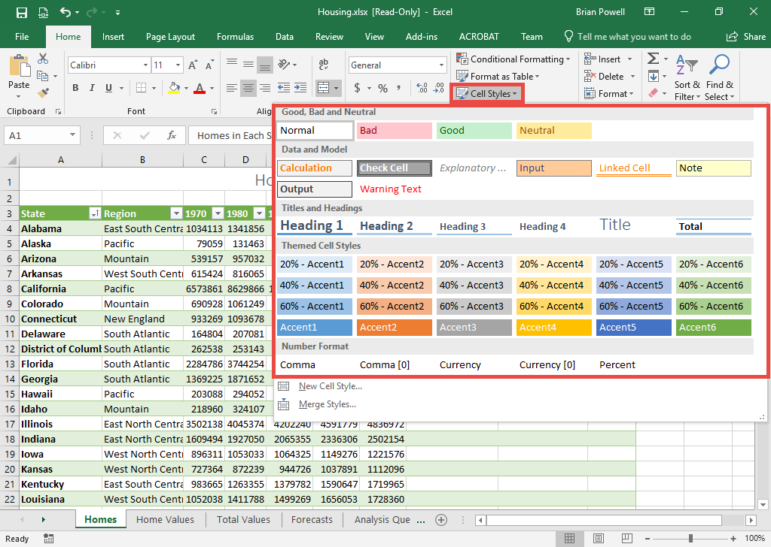
Format Cells: cell styles
Cell styles provide a way to add predefined formatting settings to a cell.
Click the cell where you wish to apply cell styles.
Go to the Home ribbon.
In the Styles section, click Cell Styles, and then select the specific cell style to use.

Slide 7
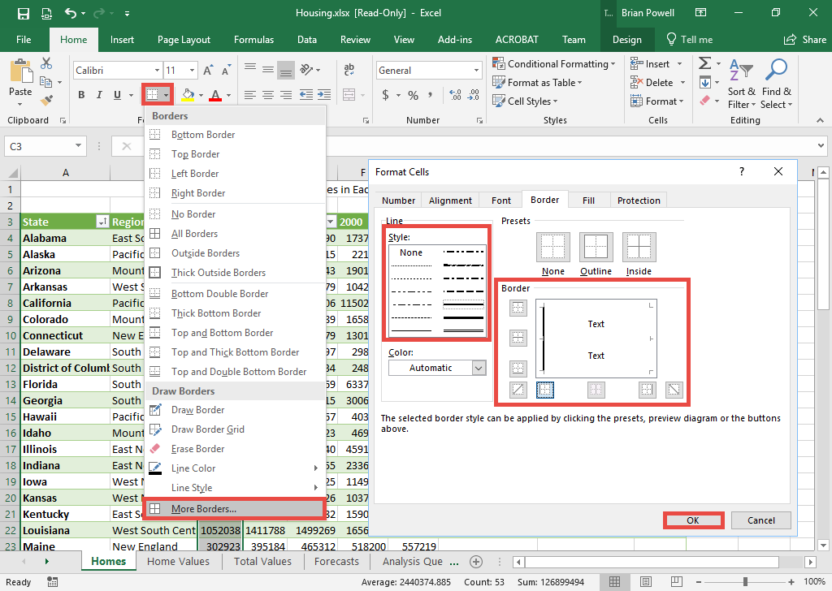
Format Cells:
Add borders
Select the range of cells to add borders to.
Go to the Home ribbon.
In the Font section, click the dropdown arrow by the border, and then select More Borders to open the Format Cells dialog box.
Select the border style to use.
Select the border positions needed.
Click the OK button.

Slide 8
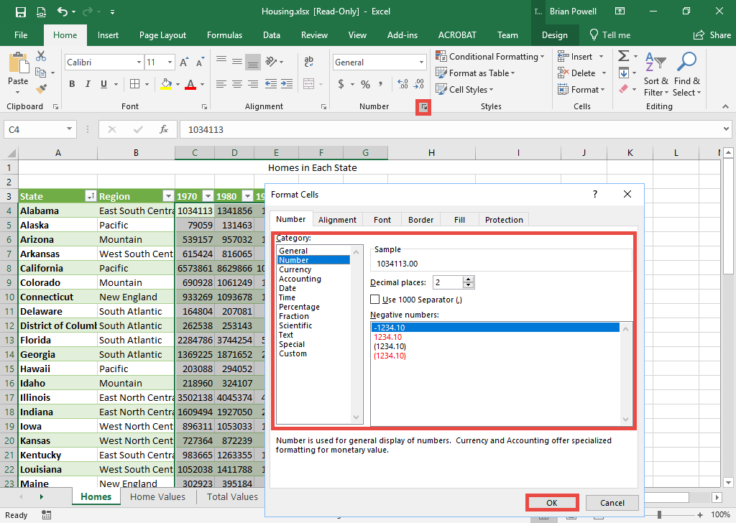
Format Cells:
Format values
Select the range of cells you wish to format.
Go to the Home ribbon.
In the Number section, click the arrow at the bottom-right corner to open the Format Cells dialog box.
On the Number tab, select the number style and set the decimal places and/or other settings according to the instructions.
Click the OK button.

Slide 9
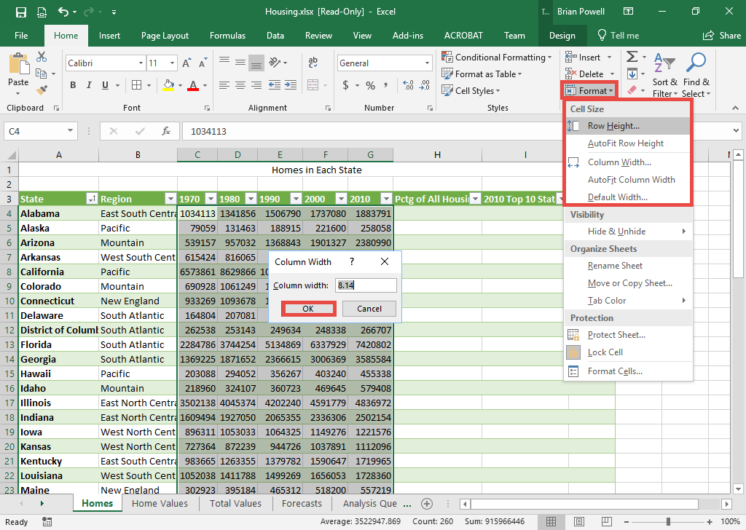
Format Cells:
Set row height and column width
Select the range of rows or columns you wish to resize.
Go to the Home ribbon.
In the Cells section, click Format, and then select Row Height or Column Width as needed.
Enter the specific number for row height or column width.
Click the OK button.

Slide 10
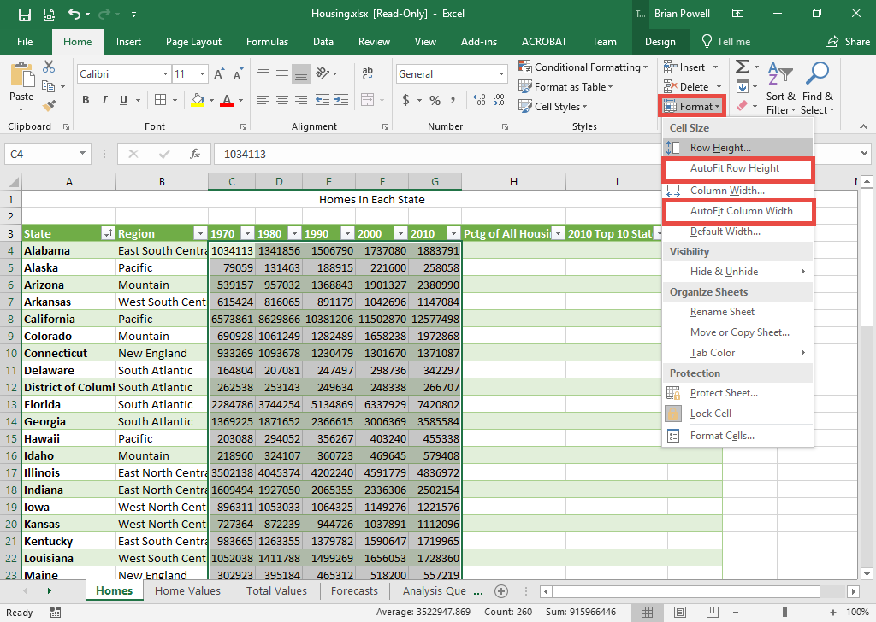
Format Cells:
AutoFit row height/column width
AutoFit will automatically set the width or height to fit the longest amount of text.
Select the range of rows or columns you wish to autofit.
Go to the Home ribbon.
In the Cells section, click Format, and then select AutoFit Row Height or AutoFit Column Width as needed.

Slide 11
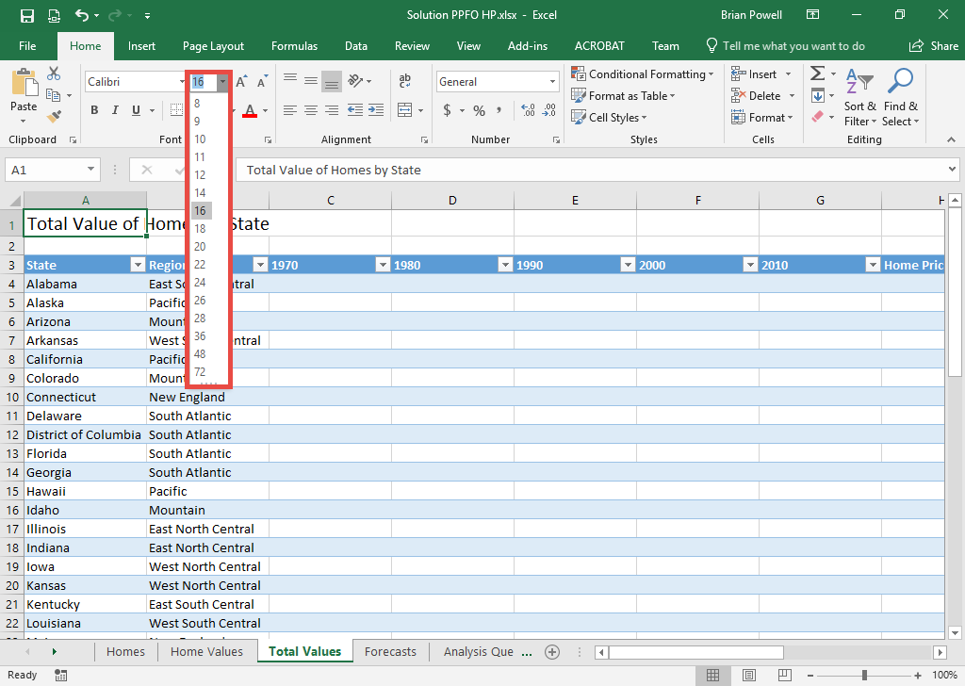
Format Cells: set font size
Select the cell for which you wish to change the font size.
Go to the Home ribbon.
In the Font section, click the drop-down arrow by the font size, and then select the specific size.

Slide 12
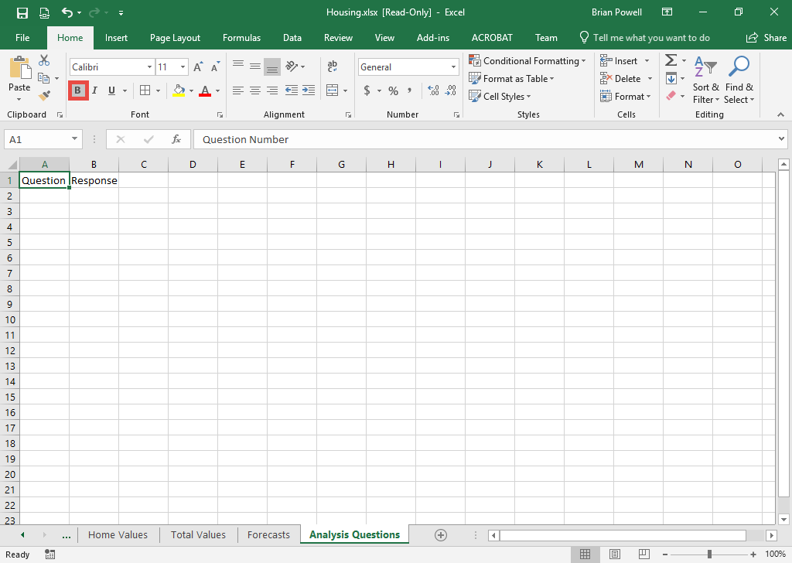
Format Cells:
Bold Cell contents
Select the cells, rows, or columns you wish to bold.
Go to the Home ribbon.
In the Font section, click the B button to bold the contents.

Slide 13
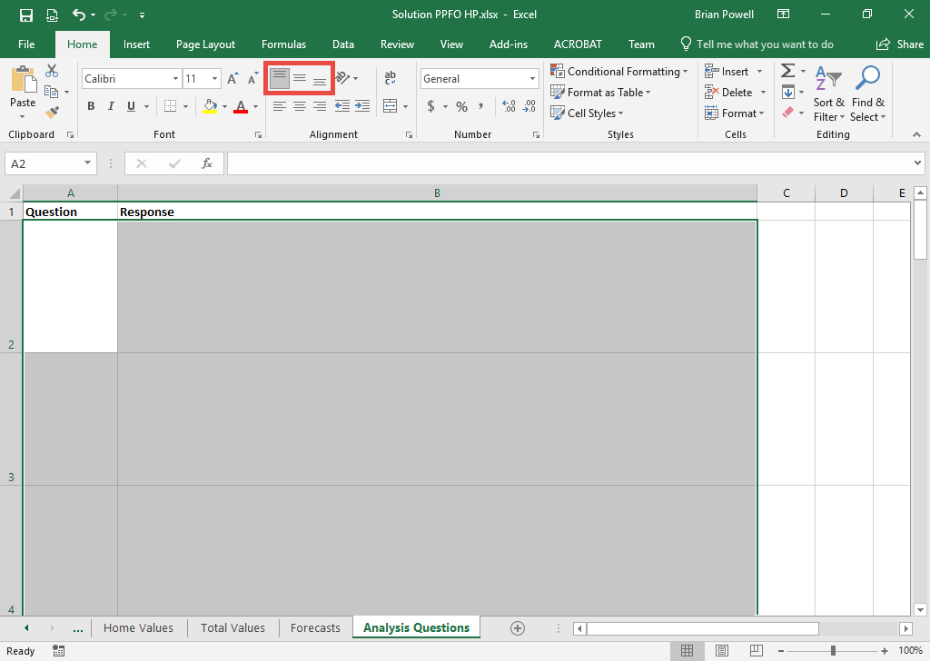
Format Cells:
Change vertical alignment
Select the range of cells, rows, or columns where you wish to change the vertical alignment.
Go to the Home ribbon.
In the Alignment section, click the button for the desired vertical alignment.

Slide 14
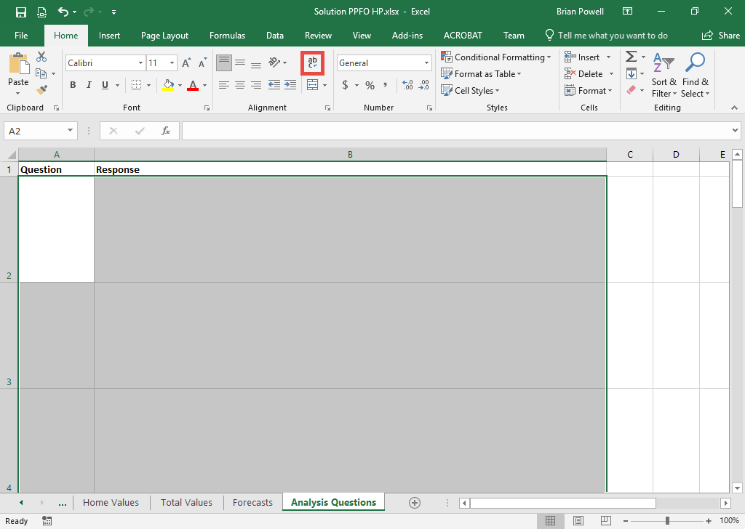
Format Cells:
Enable text wrapping
By default, all text in an Excel cell will be on the same line. Enable text wrapping will use multiple lines in taller cells.
Select the range of cells, rows, or columns where you wish to turn on text wrapping.
Go to the Home ribbon.
In the Alignment section, click Wrap Text.

Slide 15
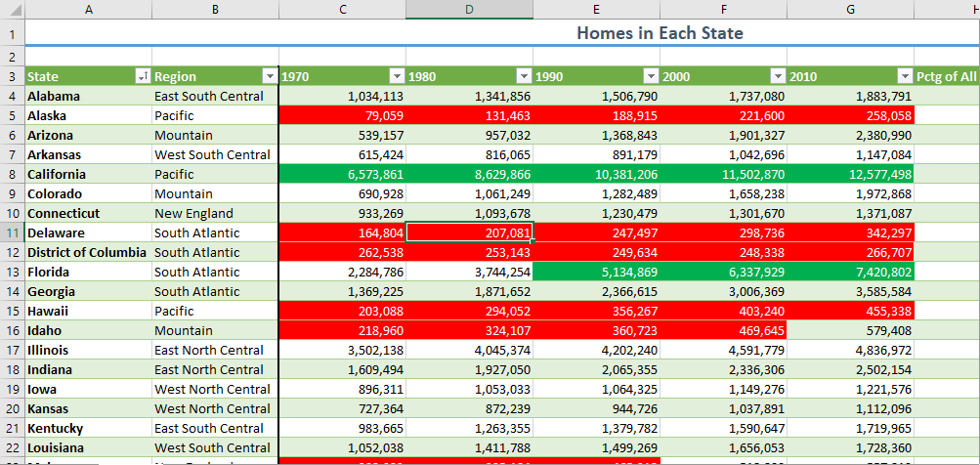
Conditional Formatting
Conditional formatting changes the appearance of cells (fonts, colors) depending on the values they contain.
This formatting can make it easier to pick out specific types of values in a large sheet of data.

Slide 16
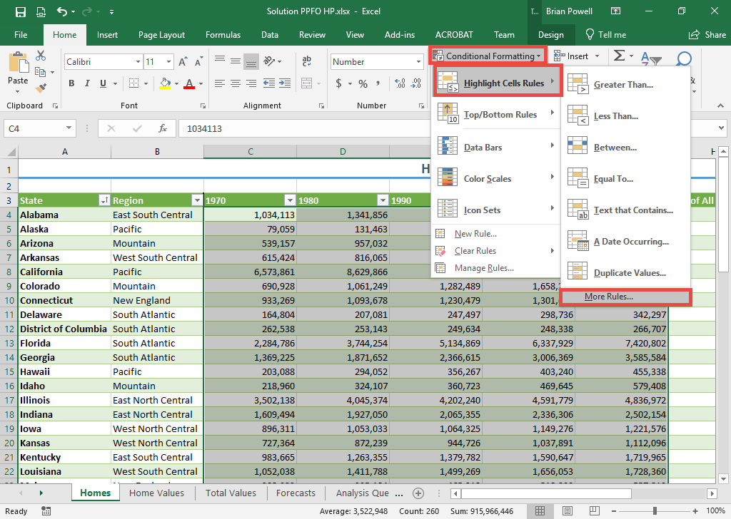
Apply conditional formatting:
Part 1
Select the range of cells where you wish to apply conditional formatting.
Go to the Home ribbon.
In the Styles section, click Conditional Formatting
Select Highlight Cells Rules and then select More Rules.

Slide 17
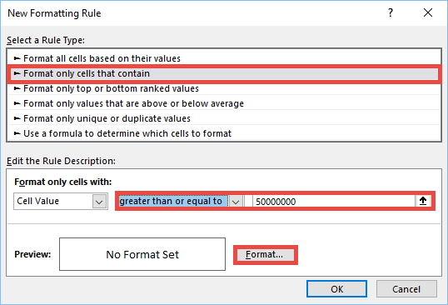
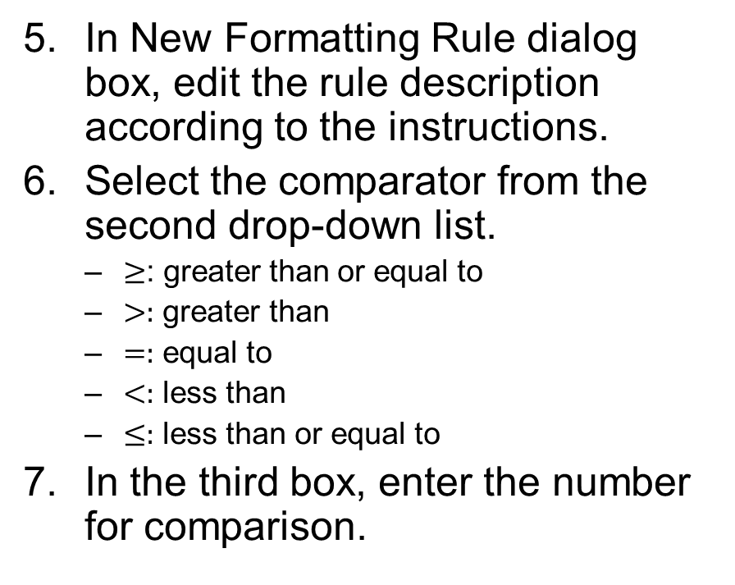
Apply conditional formatting:
Part 2
In New Formatting Rule dialog box, edit the rule description according to the instructions.
Select the comparator from the second drop-down list.
  $≥$: greater than or equal to
  $>:$ greater than
  $=:$ equal to
  $<:$ less than
  $≤:$ less than or equal to
In the third box, enter the number for comparison.

Slide 18
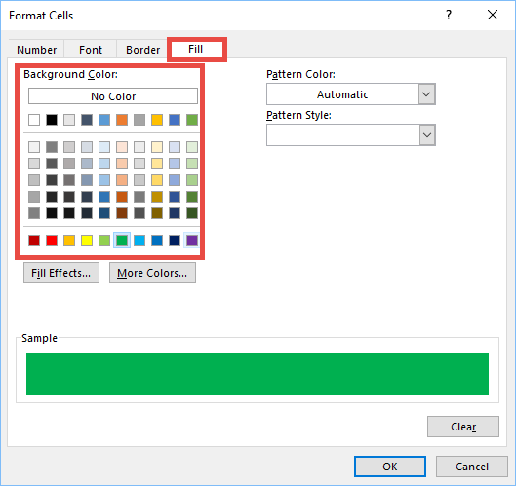
Apply conditional formatting:
Part 3
Change the cell fill color:
  Click Format.
  Go to the Fill tab.
  Select the fill color as required.

Slide 19
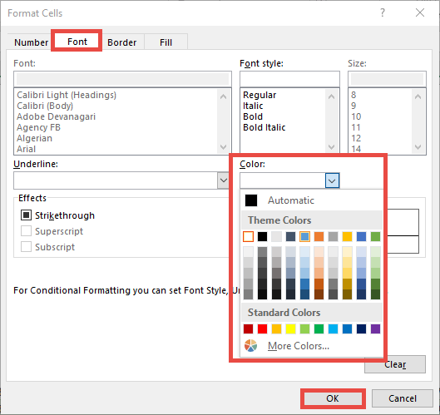
Apply conditional formatting:
Part 4
Change the text color:
  Go to the Font tab.
  In the Color section, click the dropdown list to expand different color options.
  Select the desired text color.
Click the OK button to return to the New Formatting Rule dialog box.
Click the OK button to apply the conditional formatting to the selected cells.

Slide 20
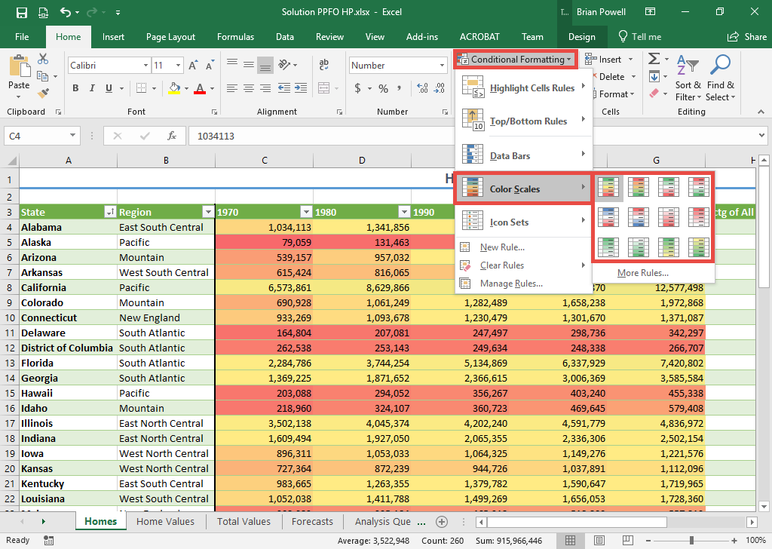
Apply color scale formatting
Color scales apply a range of colors to help easily differentiate high and low values.
Select the range of cells where you wish to apply color scale formatting.
Go to the Home ribbon.
In the Styles section, click Conditional Formatting.
Select Color Scales and then click the desired color scale.
  Hovering over an option will show its name

