Slide 1
Excel: PivotTables Participation Project
Housing Problem
WV Mining Problem

Slide 2
Topics Covered
Create a PivotTable
Group PivotTable data
Create a PivotChart and PivotTable
Refresh the PivotTable data

Slide 3
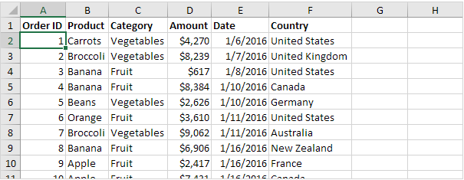
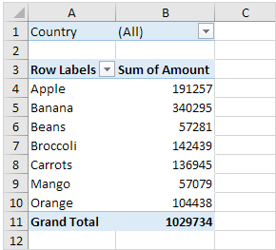
PivotTables
PivotTables are one of Excel’s most powerful features.
Provide an interactive way to quickly summarize data.
Allow users to easily extract detailed data from large tables
PivotTables are designed for:
Subtotaling data
Pivoting (Moving rows to columns or columns to rows)
Filtering, grouping, ….
Presenting a concise and attractive table

Slide 4
PivotTables Components
M. A. Poatsy, K. Mulbery, J. Davidson, A. Rutledge, and R. Grauer, Exploring Microsoft Office Excel 2016 Comprehensive, 1st ed. Upper Saddle River, NJ: Pearson Education, 2016.

Slide 5
Create a PivotTable: Part 1
Select the range of cells you wish to use for the PivotTable.
Go to the Insert ribbon.
In the Tables section, click PivotTable to open the Create PivotTable dialog box.
In the Create PivotTable dialog box, keep New Worksheet selected to place the PivotTable on a new sheet.
Click the OK button.

Slide 6
Create a PivotTable: Part 2
Click in the white space to display the PivotTable Fields pane.
In the PivotTable Fields pane, click and drag the fields to the Filters, Columns, Rows, and Values areas as listed in the instructions.
As you add fields to these quadrants, you will see the PivotTable created on the sheet

Slide 7
Summarize PivotTable Values
Right-click in the column where you want to modify the calculation to summarize data.
Select Value Field Settings to open Value Field Settings dialog box.
Select the type of calculation that you want to summarize the data for this column.
Click the OK button.

Slide 8
Format PivotTable Values
Right-click in the column where you want to format the cell values.
Select Value Field Settings to open the Value Field Settings dialog box.
Click the Number Format button to open the Format Cells dialog box.
Apply the number formatting listed in the instructions.
Click the OK button.

Slide 9
Group PivotTable Data
Right-click in the column where you want to group the values.
Select Group to open the Grouping dialog box.
Enter numbers in the Starting at and By boxes according to the instructions.
Click the OK button.

Slide 10
PivotCharts
PivotCharts are a special form of chart where the data can be reorganized and filtered, like with PivotTables.
PivotCharts are commonly tied to PivotTables. When something changes with one, the other is automatically updated.

Slide 11
Create a PivotTable & PivotChart: Part 1
Select the range of cells you wish to use for the PivotTable and PivotChart.
Go to the Insert ribbon.
In the Charts section, click the PivotTable & PivotChart button to open the Create PivotTable dialog box.
Keep New Worksheet selected to place the PivotTable and PivotChart on a new sheet.
Click the OK button.

Slide 12
Create a PivotTable & PivotChart: Part 2
Right-click in a blank area of the PivotChart and select Move Chart to move the PivotChart to a new sheet.
In the Move Chart dialog box, select New sheet, and enter the sheet name.
Click the OK button.
The PivotChart will now be moved to a new sheet

Slide 13
Create a PivotTable & PivotChart: Part 3
Select the PivotTable.
In the PivotTable Fields pane, click and drag the fields to the Filters, Columns, Rows, and Values areas as listed in the instructions.
As you configure the PivotTable, the PivotChart will be updated automatically
PivotCharts can be formatted the same way regular charts are formatted.

Slide 14
Refresh the PivotTable Data
When you modify cell values in your workbook, you must manually update your PivotTables before they reflect those new numbers.
Right-click on the PivotTable and choose the Refresh option.

