Slide 1
Excel: What-If Analysis Participation Project
Housing Problem
WV Mining Problem

Slide 2
Topics Covered
Perform correlation analysis
Create scenarios
Use Goal Seek
Create a scenario summary report

Slide 3
Correlation
Correlation determines if there is a linear relationship between two sets of values.
Results are between -1 and 1.
Result between -1 and 0: There is a negative correlation between the sets; when one value increases, the other value decreases
Zero result: No relationship between values
Result between 0 and 1: There is a positive correlation between the sets; when one value increases, the other does as well
“Linear Correlations,” MathIsFun.com, 2016. Available: https://www.mathsisfun.com/data/images/correlation-examples.svg.
Notes:
https://www.mathsisfun.com/data/correlation.html

Slide 4
Perform Correlation Analysis
Use the CORREL function to calculate the correlation coefficient.
Select the cell where you wish to enter the function
Type =CORREL(the first range of cells, the second range of cells).
Press the Enter key.

Slide 5
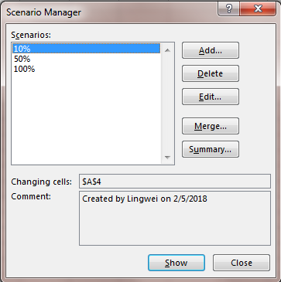
Scenarios
A scenario is a set of values saved for later use.
You can create and save different groups of values as scenarios and then switch between the scenarios to view different results.

Slide 6
Create a scenario: Part 1
Go to the Data ribbon.
In the Data Tools section, click What-If Analysis, and then select Scenario Manager.
In the Scenario Manager dialog box, click the Add button to create a new scenario.

Slide 7
Create a scenario: Part 2
In the Add Scenario dialog box, enter the scenario name.
Choose the cell(s) where you are changing the values.
Click the OK button.
In Scenario Values dialog box, check and confirm if the values in changing cells are correct.
Click the OK button.
After your scenario is created, it should be displayed in the Scenarios list

Slide 8
View Scenarios
In Scenario Manager, you can choose which scenario is shown.
Go to the Data ribbon.
In the Data Tools section, click What-If Analysis, and then select Scenario Manager.
Click the scenario to display and click the Show button.

Slide 9
Goal Seek
Goal Seek is used to find the input value needed to result in an output value that the user specifies.
For example, how many points do I need to earn the rest of the semester to get an A in the course?
$$x=\frac{The value in 2010}{The value in 2000} −1=0.5$$

Slide 10
Use Goal Seek
Go to the Data ribbon.
In the Data Tools section, click What-If Analysis, and then select Goal Seek.
In the Goal Seek dialog box, specify:
Set cell: Cell where you want to set the result
To value: Desired result
By changing cell: Enter cell that Excel will change to make the result match value you want
Click the OK button.
Change cell will update to the new value required to get the result specified

Slide 11
Create a Scenario Summary Report
A Scenario Summary Report lists the different scenario variables and their results.
Go to the Data ribbon.
In the Data Tools section, click What-If Analysis, and then select Scenario Manager.
In Scenario Manager dialog box, click Summary.
Select Scenario summary.
Click the OK button.
The summary will be on a new sheet named Scenario Summary.

