Slide 1
PowerPoint: Layout & formatting
Participation Project
Lewis Carroll Problem
McAlpine Locks & Dam Problem
US 1 Problem

Slide 2
Topics Covered
Use slide layouts and add content
Insert automatically updating dates
Embed Excel charts
Add headers and footers
Modify slide masters
Insert pictures
Crop pictures
Apply design themes
Apply animations
Apply slide transitions

Slide 3
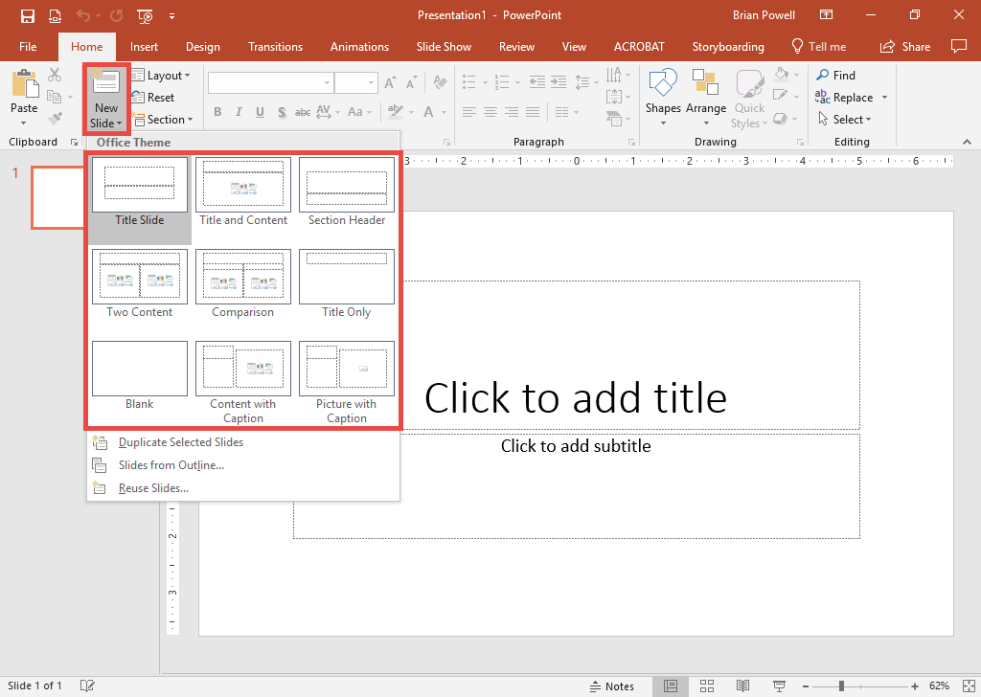
Use Slide Layouts
Slide layouts control how information is presented.
Go to the Home ribbon.
In the Slides section, click the drop-down arrow under the New Slide button.
Select the desired slide layout from the list.

Slide 4
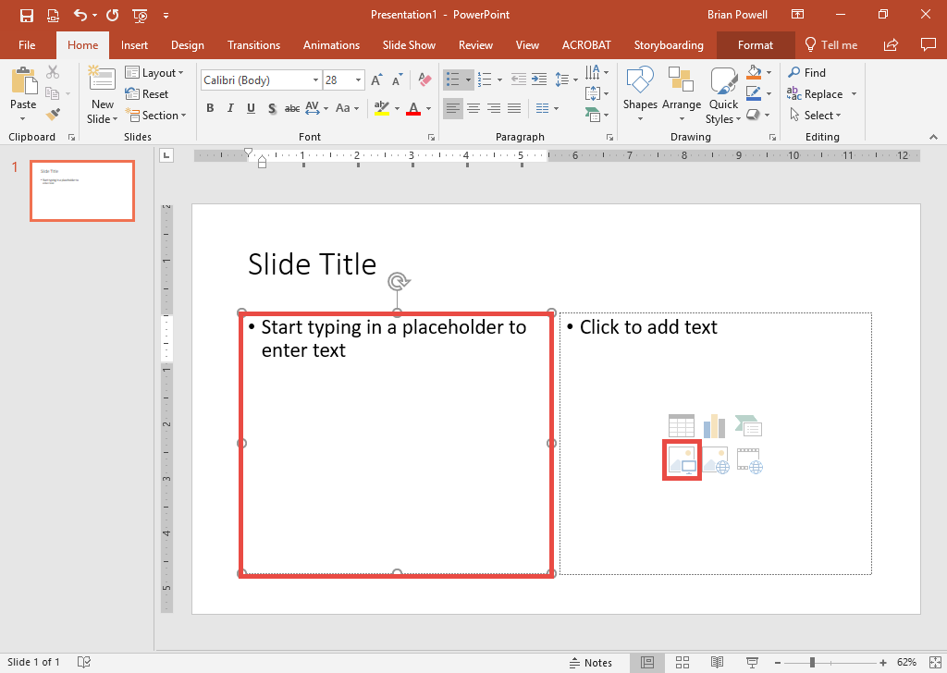
Add Content to a Slide
To add text:
  Click in a placeholder box.
  Type your text.
To add pictures:
  Click the Pictures button in the placeholder.
  Browse for your image.
To copy-and-paste content:
  Click to select the placeholder where the content will go.
  Right-click and choose Paste.

Slide 5
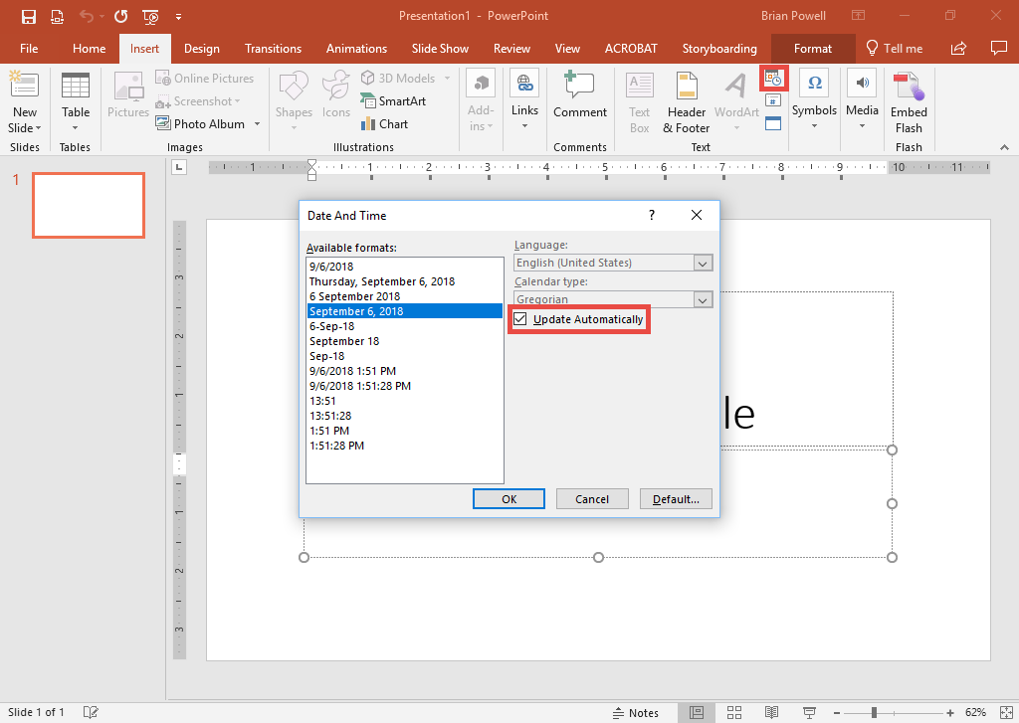
Insert Automatically Updating Dates
Automatically-updating dates always display the current date.
Go to the Insert ribbon.
In the Text section, click the Date & Time button.
In the Date And Time dialog box, select Update Automatically.
Click the OK button.

Slide 6
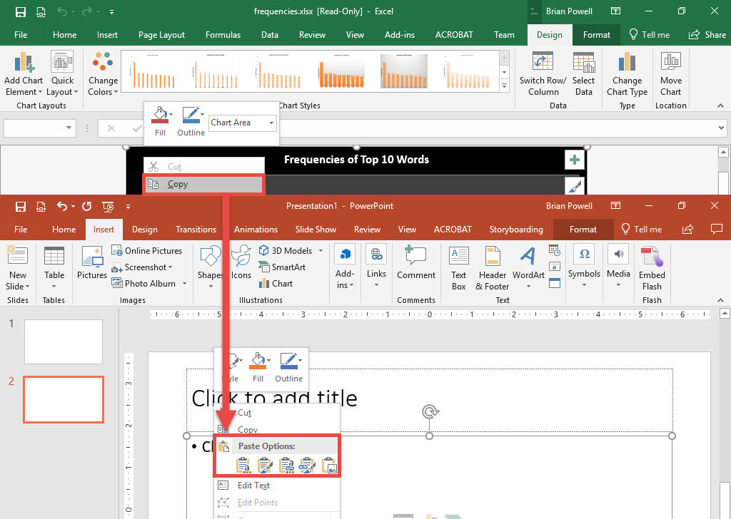
Embed Excel Charts
We can include charts from Excel in our slides to illustrate data.
Open the Excel workbook.
Right-click on blank area of chart and choose Copy.
Open the PowerPoint presentation.
Click to select a content area.
Right-click and paste.

Slide 7
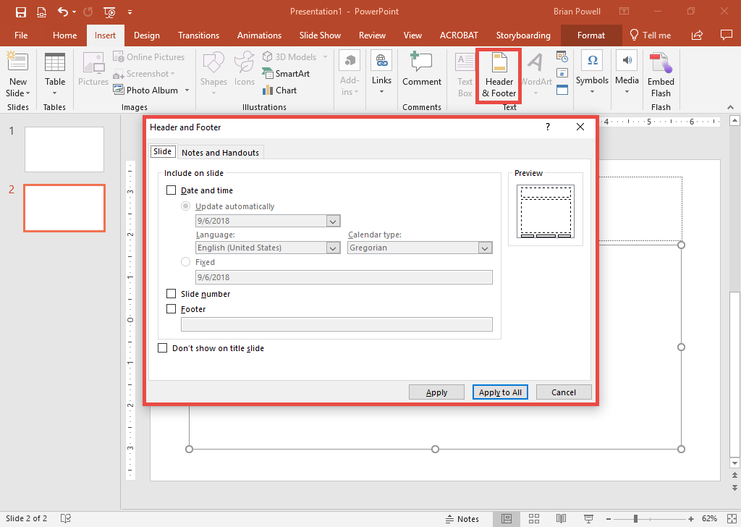
Add headers and Footers
Footers include things like the slide number and date.
Go to the Insert ribbon.
In the Text section, click the Header & Footer button.
In the Header and Footer dialog box, select:
  Date and time
  Slide number
  Footer

Slide 8
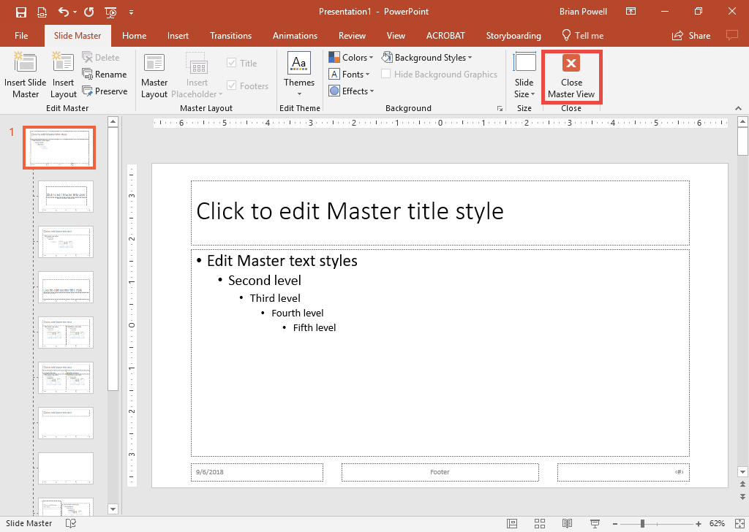
Modify Slide Masters
Slide masters control the available slide layouts and the appearance of a presentation.
Go to the View ribbon.
In the Master Views section, click the Slide Master button.
Click on the parent (top-most) slide master to affect all slide layouts.
Make modifications to the slide master, such as adding placeholders or images.
Click Close Master View when done.

Slide 9
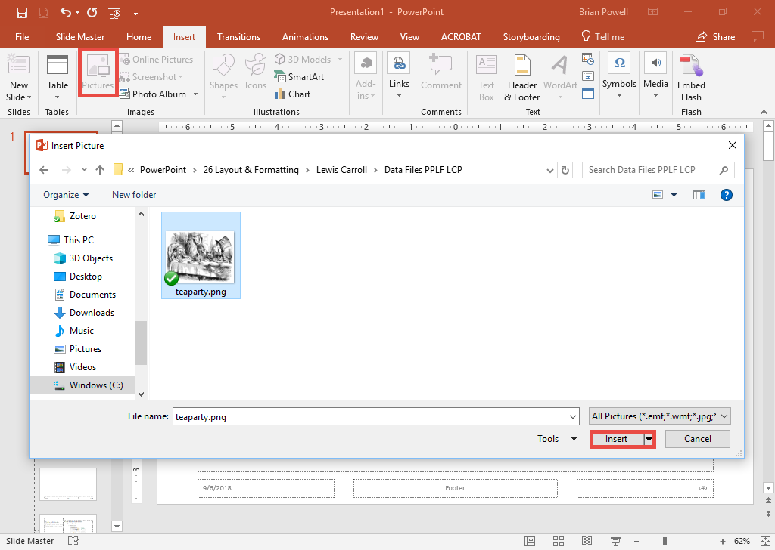
Insert Pictures outside of a placeholder
Go to the Insert ribbon.
In the Images section, click the Pictures button.
In the Insert Picture Dialog box, select the picture file.
Click the Insert button.
Drag the picture to its desired location.

Slide 10
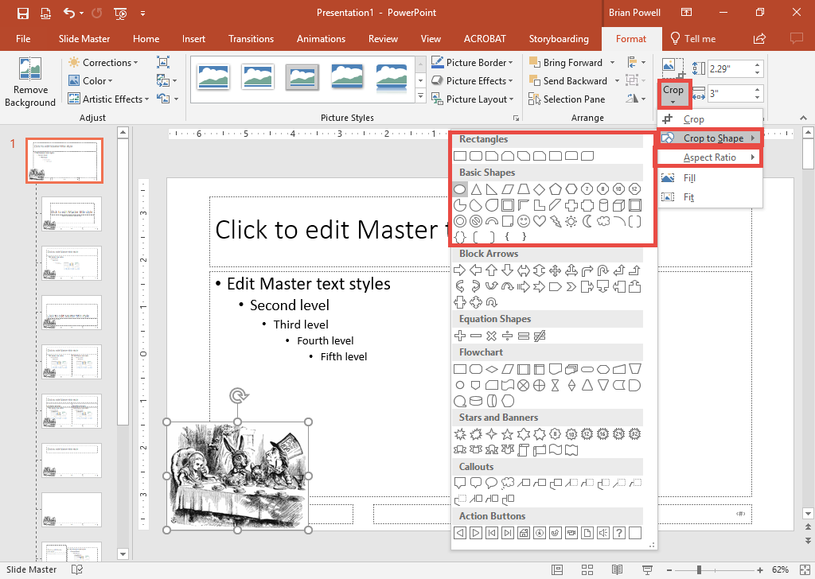
Crop Pictures to Shapes and set the aspect ratio
Cropping pictures allows you to focus on areas of interest.
Click to select the picture.
Go to the Picture Tools Format ribbon.
Open the Crop menu, click Crop to Shape, and choose the desired shape.
Go back to the Crop menu, click Aspect Ratio, and choose the desired setting.

Slide 11
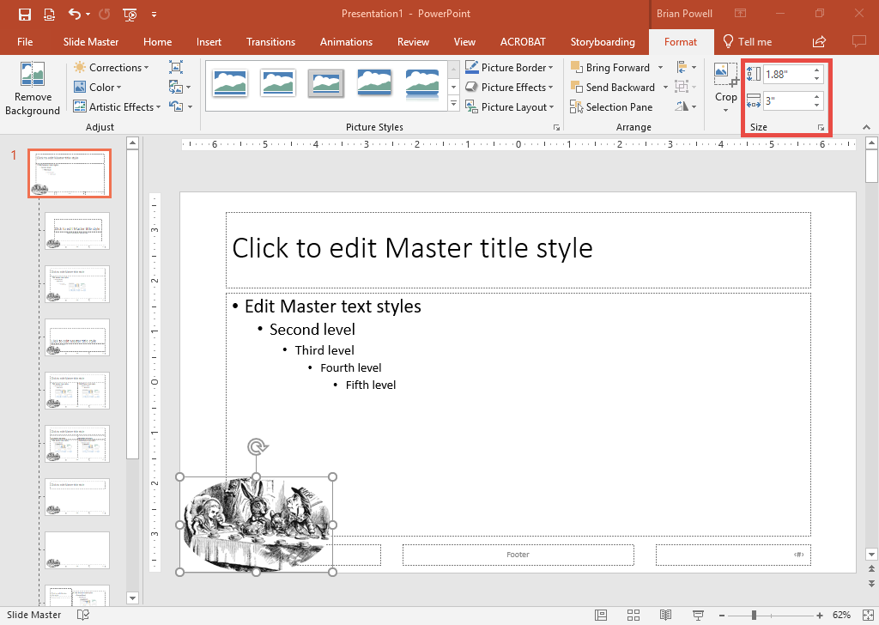
Size Pictures
The ribbon gives a way to set specific picture dimensions.
Click to select the picture
Go to the Picture Tools Format ribbon.
In the Size section, set the height and width.

Slide 12
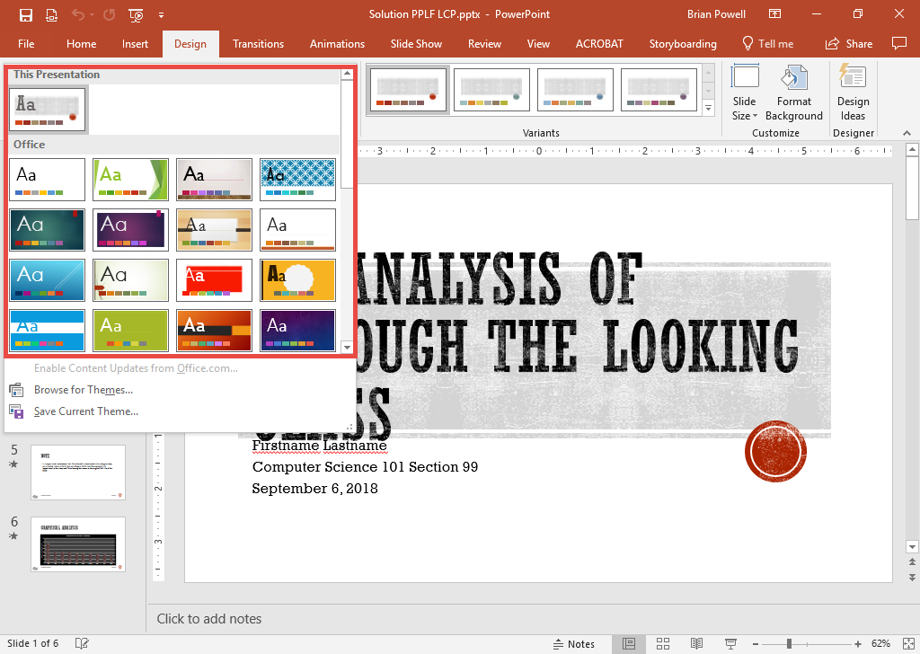
Apply Design Themes
Design themes control the appearance of a presentation.
Go to the Design ribbon.
In the Themes section, click the See More button.
Select the desired slide design to apply it to all slides.

Slide 13
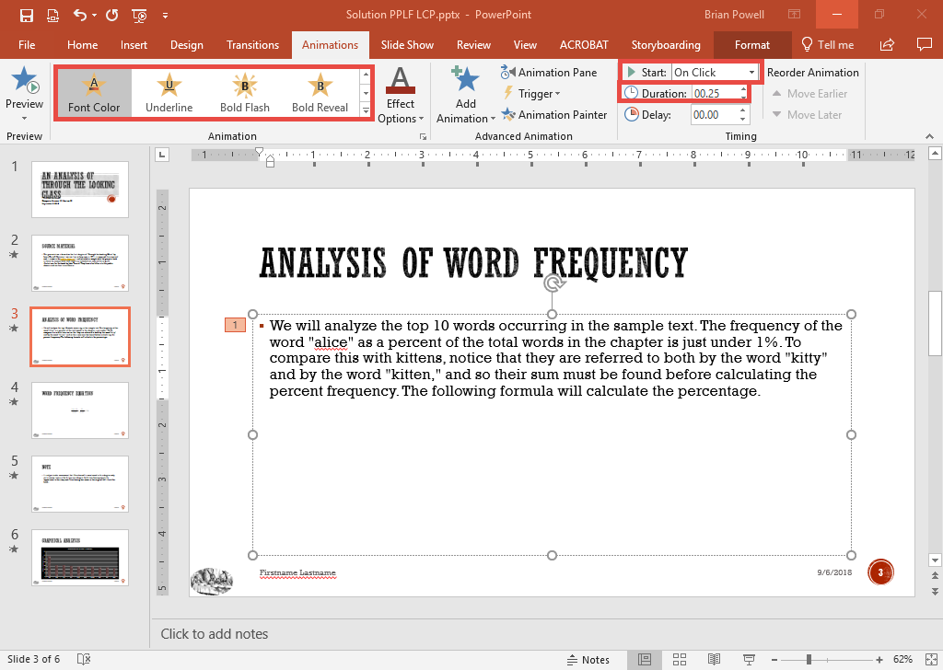
Apply Animations
Animations allow you to emphasize specific items on a slide.
Click the item on the slide you wish to animate.
Go to the Animations ribbon.
In the Animations section, select an animation.
In the Timing section, configure the duration and how animations start playing.

Slide 14
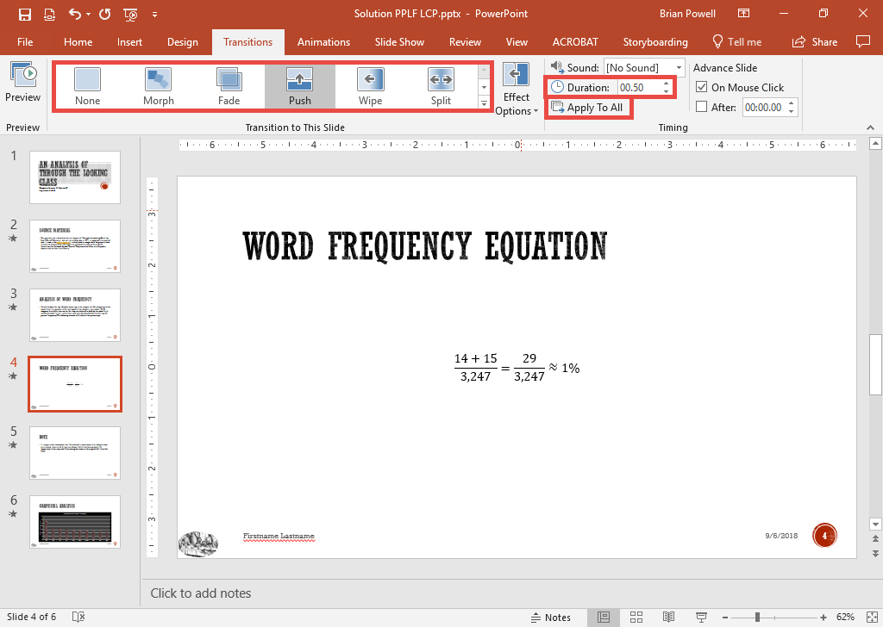
Apply Slide Transitions
Slide transitions are visual effects shown when changing slides.
Go to the Transitions ribbon.
In the Transition to This Slide section, click the desired transition to display when this slide loads.
In the Timing section, set the transition duration.
Click the Apply To All button.

