Slide 1
Access: Access Basics
Participation Project
WV K-12 Education Problem
WV Senate Problem

Slide 2
Topics Covered
Add, edit, and delete records
Use Datasheet and Design views for tables
Use Datasheet, Design, and SQL views for queries
View query results
View forms
View reports
Compact and repair the database

Slide 3
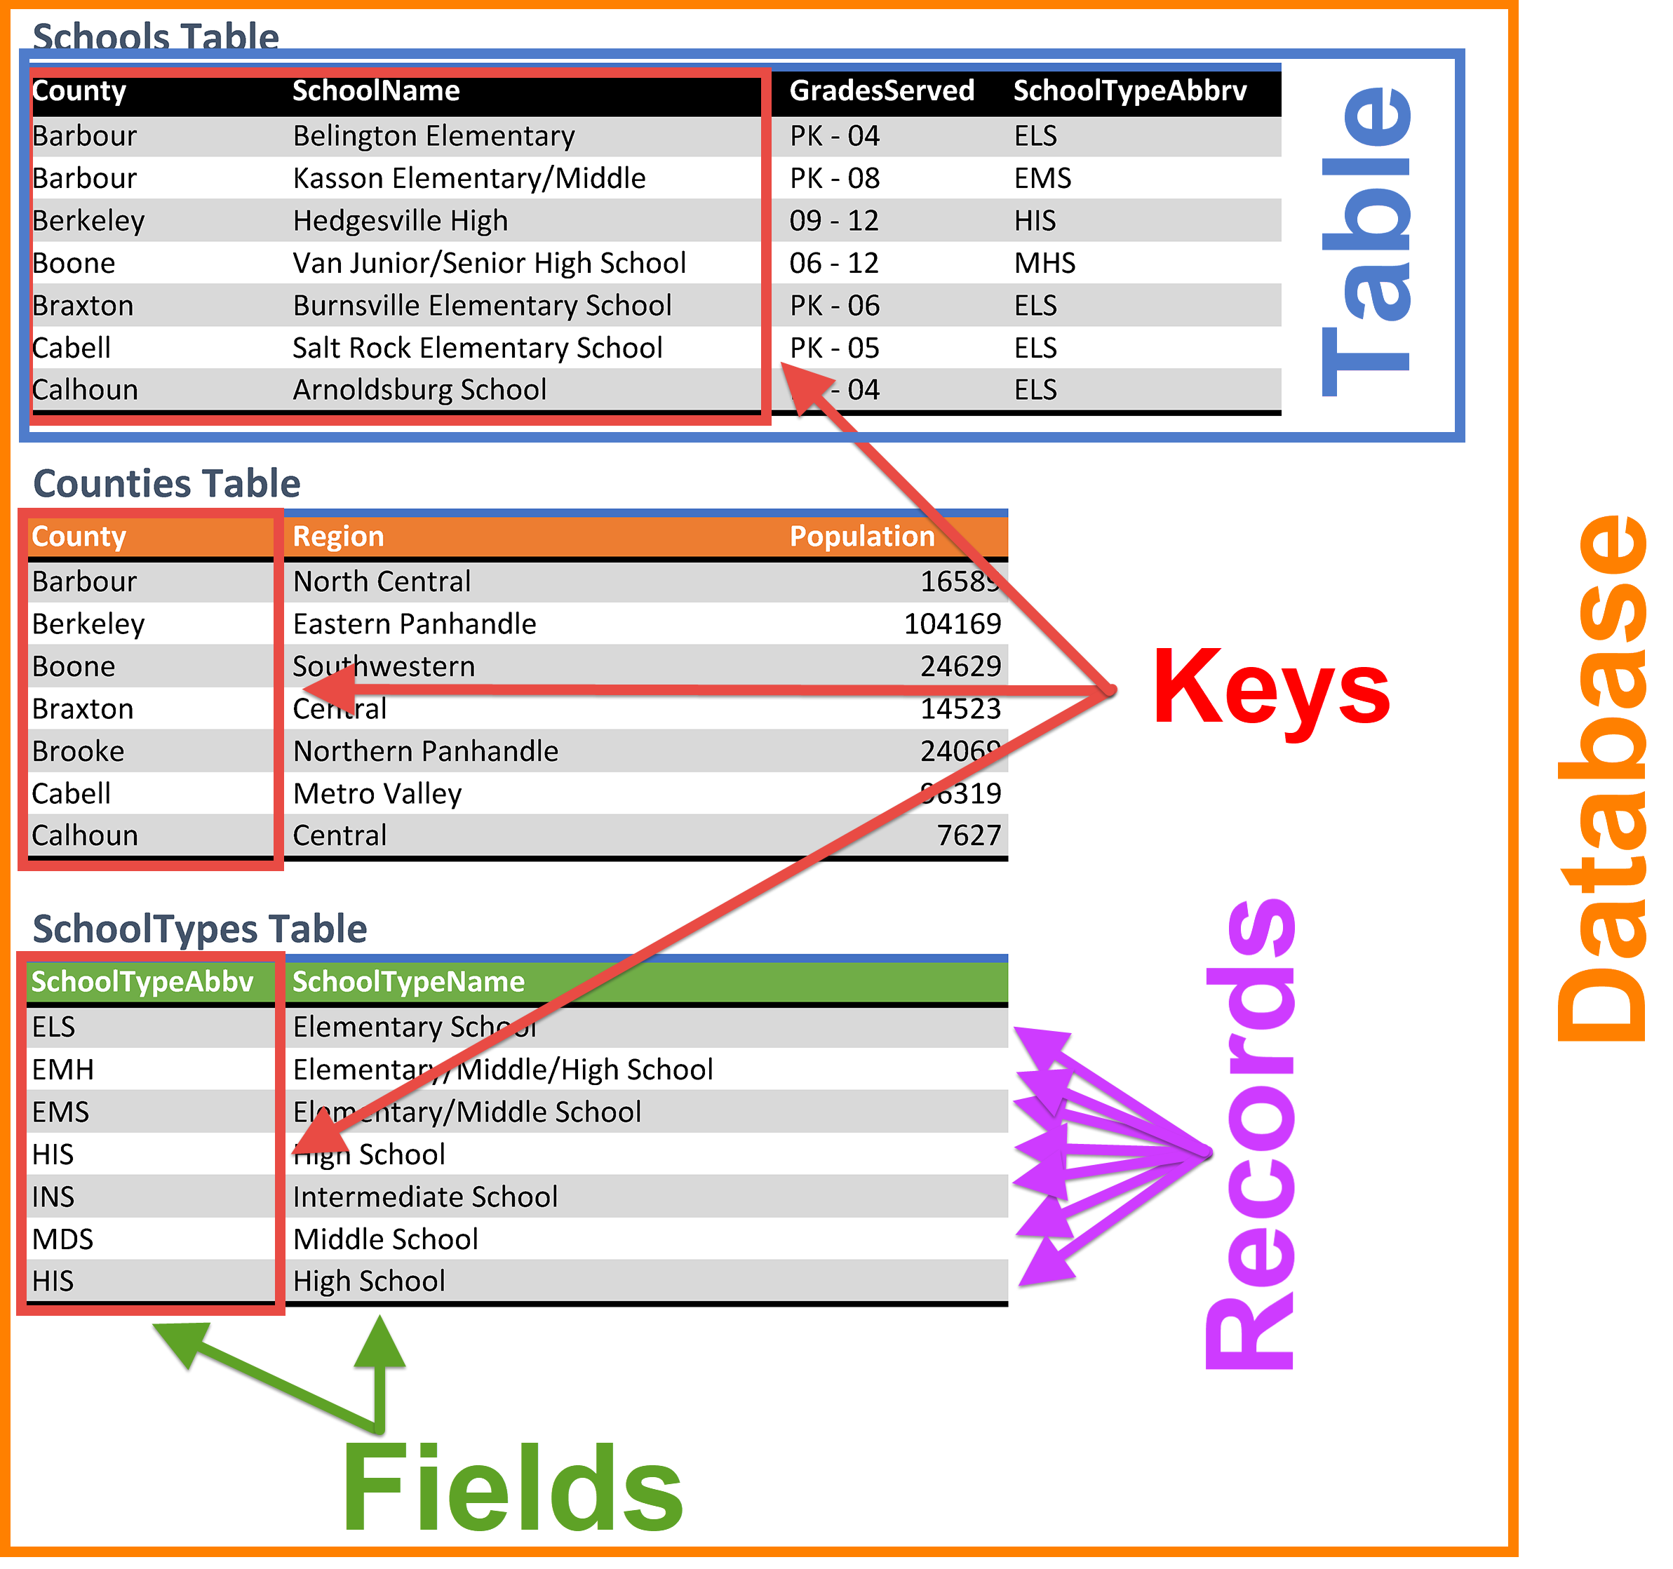
Database Terminology
A database is a structured collection of data, organized as a collection of tables.
Each table has multiple records (rows).
Each record has multiple fields (columns).
A key is a value that can uniquely identify each record in the database.

Slide 4
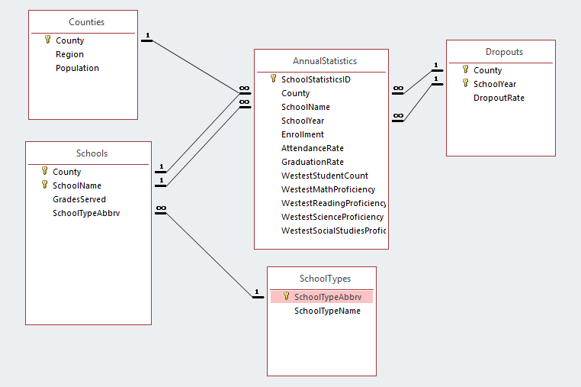
Relationships:
Part 1
Relationships are how records in different tables are connected to each other.
Each relationship is between two tables.
  Normally, a relationship involves two fields: one field in the first table and a corresponding field with the same type of data in the second table
  At least one of the fields involved should be a key
  If one of the tables has a composite key, there may be multiple fields in each table in the relationship

Slide 5
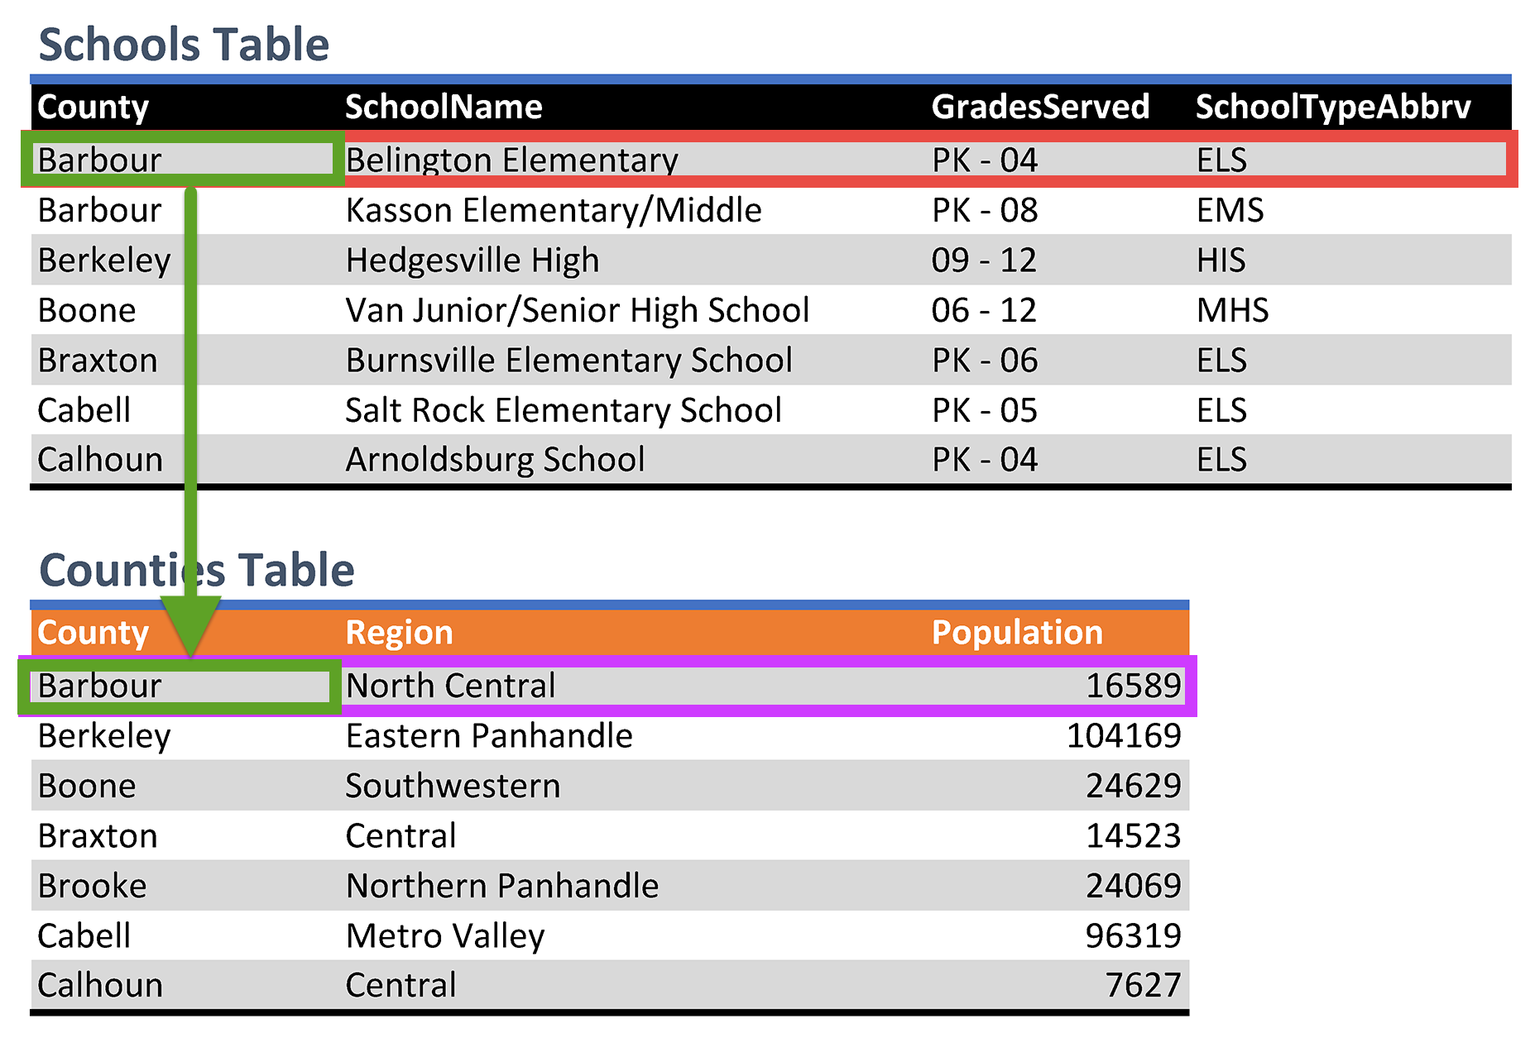
Relationships:
Part 2
A query is created to retrieve data or information we want from one or more tables.
In our example, how would we find the region where Belington Elementary is located?
  First, locate Belington Elementary in the Schools table
  Next, find its County is Barbour
  Then, look up Barbour in the Counties table to see a Region of North Central

Slide 6

Introduction to Microsoft Access
Excel (tables, formulas & functions, charts, PivotTable, …) for data analysis
Access (query, form, report, …) for data search and management

Slide 7

What is Microsoft access?
Microsoft Access is a database management system (DBMS), a software “engine” that provides an interface between physical data and user application queries.
Other common DBMS include Oracle and Microsoft SQL Server.

Slide 8
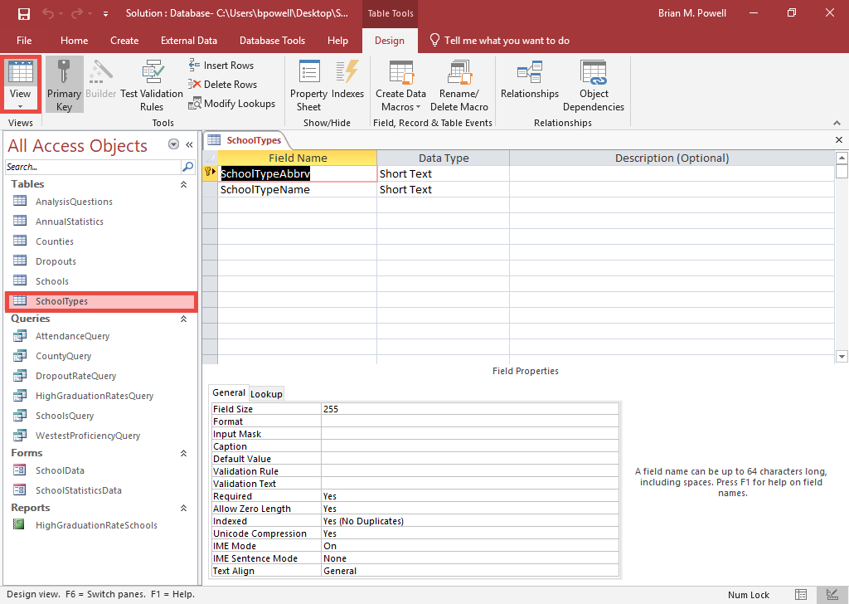
View Tables in Datasheet View
By opening a table in Datasheet View, you can see its records and make changes.
If the table is already open:
  Go to the Table Tools Design ribbon.
  Click the Datasheet View button.
If the table is not open:
  Double-click on the query in the Object Pane on the left side of the screen.

Slide 9
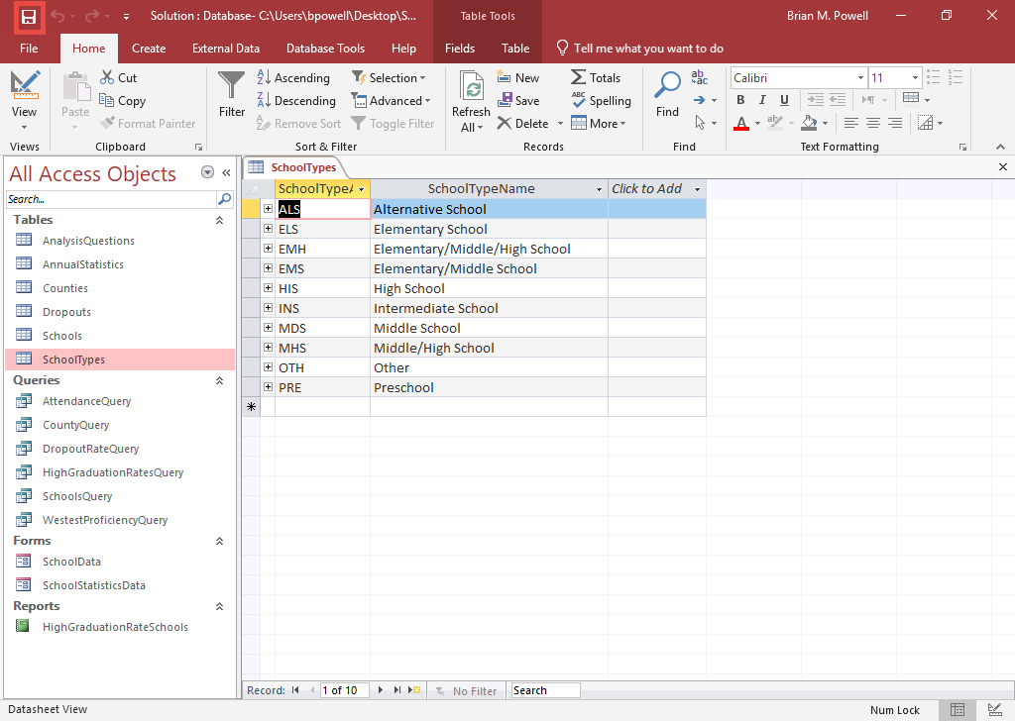
Save Changes to a Database
For most operations in Datasheet View for tables, as soon as you move the cursor out of a row, any changes you make are automatically saved.
It’s always a good idea to save your changes, though, by click the Save icon in the Quick Access Toolbar.

Slide 10
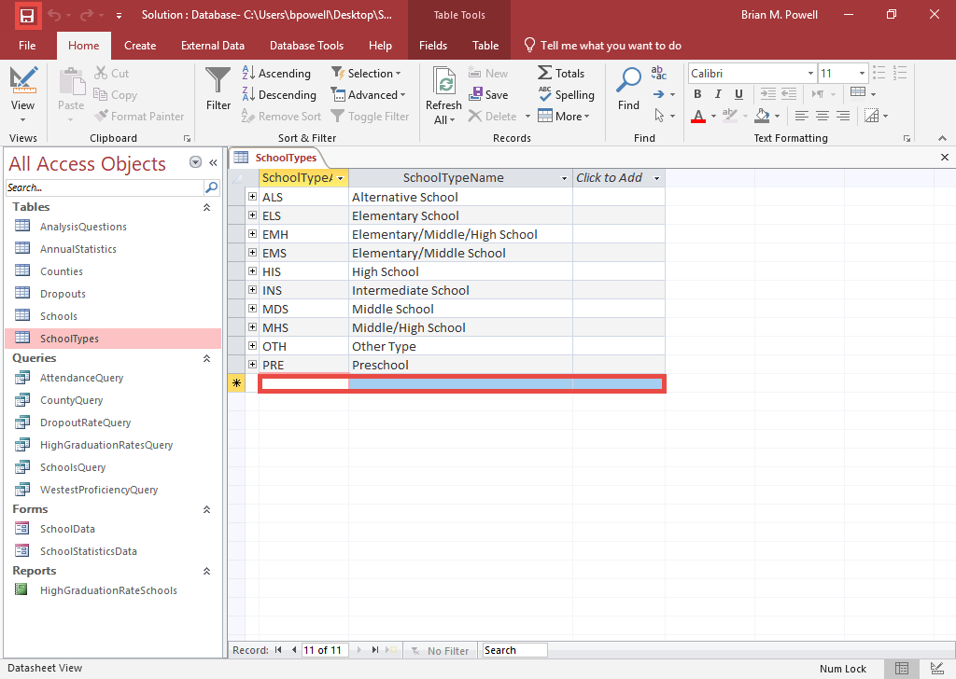
Add New Records
To add new records, make sure you have the correct table open in Datasheet View.
Go to the last row, which has an asterisk (*) in the leftmost column.
Type in new records one at a time.
Once you have finished adding records, save your database.

Slide 11
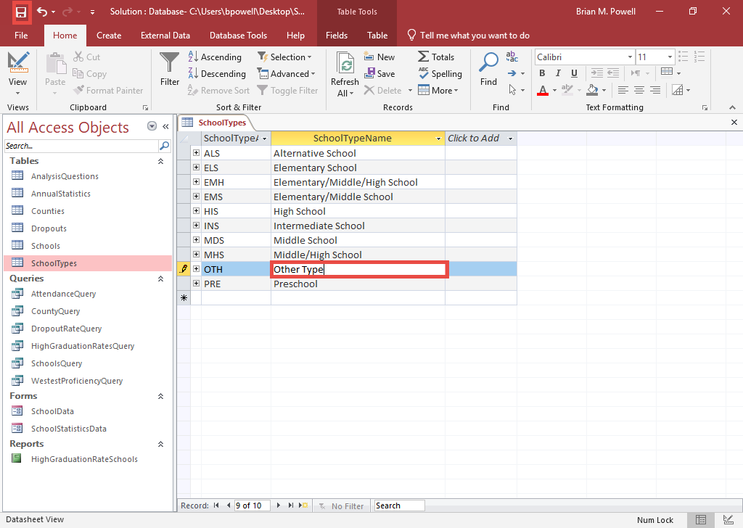
Edit Existing Records
Open the table containing the records you want to edit in Datasheet View.
Click in the cell containing the data you wish to change.
Make your changes.
Once you have finished editing records, save your database.

Slide 12
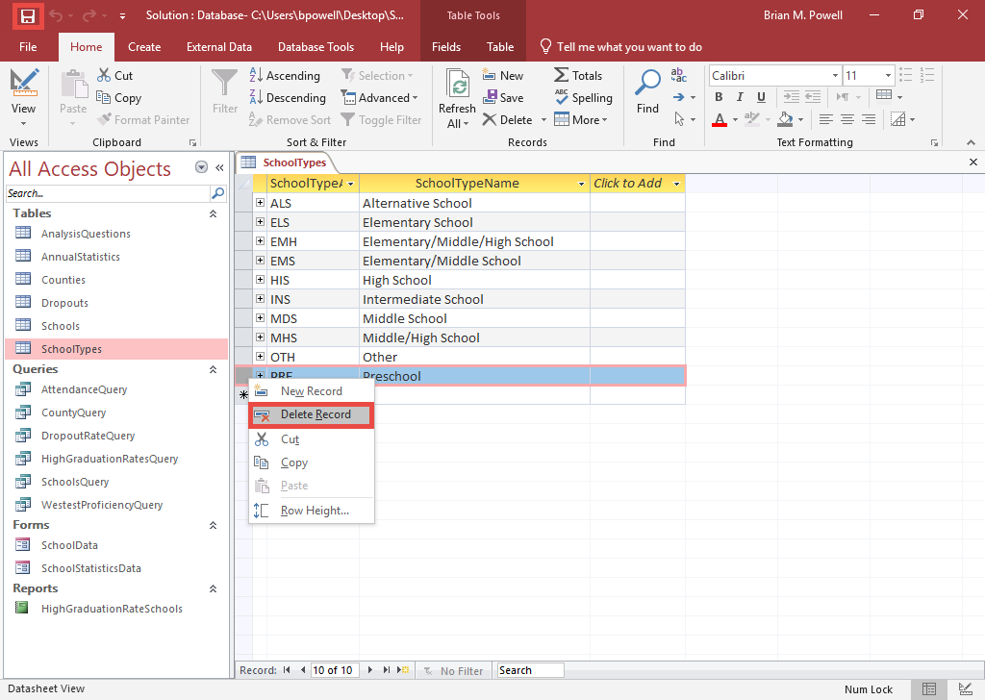
Delete Records
To delete records, open the table containing the records in Datasheet View.
Right-click in the left-most column to select the row. Choose Delete Record.
Once you have finished deleting records, save your database.

Slide 13
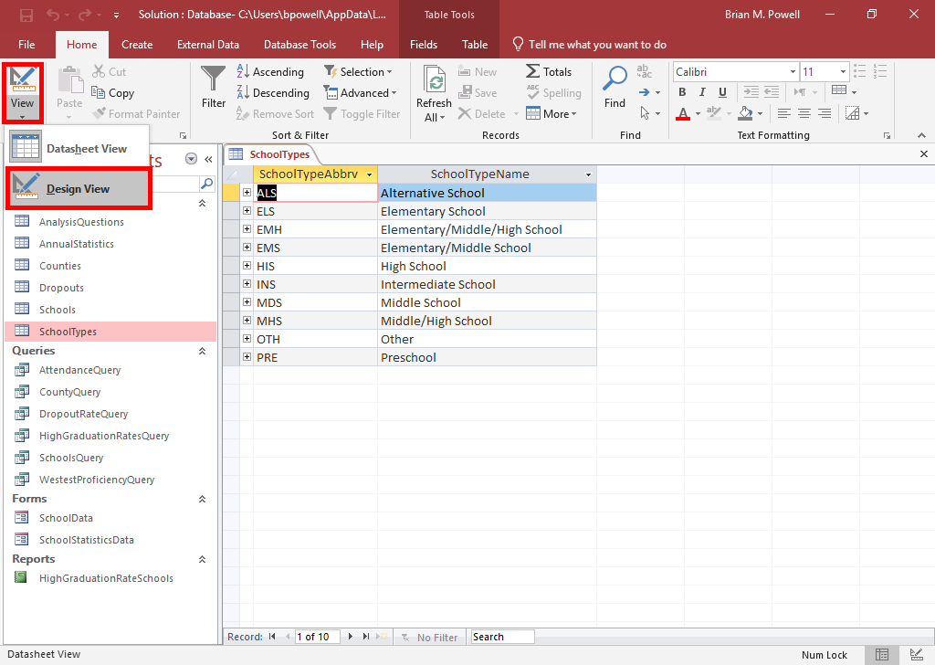
View Tables in Design View
Design View is used to modify the structure of a table.
  Field names
  Field data types and properties
With the table already open, go to the Home ribbon.
Click the arrow below the View button and select Design View from the resulting menu.

Slide 14
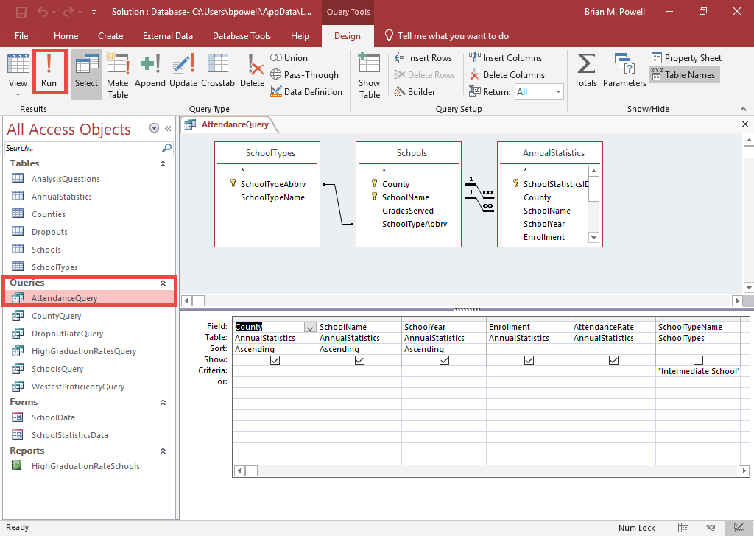
View Queries in Datasheet View
Query results are shown in Datasheet View.
If the query is already open:
  Go to the Query Tools Design ribbon.
  Click the Run button.
If the query is not open:
  Double-click on the query in the Object Pane on the left side of the screen.

Slide 15
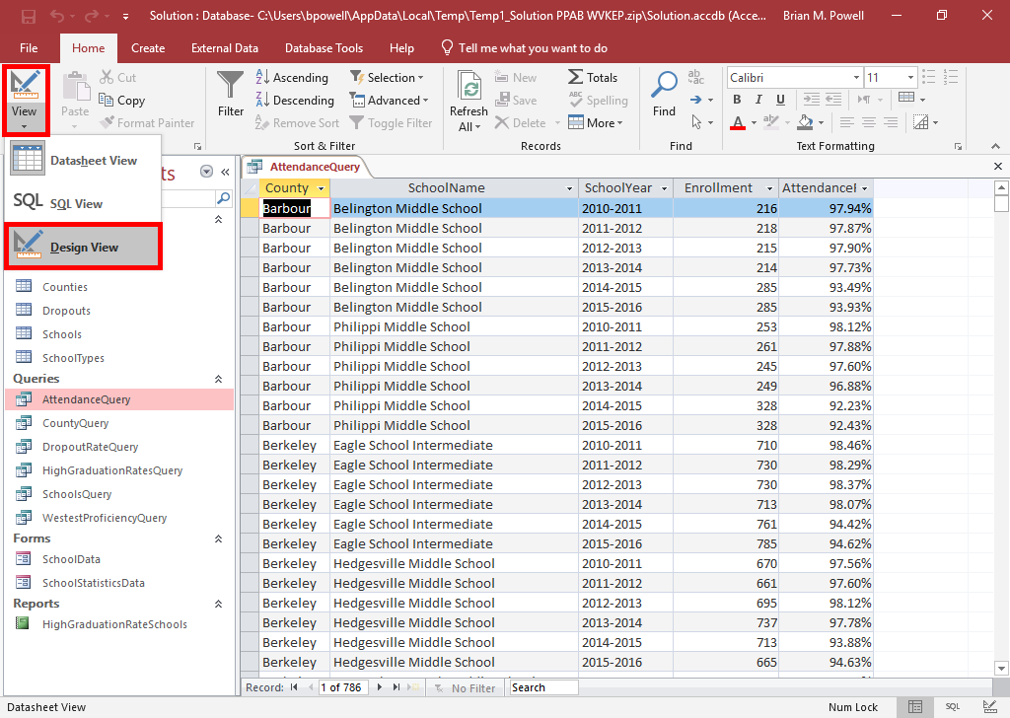
View Queries in Design View
Design View is used to modify queries.
With the table or query already open, go to the Home ribbon.
Click the arrow below the View button and select Design View from the resulting menu.
More about modifying queries will be discussed in a later project.

Slide 16
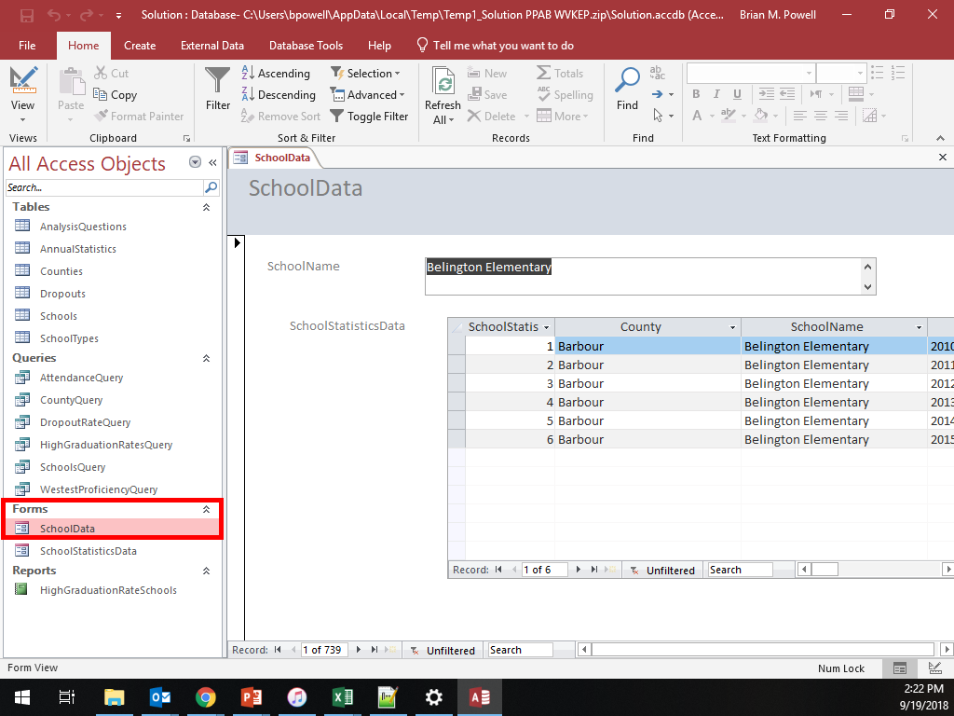
View Forms
Forms provide a user-friendly view of the data in tables or queries.
They can also simplify data entry. It’s often easier to enter data as a series of fields in forms than in Table Datasheet View.
In the Object Pane on the left side of the screen, double-click on the form you wish to view.

Slide 17
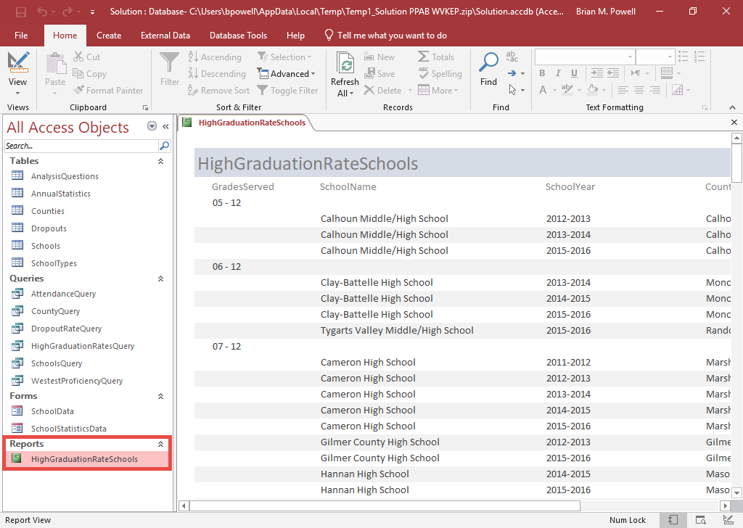
View Reports
Reports display the data in tables or results returned by queries.
They provide a way to neatly format and organize information in a database.
In the Object Pane on the left side of the screen, double-click on the report you wish to view.

Slide 18
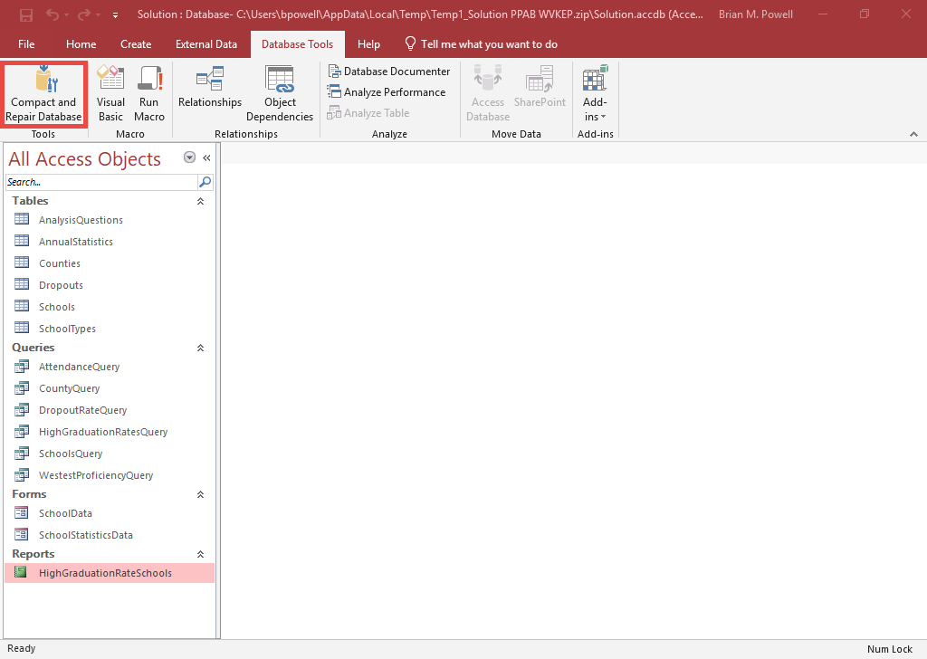
Compact and Repair the Database
Access ACCDB files can become quite large as you use them. The Compact and Repair Database utility shrinks the file size.
Go to the Database Tools ribbon.
Click the Compact and Repair Database button.
  You might get an error that your file is in use by another process. You can ignore this and go on.

