Slide 1
Access: Database Design
Participation Project
WV K-12 Education Problem
WV Senate Problem

Slide 2
Topics Covered
Determine if Excel or Access are best suited for a dataset
Design a relational database including tables and fields
Identify appropriate table relationships

Slide 3
DETERMINE IF EXCEL OR ACCESS are best suited for a dataset
Consider Excel if:
  One category of data
  Little redundant data
  No need to search specific parts of the data
  Need to create charts
  Need to perform what-if analysis (scenarios, goal seek, etc.)
Consider Access if:
  Have multiple categories of data
  Have large amounts of redundant data
  Need to be able to search only specific parts of the data
  No need to create charts
  No need to perform what-if analysis

Slide 4
Participation Project Note
The Database Design Participation Project is intended to be done in Excel, not Access.
By starting with the original dataset in a single-sheet workbook, we can transform it into multiple sheets (one per table) in a format that is ready to import into Access.

Slide 5
Sometimes, Using Both Access and Excel is Best
Sometimes, your needs may require using both Access and Excel.
It’s common to keep the original data in Access, write queries to extract specific information of interest, and then to further analyze that data in Excel.
  You’ll do this in Homework #6 later this semester

Slide 6
Identify field Groupings:
Part 1
To work properly, databases must be normalized.
  Each database table should only include records that are logically related
  All of the non-key fields in a table should have a direct relationship to that table’s key
  For example, if you have a table of school data, the population of the county where the school is located should be in a different table because it’s not directly related

Slide 7
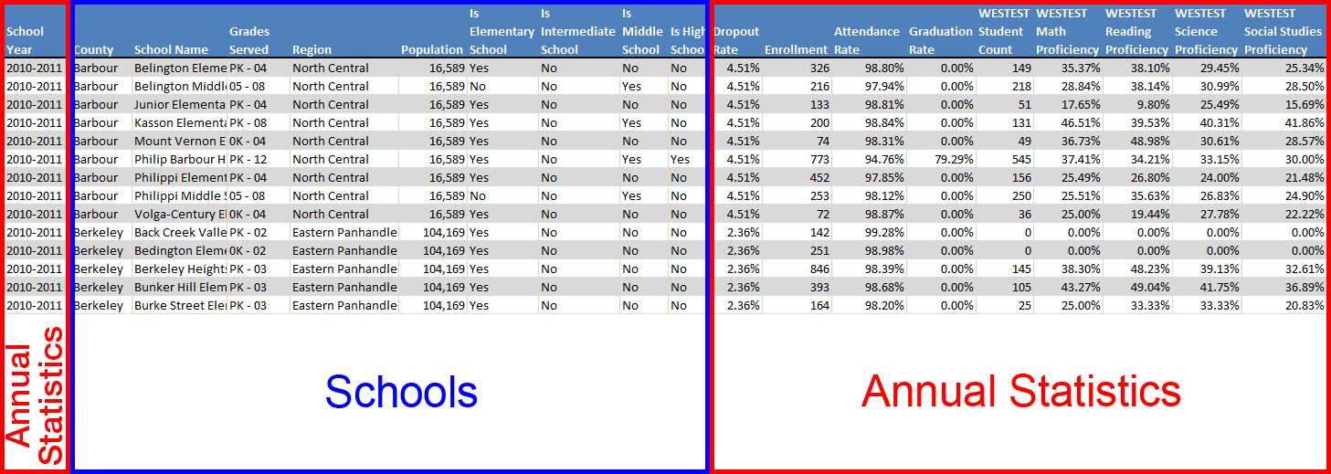
Identify field Groupings:
Part 2
Notes:
Here, we can see 2 rough groupings of fields: Annual Statistics and Schools.

Slide 8
Identify field Groupings:
Part 3
We split the table in 2 rough groupings:
  Annual Statistics, with the year, enrollment, test scores, and graduation rates
  Schools, with the names and locations of schools and their type
Can we break things down further?
  Yes. We can split school demographic data into its own table. We will also break dropout rates, which are on a per-county basis rather than per-school, into its own table.

Slide 9
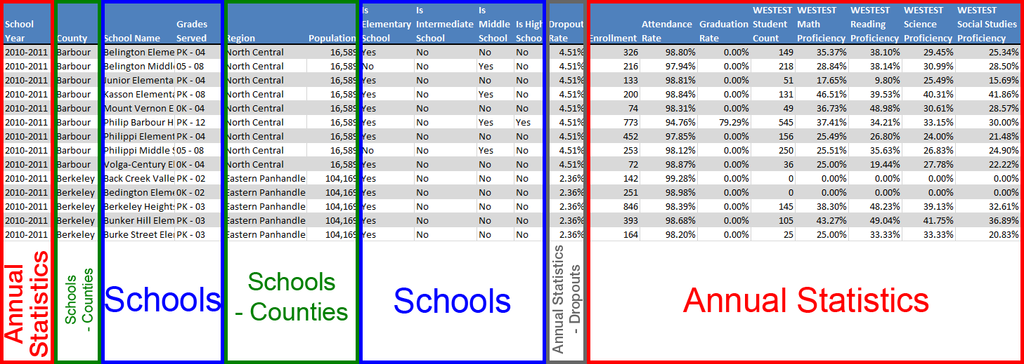
Identify field Groupings:
Part 4
Notes:
Here, we have split Counties and Dropout Rates into their own groupings.

Slide 10
Reorganize the Fields
Now that we have divided our fields into groupings, we want to make sure that each field contains one discrete piece of information.
  In this dataset, there are no fields that need split further.
  As an example of a field that could merit splitting, it would be common to separate a name field into separate first name and last name fields.

Slide 11
Divide Fields Into Tables:
Part 1
Now, we’re ready to split our field groups into their own tables.
  Generally, 1 field group = 1 table
We also need to name our fields and tables.
  CamelCase, with the first letter of each word capitalized and no spaces, is common for database usage
We also must pick appropriate field types.
  Short Text works well for many fields, but be aware of special types for storing numbers, dates, and Boolean (yes/no) values
  Sometimes, you may want to use Short Text even for values that are normally numbers to provide flexibility in case they’re ever not

Slide 12
Divide Fields into Tables:
Part 2
Counties Table | Field Name | Field Type
 | County | Short Text
 | Region | Short Text
 | Population | Number-Integer
AnnualStatistics Table | Field Name | Field Type
 | SchoolYear | Short Text
 | Enrollment | Number-Integer
 | AttendanceRate | Number-Pctg
 | GraduationRate | Number-Pctg
 | WestestStudentCount | Number-Integer
 | WestestMathProficiency | Number-Pctg
 | WestestReadingProficiency | Number-Pctg
 | WestestScienceProficiency | Number-Pctg
 | WestestSocialStudiesProficiency | Number-Pctg
Schools Table | Field Name | Field Type
 | SchoolName | Short Text
 | GradesServed | Short Text
 | IsElementarySchool | Yes/No
 | IsIntermediateSchool | Yes/No
 | IsMiddleSchool | Yes/No
 | IsHighSchool | Yes/No
Dropouts Table | Field Name | Field Type
 | DropoutRate | Number-Pctg

Slide 13
Specify Keys and Junction tables:
Part 1
Each table needs to have a key to uniquely identify all records.
  For several tables, we need to add the County and SchoolName fields as part of a composite key
We may also need to add tables so we can relate other tables together.
  This database does not need junction tables.
  An example where we might use junction tables is to relate students and majors in college enrollment data, where a student can have multiple majors.

Slide 14
Specify Keys and Junction tables:
Part 2
AnnualStatistics Table | Field Name | Field Type
 | 🔑County | Short Text
 | 🔑SchoolName | Short Text
 | 🔑SchoolYear | Short Text
 | Enrollment | Number-Integer
 | AttendanceRate | Number-Pctg
 | GraduationRate | Number-Pctg
 | WestestStudentCount | Number-Integer
 | WestestMathProficiency | Number-Pctg
 | WestestReadingProficiency | Number-Pctg
 | WestestScienceProficiency | Number-Pctg
 | WestestSocialStudiesProficiency | Number-Pctg
Counties Table | Field Name | Field Type
 | 🔑County | Short Text
 | Region | Short Text
 | Population | Number-Integer
Schools Table | Field Name | Field Type
 | 🔑County | Short Text
 | 🔑SchoolName | Short Text
 | GradesServed | Short Text
 | IsElementarySchool | Yes/No
 | IsIntermediateSchool | Yes/No
 | IsMiddleSchool | Yes/No
 | IsHighSchool | Yes/No
Dropouts Table | Field Name | Field Type
 | 🔑County | Short Text
 | 🔑SchoolYear | Short Text
 | DropoutRate | Number-Pctg
Notes:
Added fields are highlighted in yellow.

Slide 15
Address redundant or Inflexible Fields: Part 1
By making your database design flexible, you can expand the types of data you store without having to later rebuild the database.
  For example, we can use a single SchoolType field in the Schools table instead of separate yes/no fields for each type

Slide 16
Address redundant or Inflexible Fields: Part 2
AnnualStatistics Table | Field Name | Field Type
 | 🔑County | Short Text
 | 🔑SchoolName | Short Text
 | 🔑SchoolYear | Short Text
 | Enrollment | Number-Integer
 | AttendanceRate | Number-Pctg
 | GraduationRate | Number-Pctg
 | WestestStudentCount | Number-Integer
 | WestestMathProficiency | Number-Pctg
 | WestestReadingProficiency | Number-Pctg
 | WestestScienceProficiency | Number-Pctg
 | WestestSocialStudiesProficiency | Number-Pctg
Counties Table | Field Name | Field Type
 | 🔑County | Short Text
 | Region | Short Text
 | Population | Number-Integer
Schools Table | Field Name | Field Type
 | 🔑County | Short Text
 | 🔑SchoolName | Short Text
 | GradesServed | Short Text
 | SchoolType | Short Text
Dropouts Table | Field Name | Field Type
 | 🔑County | Short Text
 | 🔑SchoolYear | Short Text
 | DropoutRate | Number-Pctg
Notes:
Added fields are highlighted in yellow.

Slide 17
Address redundant or Inflexible Fields: Part 3
In large datasets, you can have tables with composite keys that include many fields.
Sometimes, it can be easier to use a single AutoNumber-type primary key instead of a complex multi-field composite key.
In this database, AnnualStatistics has 3-field composite key. We will create a new AutoNumber-type field to serve as primary key instead.

Slide 18
Address redundant or Inflexible Fields: Part 4
AnnualStatistics Table | Field Name | Field Type
 | 🔑SchoolStatisticsID | AutoNumber
 | County | Short Text
 | SchoolName | Short Text
 | SchoolYear | Short Text
 | Enrollment | Number-Integer
 | AttendanceRate | Number-Pctg
 | GraduationRate | Number-Pctg
 | WestestStudentCount | Number-Integer
 | WestestMathProficiency | Number-Pctg
 | WestestReadingProficiency | Number-Pctg
 | WestestScienceProficiency | Number-Pctg
 | WestestSocialStudiesProficiency | Number-Pctg
Counties Table | Field Name | Field Type
 | 🔑County | Short Text
 | Region | Short Text
 | Population | Number-Integer
Schools Table | Field Name | Field Type
 | 🔑County | Short Text
 | 🔑SchoolName | Short Text
 | GradesServed | Short Text
 | SchoolType | Short Text
Dropouts Table | Field Name | Field Type
 | 🔑County | Short Text
 | 🔑SchoolYear | Short Text
 | DropoutRate | Number-Pctg
Notes:
Added fields are highlighted in yellow.

Slide 19
Address redundant or Inflexible Fields: Part 5
When users have to repetitively enter the same text, it increases the chance of data entry.
  Is it “Jr. High School” or “Junior High School”?
You may wish to create a separate table to store these values.
  By creating a relationship to this table with referential integrity, we can avoid multiple similar values
  We will create a new SchoolTypes table to store the school types, and swap SchoolType for SchoolTypeAbbrv in the existing Schools table

Slide 20
Address redundant or Inflexible Fields: Part 6
AnnualStatistics Table | Field Name | Field Type
 | 🔑SchoolStatisticsID | AutoNumber
 | County | Short Text
 | SchoolName | Short Text
 | SchoolYear | Short Text
 | Enrollment | Number-Integer
 | AttendanceRate | Number-Pctg
 | GraduationRate | Number-Pctg
 | WestestStudentCount | Number-Integer
 | WestestMathProficiency | Number-Pctg
 | WestestReadingProficiency | Number-Pctg
 | WestestScienceProficiency | Number-Pctg
 | WestestSocialStudiesProficiency | Number-Pctg
Counties Table | Field Name | Field Type
 | 🔑County | Short Text
 | Region | Short Text
 | Population | Number-Integer
Schools Table | Field Name | Field Type
 | 🔑County | Short Text
 | 🔑SchoolName | Short Text
 | GradesServed | Short Text
 | SchoolTypeAbbrv | Short Text
Dropouts Table | Field Name | Field Type
 | 🔑County | Short Text
 | 🔑SchoolYear | Short Text
 | DropoutRate | Number-Pctg
SchoolTypes Table | Field Name | Field Type
 | 🔑SchoolTypeAbbrv | Short Text
 | SchoolTypeName | Short Text
Notes:
Added fields are highlighted in yellow.

Slide 21
Remove Duplicate Records
Remember that only one record in a table can have the same key value.
  Can’t have two records in Counties table for Marion County
When importing data from Excel or a text file into a table, you may need to filter the data to remove duplicates with the same key first.
  The Remove Duplicates tool on the Data ribbon in Excel is good for this

Slide 22
Identify Relationships:
Part 1
Once you have finished designing the database tables and fields, you should consider how they will be related to each other.
This information was covered in the Access: Fields & Keys Participation Project.

Slide 23
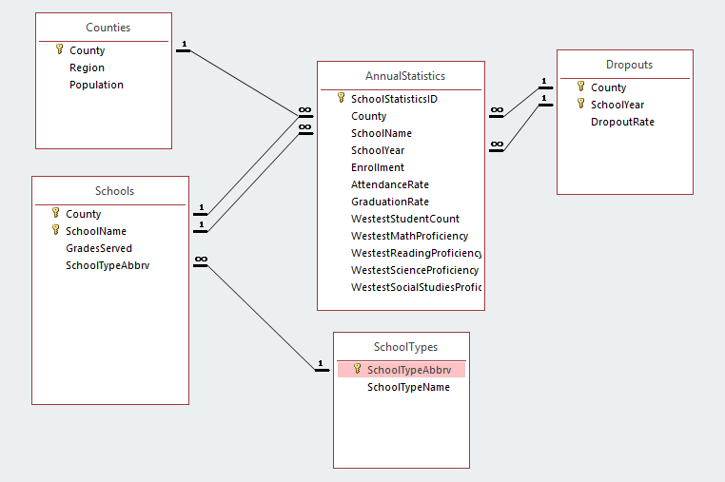
Identify Relationships:
Part 2
Notes:
The figure above shows how the relationships are configured in our database.

