Slide 1
Access: Database Creation
Participation Project
WV K-12 Education Problem
WV Senate Problem

Slide 2
Topics Covered
Create a new database
Import database tables and data
Create database tables
Add records
Create lookup fields
Create relationships
Answer analysis questions

Slide 3
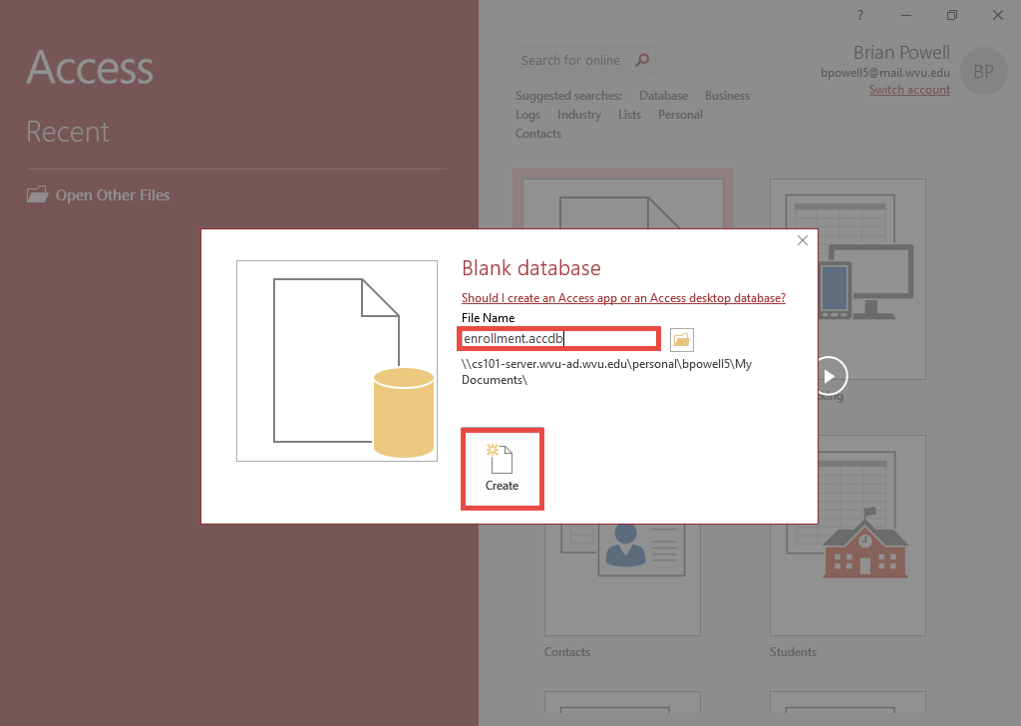
Create database
After starting Microsoft Access, click to create a new database based on the Blank database option.
Type the name of the file in the File Name field.
Click the Create button.

Slide 4
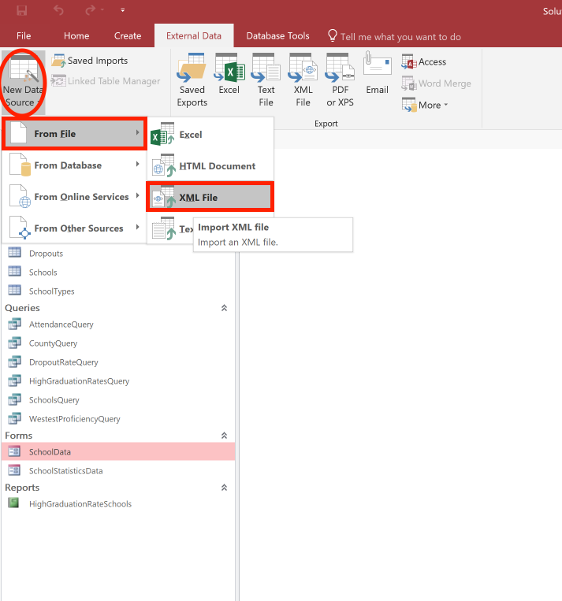
Import from an XML file:
Part 1
XML files are a common way of sharing data.
In Access, you can share both data and table structures with XML files.
Go to the External Data ribbon.
In the Import & Link section, click the New Data Source button.
Select From File and then XML File.

Slide 5
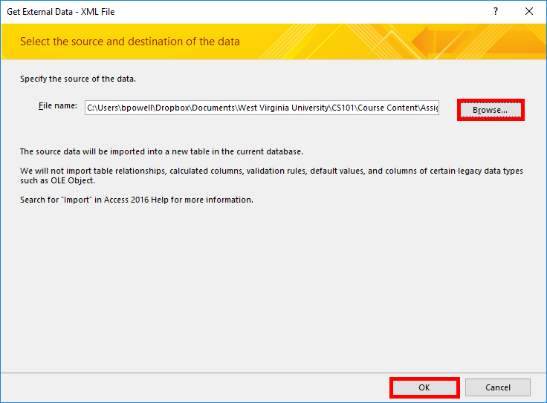
Import from an XML file:
Part 2
Click the Browse button.
Select the XML data file you wish to import.
Click the OK button.

Slide 6
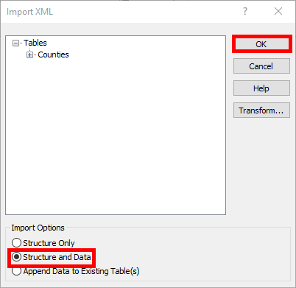
Import from an XML file:
Part 3
To import both the table and its data, select the Structure and Data import option.
  If you want to import data into an existing table instead, you would just choose the Append Data to Existing Table option.
Click the OK button.
Ensure the Save import steps box is unchecked.
Click the Close button to finish.

Slide 7
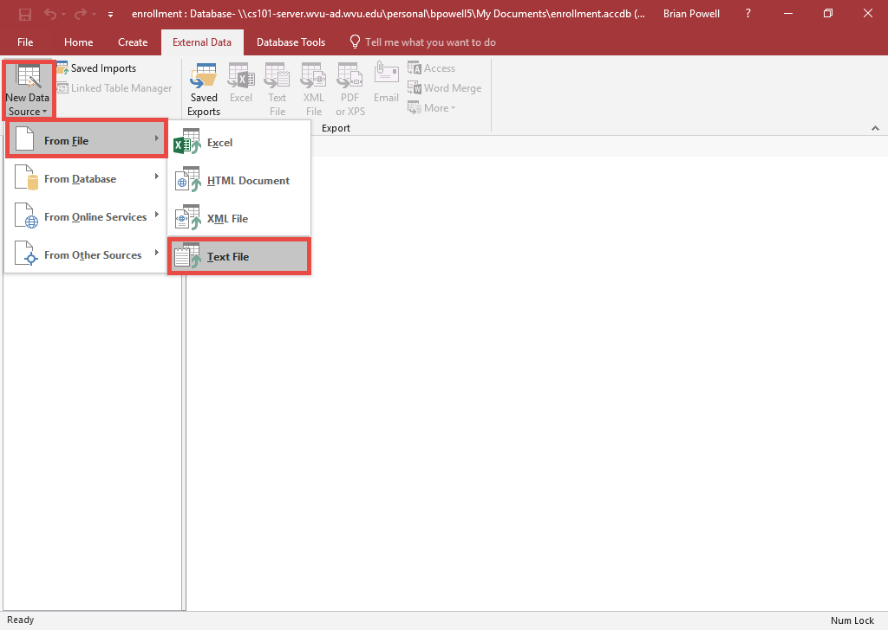
Import from a CSV File:
Part 1
CSV files are a common way of sharing data.
CSV files only contain data, not table structures, but Access can try to create a table based on the data.
Go to the External Data ribbon.
In the Import & Link section, click the New Data Source button.
Select From File and then Text File.

Slide 8
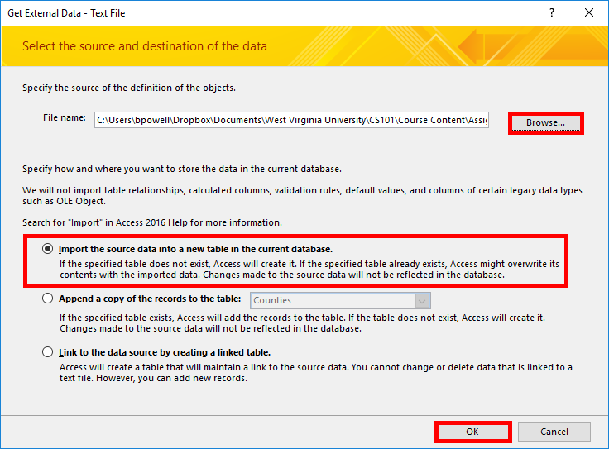
Import from a CSV File:
Part 2
Click the Browse button.
Select the CSV data file you wish to import.
Click the OK button.
Select Import the source data into a new table in the current database from the list.
Click the OK button.

Slide 9
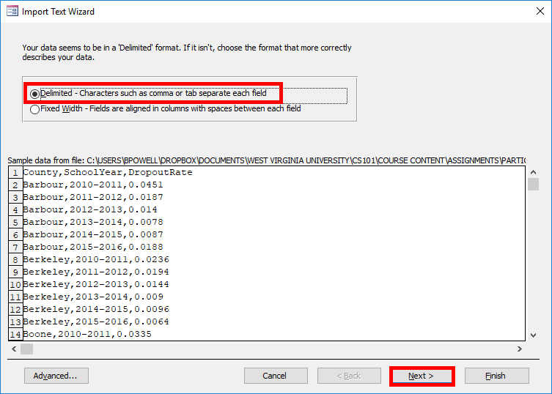
Import from a CSV File:
Part 3
Select the Delimited format from the list.
Click the Next button.

Slide 10
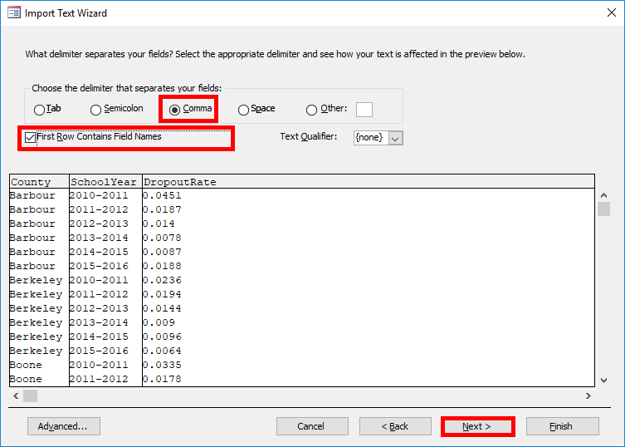
Import from a CSV File:
Part 4
Select Comma as the delimiter.
Select First Row Contains Field Names.
Click the Next button.

Slide 11
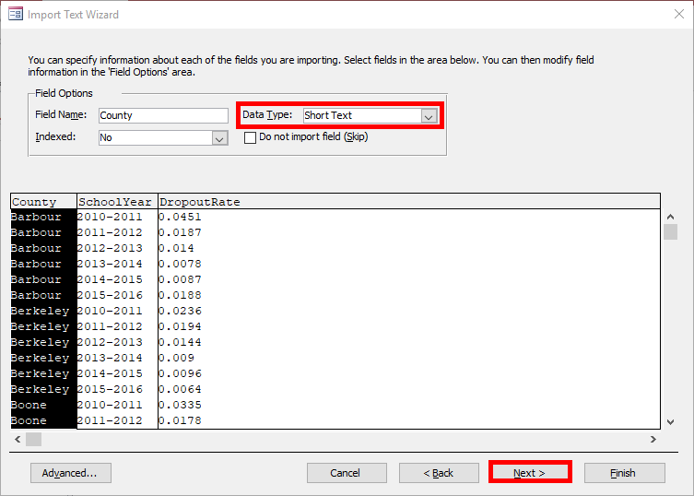
Import from a CSV File:
Part 5
Ensure that all fields have an appropriate data type.
  Text should normally be Short Text
  Whole numbers should be Integer
  Numbers with decimals should Double
  Money should be Currency
  True/false fields should be as Yes/No
Click the Next button.

Slide 12
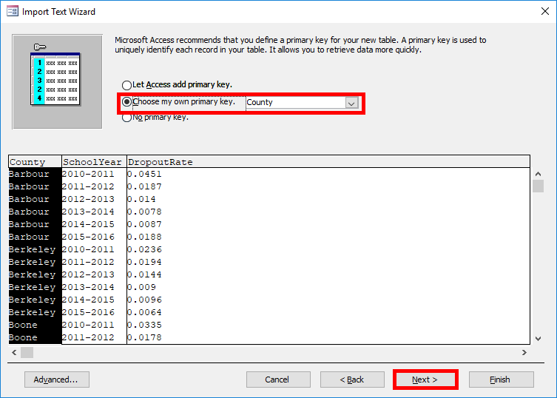
Import from a CSV File:
Part 6
Specify the primary key:
  If you know the primary key you would like, select Choose my own primary key and choose one of the existing fields as a key
  Otherwise, have Access add a primary key
  Alternatively, you can choose No primary key and define one yourself later in Design View

Slide 13
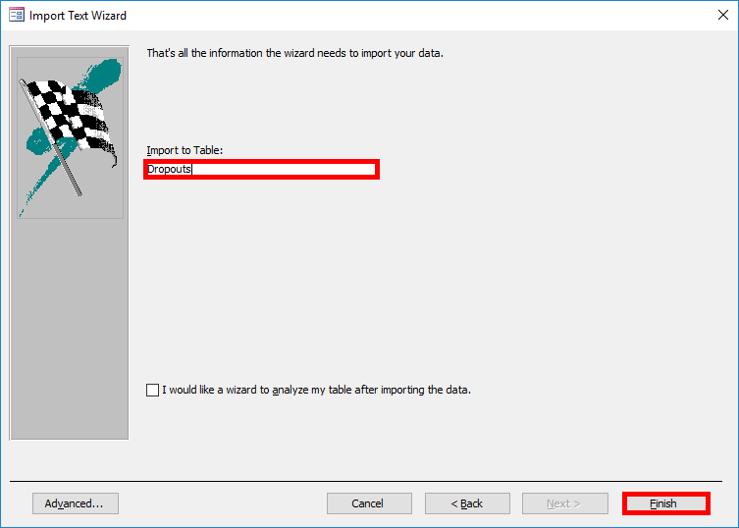
Import from a CSV File:
Part 7
In the Import to Table field, ensure the name of the table is correct.
Click the Finish button.
Click the Close button to finish the wizard.

Slide 14
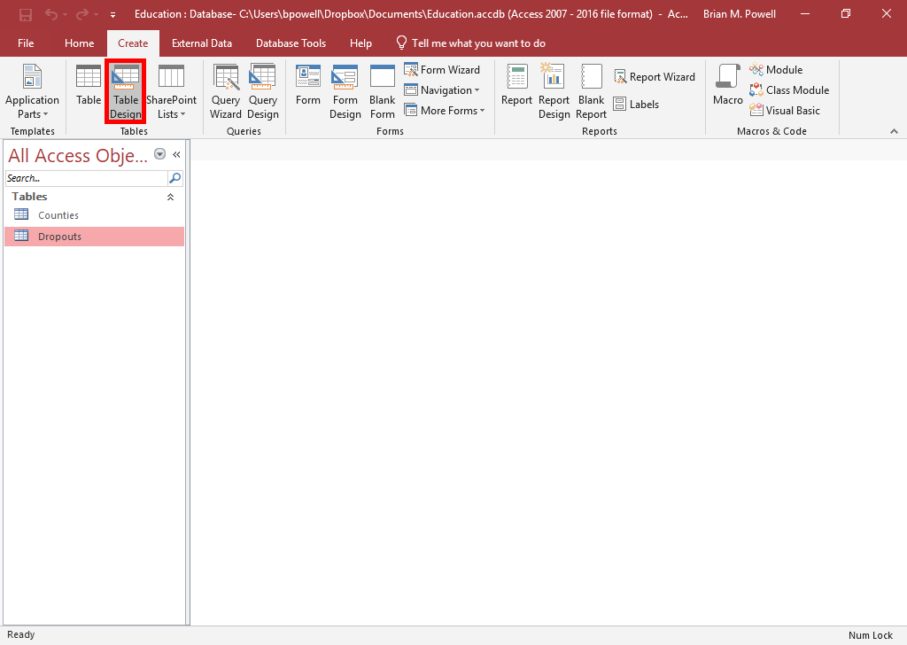
Create Tables:
Part 1
You need to create any tables that are not being imported.
Go to the Create ribbon.
In the Tables group, click the Table Design button.
  Table option works differently and is not recommended

Slide 15
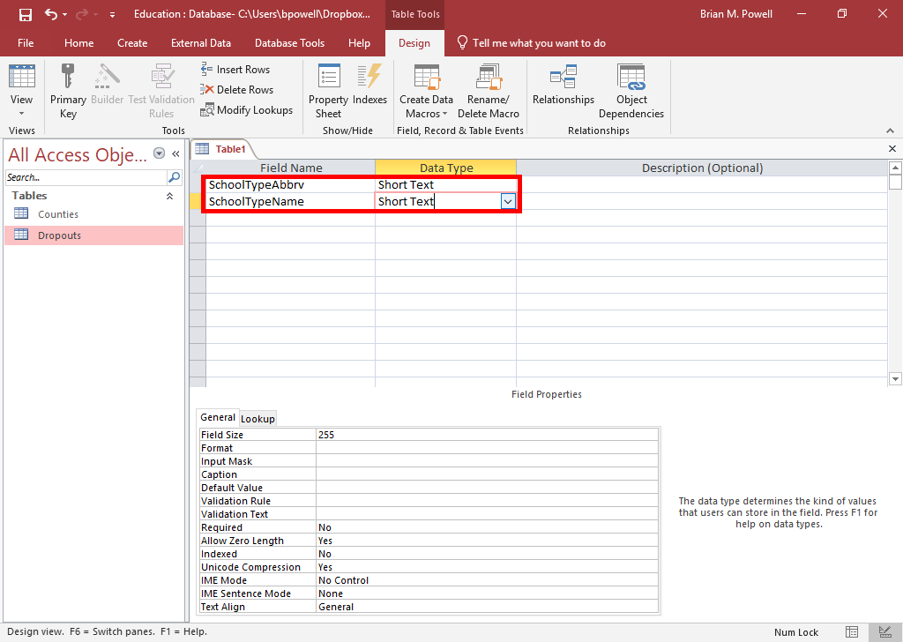
Create tables:
Part 2
Enter the name and type for each field in the table.
  Be sure to specify field properties like the field size, especially for numbers that have decimal places
  If you edit settings on a table that already contains data, be careful you don’t lose data like by converting a text field to a number

Slide 16
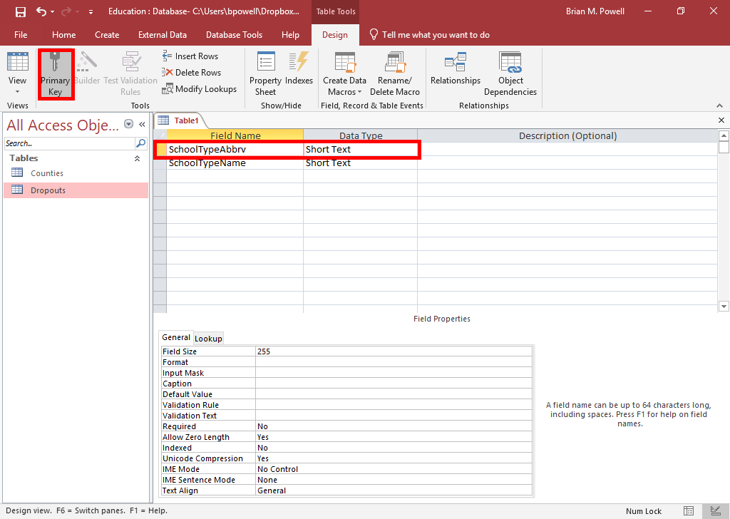
Create Tables:
Part 3
Click to select the field(s) that will be part of the key.
  To create a composite key, simultaneously select all fields that will be part of the key
Go to the Table Tools Design ribbon.
Click the Primary Key button.

Slide 17
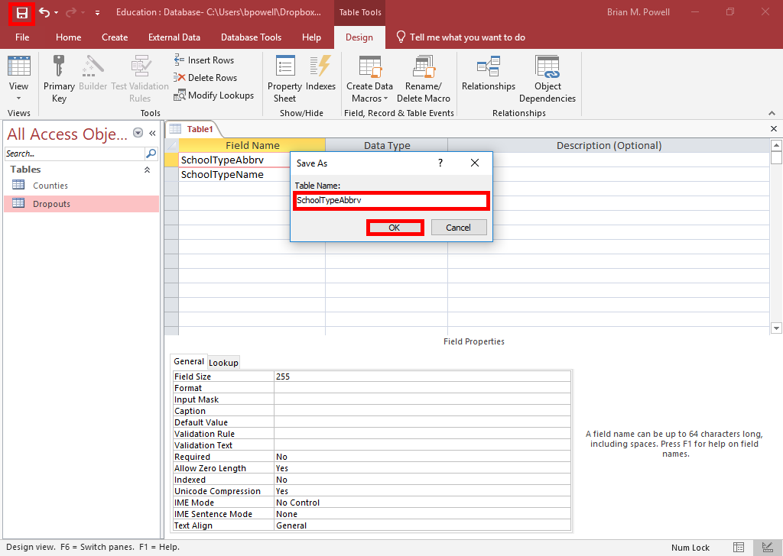
Create Tables:
Part 4
Click the Save button on the Quick Access Toolbar.
Enter the name of the table.
Click the OK button.
If you are not immediately going to add data to the table, close it to avoid causing problems with queries and relationships.

Slide 18
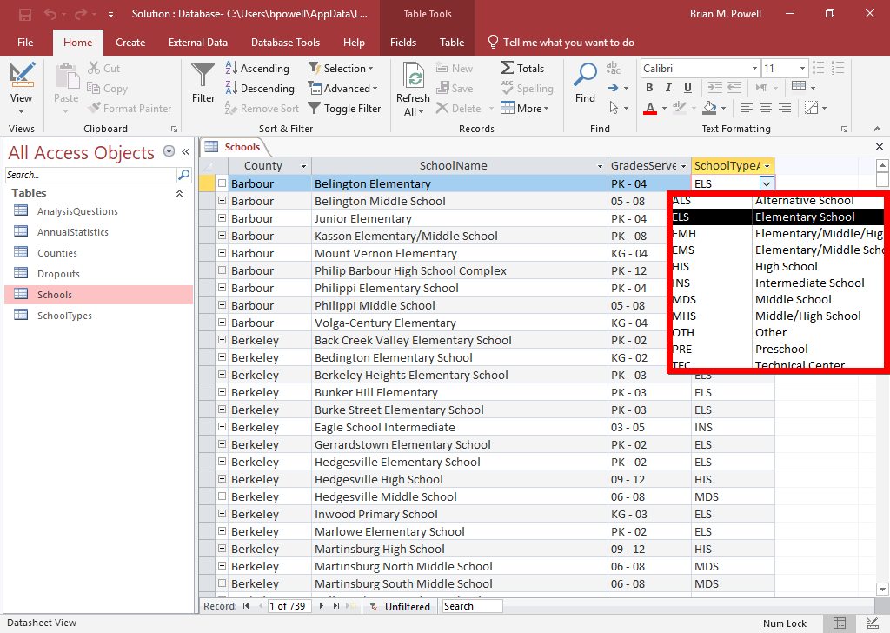
Lookup Fields:
Part 1
Lookup fields allow users to select predetermined values from a dropdown list.
  Values can come from a table, a query, or a manually entered list
They help avoid data entry errors since users don’t have to enter text themselves.

Slide 19
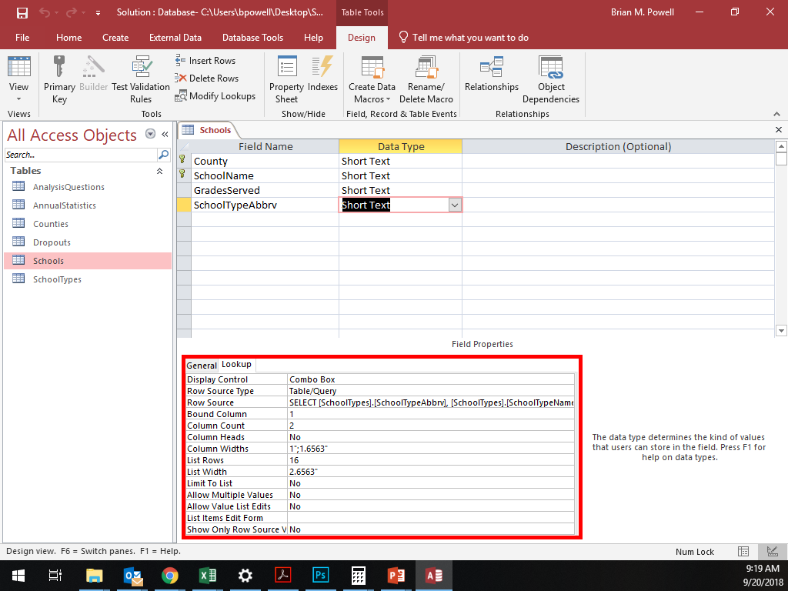
Lookup Fields:
Part 2
In Design View, lookup fields will show as having the whatever data type they store.
You can see that a particular field is a lookup field by:
  Clicking on the field.
  Viewing the Lookup tab at the bottom of the screen and seeing the Display Control is set to Combo Box.

Slide 20
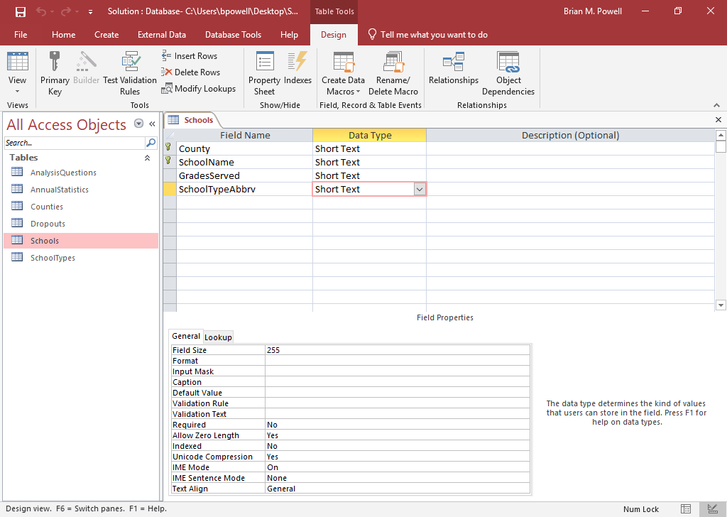
Create Lookup Fields Using a table:
Part 1
To create lookup fields whose values come from a table or query:
Close all other tables and the Relationships Window.
Ensure the table or query that will provide the data has already been created.
Open the table to have the lookup field in Design View.

Slide 21
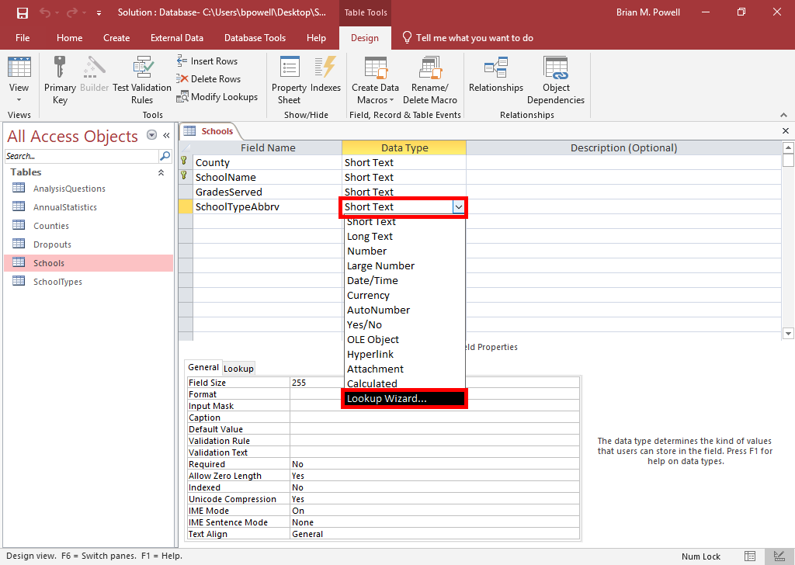
Create Lookup Fields Using a table:
Part 2
For the field that is to be a lookup field, go to the Data Type column and choose Lookup Wizard.
In the Lookup Wizard dialog box, choose I want the lookup field to get the values from another table or query.
Click the Next button.

Slide 22
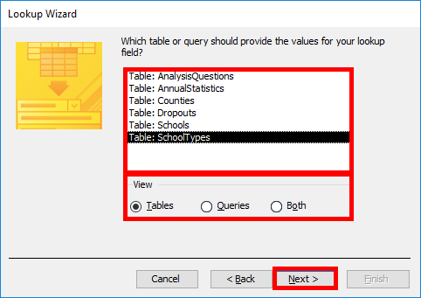
Create Lookup Fields Using a table:
Part 3
Choose the table or query that contains the values to use for the lookup field.
Click the Next button.

Slide 23
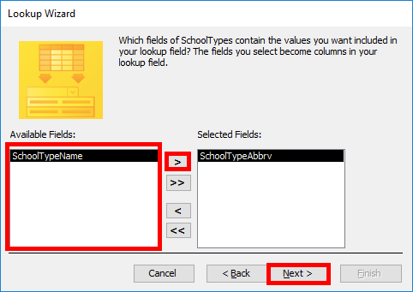
Create Lookup Fields using a table: part 4
Add the field(s) that should be shown in the lookup field by selecting them and clicking the > button.
Click the Next button when done.

Slide 24
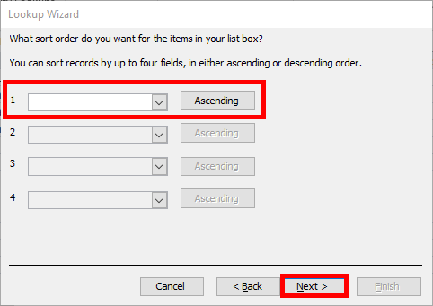
Create Lookup Fields using a table:
Part 5
If desired, select fields to sort by and choose a sort order.
Click the Next button.

Slide 25
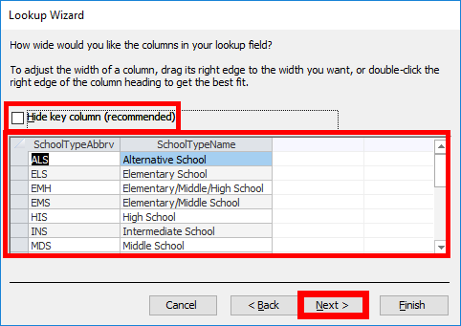
Create Lookup Fields using a table:
Part 6
By default, Access will hide the key columns in the lookup field. If you want to show them, uncheck the Hide key column box.
  For most CS101 assignments, you will need to uncheck this box
Adjust the column width so you can see the full text.
Click the Next button.

Slide 26
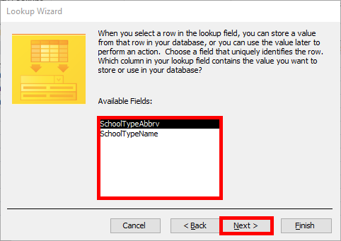
Create Lookup Fields using a table:
Part 7
If the lookup field displays multiple fields, you will be asked which value to store. Choose the key field.
  In this case, SchoolTypeAbbrv is the key so we will store it
Click the Next button.

Slide 27
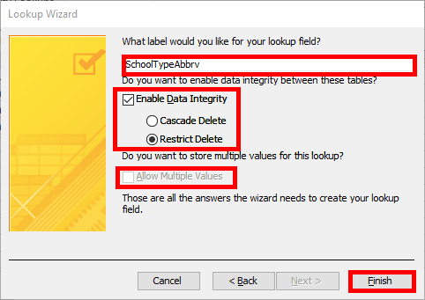
Create Lookup Fields using a table:
Part 8
Enter a name for the field.
If desired, enable data integrity.
  Enabling data integrity creates a relationship with both referential integrity and cascade updates enabled
  Restrict Delete has cascade deletes disabled, Cascade Delete has it enabled
Ensure allowing multiple values is disabled.
  Allowing multiple values created a non-standard database.
Click the Finish button.

Slide 28
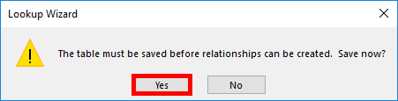
Create Lookup Fields using a table:
Part 9
When asked about saving the table, click the Yes button.

Slide 29
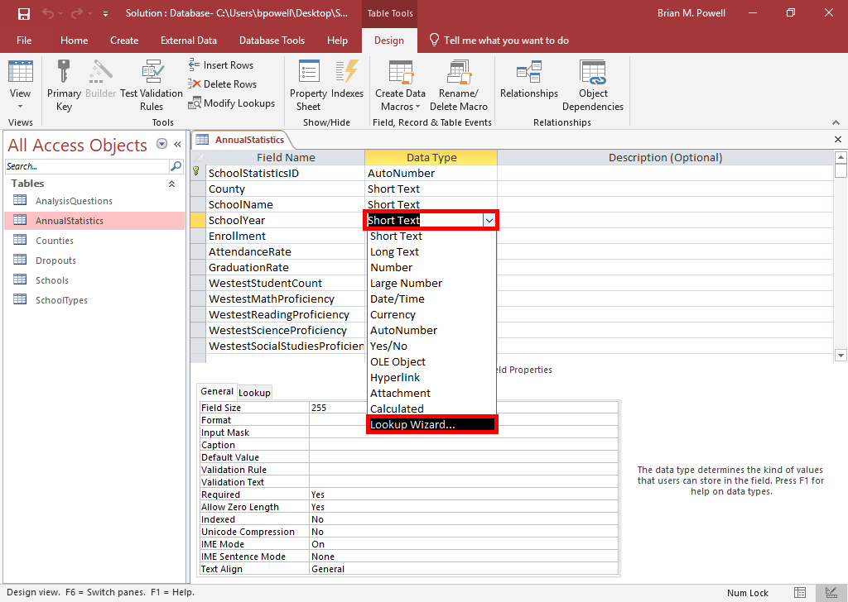
Create Lookup fields using specified values: Part 1
To create lookup fields whose values come from a specified list:
For the field that is to be a lookup field, go to the Data Type column and choose Lookup Wizard.
In the Lookup Wizard dialog box, choose I will type in the values that I want.
Click the Next button.

Slide 30
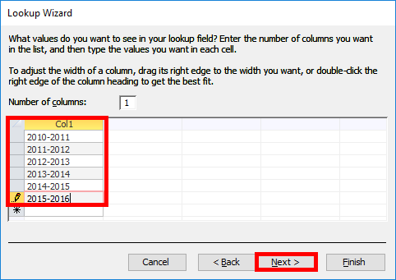
Create Lookup fields using specified values: Part 2
In the grid, enter the values that should be displayed for the user, one to a row.
Click the Next button when done.

Slide 31
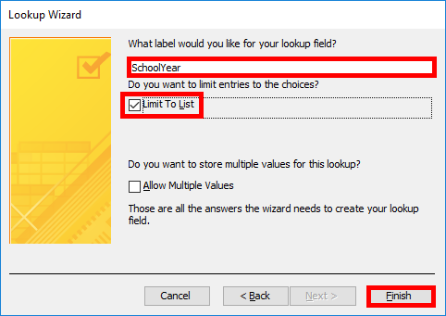
Create Lookup fields using specified values: Part 3
Enter a name for your field.
Click to enable Limit to List to ensure users can only pick from the selected values.
Ensure allowing multiple values is disabled.
  Allowing multiple values created a non-standard database.
Click the Finish button.

Slide 32
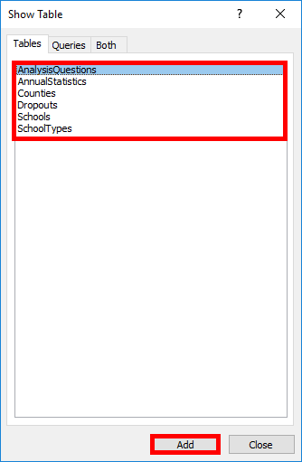
Create Relationships:
Part 1
Be sure to close any open tables or queries before you start.
Go to the Database Tools ribbon.
In the Relationships section, click the Relationships button.
Double-click the names of the tables you wish to create relationships between.
Click the Close button when done.

Slide 33
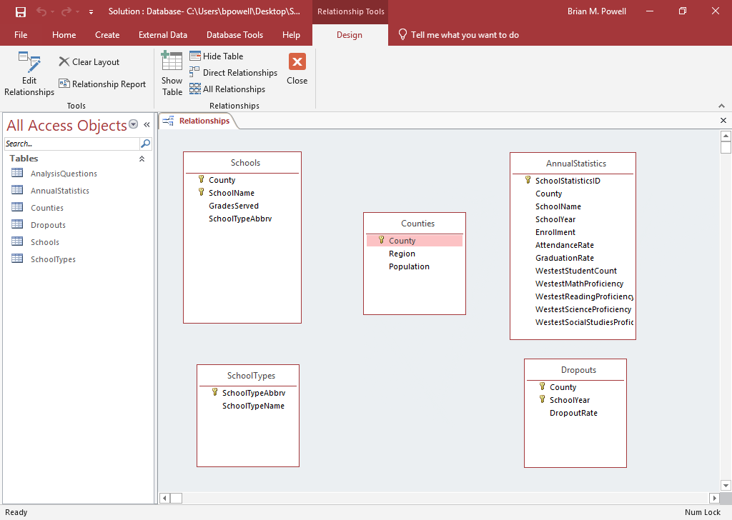
Create Relationships:
PART 2
You may need multiple relationships, but they must be created one-by-one.
The fields on both sides of a relationship must have identical data (i.e., County and County, not County and SchoolYear).
In CS101 projects, the fields for each relationship typically have same name.
Click on the name of field in the first table.
Drag your mouse over to the second table and release the mouse button when you’re on top of the corresponding field.

Slide 34
Create Relationships:
Part 3
Referential integrity helps ensure your data is valid by preventing orphaned records (records missing a related record).
Cascade updates and cascade deletes propagate changes to avoid orphans when you edit or delete records.
If you enforce referential integrity but don’t use cascade updates or cascade deletes, Access won’t let you make changes that would create an orphaned record.

Slide 35
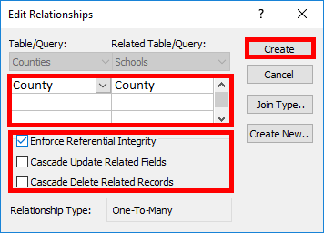
Create Relationships:
Part 4
To finish creating the relationship:
Ensure the correct fields are listed.
If the relationship involves multiple fields, as sometimes happens with composite keys, add the additional fields using dropdown menus in each column.
Set referential integrity options.
Click the Create button.

Slide 36
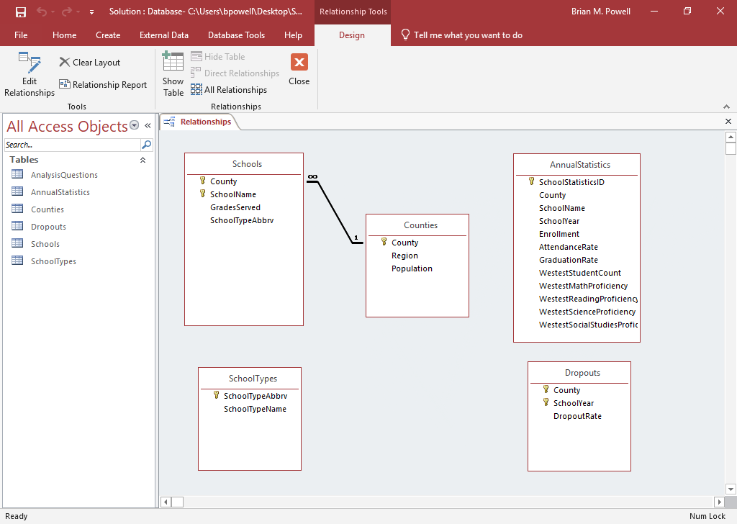
Create Relationships:
PART 5
When you finish creating a relationship, it should show up as a line connecting the tables.
If referential integrity was enforced, you may see additional symbols indicating if the relationship is 1‑to‑1, 1‑to-many, or many‑to‑many.

Slide 37
Answer Analysis Questions
Analysis questions are to help you think critically about the data in the assignment and to apply your own knowledge and reasoning.
Appear in Participation Projects, Homeworks, and Exams.
Give 2-3 sentences answering question and providing your rationale.
For Homeworks and Participation Projects, you can use the Internet to help figure out your answer.
Sample Question
The median age in Highland County, Virginia is 59.8 years old. Assuming nobody moves in or out, do you think its population is more likely to increase or decrease over time?
Good Answer
Highland County’s population is likely to decrease. A huge percentage of its population is beyond child-bearing years. Younger people would need to have abnormally large families to make up for older people who die.

