Slide 1
Access: Queries II
Participation Project
WV K-12 Education Problem
WV Senate Problem

Slide 2
Topics Covered
Use calculated fields in a query
Format fields
Use criteria to restrict results
Use AND/OR criteria in a query
Use NOT criteria in a query

Slide 3
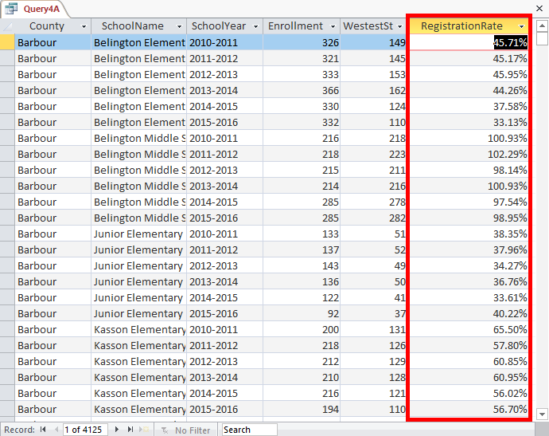
Calculated Fields
Calculated fields are columns whose values are calculated using a formula provided by the user.
  Useful for computing values such as percentages and ratios.
Formulas can be based on numbers in other columns, values provided in the formula, or output of function.

Slide 4
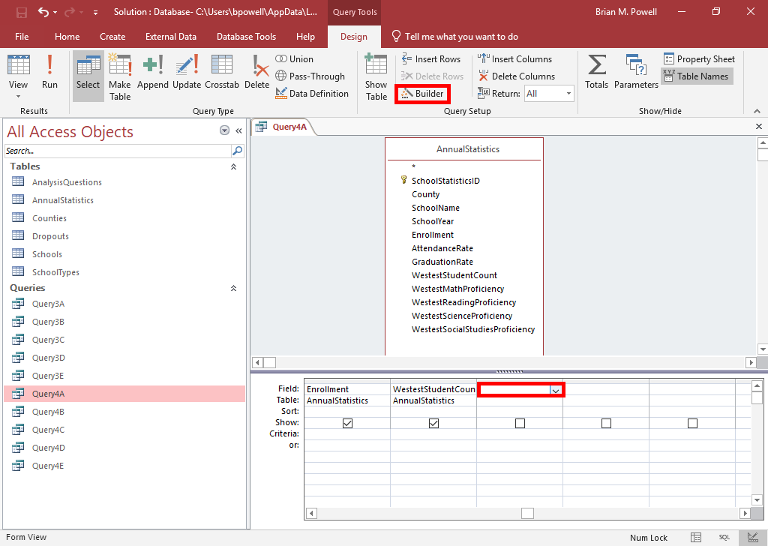
Use Calculated Fields in a Query:
Part 1
With the query open in Design View, click in an empty column.
Go to the Query Tools Design ribbon.
Click the Builder button.

Slide 5
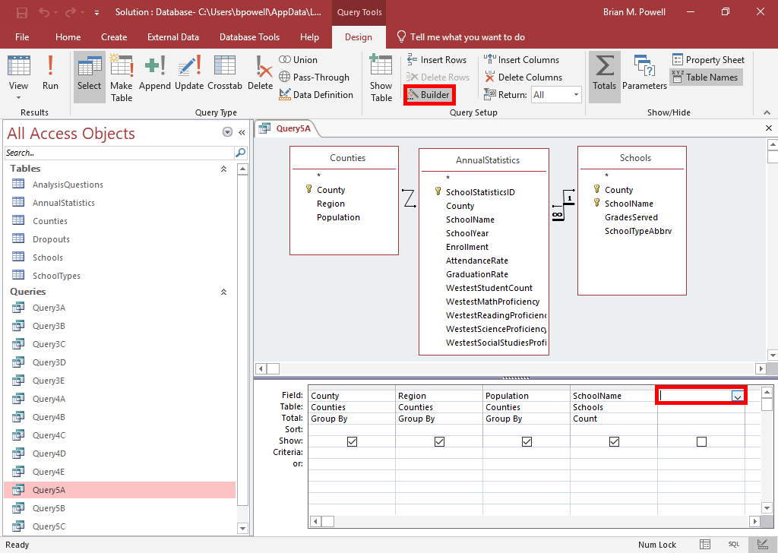
Use Calculated Fields in a Query:
Part 2
With the query open in Design View, click in an empty column.
Go to the Query Tools Design ribbon.
Click the Builder button.

Slide 6
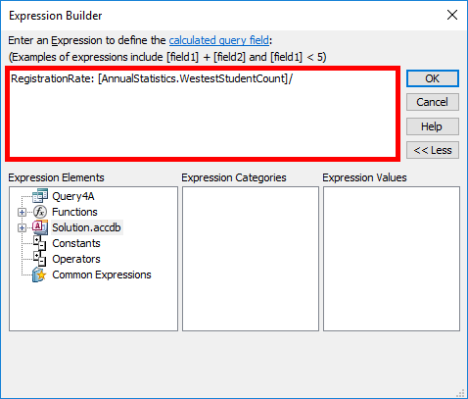
Use Calculated Fields in a Query:
Part 3
In the Expression box, enter
ColumnName:, substituting what you wish to name the column.
Then, enter your formula.
  Parentheses and mathematical operators (+, -, *, /) work the same as in Excel
  Table and field names go in square brackets using the either of formats [AnnualStatistics.County] or [AnnualStatistics]![County] for the County field in AnnualStatistics table.

Slide 7
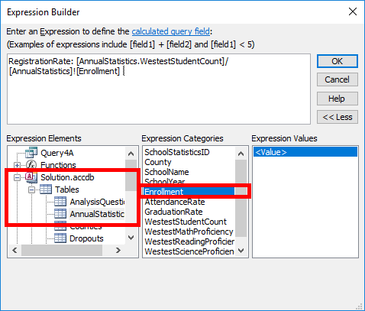
Use Calculated Fields in a Query:
Part 4
Instead of typing in field names, you can browse for them using the Expression Elements area.
To browse and add a field:
  Expand the tree for the name of your file in Expression Elements box
  Expand Tables
  Select the table
  Double-click on the field in the Expression Categories box to add it to the Expression box at top.

Slide 8
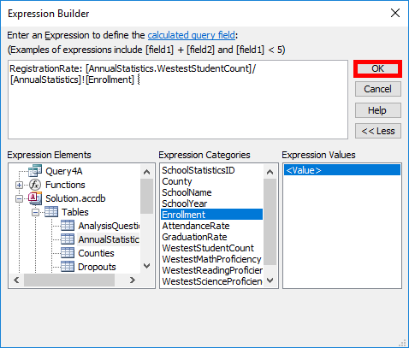
Use Calculated Fields in a Query:
Part 5
Delete any «Expr» items remaining in your formula.
Click the OK button when done.

Slide 9
Field Formatting
By using query formatting options, you can control how values appear in results.
  Number formatting including decimal places and 1000s separators
  Date and time formatting
  Formatting of yes/no fields
The RegistrationRate field to the right has been formatted as a percentage with 2 decimal places.

Slide 10
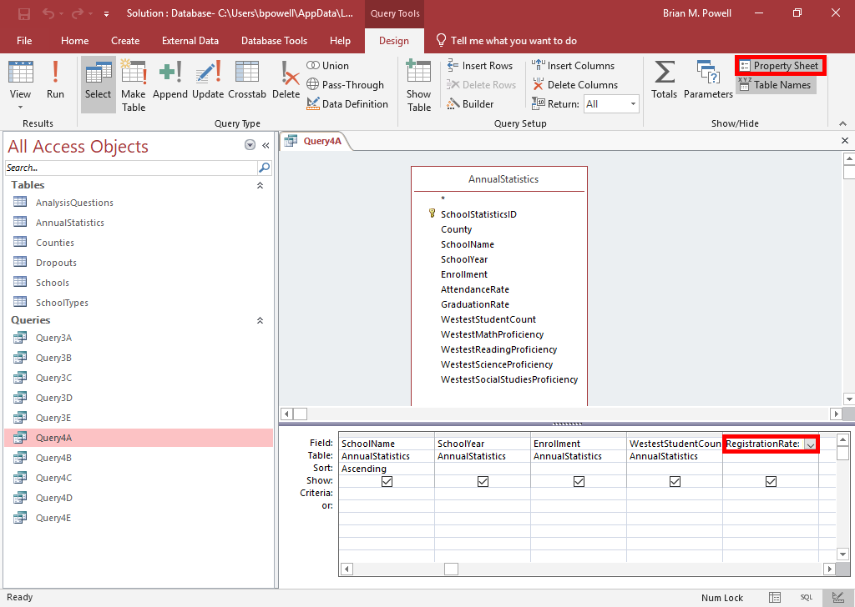
Format fields:
Part 1
Open the query in Design View.
Go to the Query Tools Design ribbon.
Click the Run button to run the query.
  If you do not run the query first, you will not be able to set the number of decimal places
Click the Design View button to go back to modifying the query.
Click within the field you need to format in the design grid.
In the Show/Hide group, click the Property Sheet button to show the Property Sheet pane.

Slide 11
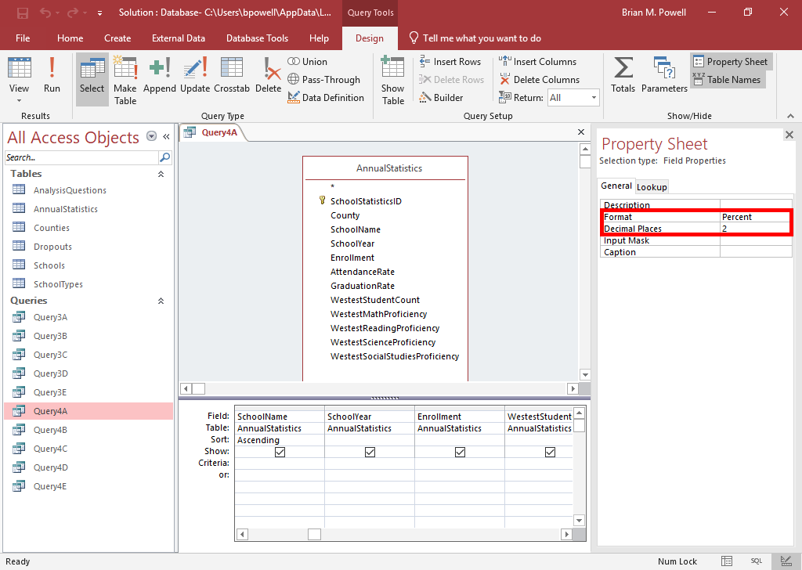
Format fields:
Part 2
In the Property Sheet pane, you can change the number formatting and number of decimal places for the field.
  If you did not run the query first, you will not be able to set the number of decimal places

Slide 12
Query Criteria
By specifying criteria, you can restrict the records in the results to those of interest to you.
Criteria are specified in the Criteria row and rows below it in the query grid.
  Criteria must be set on the column containing the values to be filtered. For example, if you want to restrict county names, set criteria on the County field.
  Data types for the fields matter. The right type of criteria must be set to avoid a data type mismatch error.

Slide 13
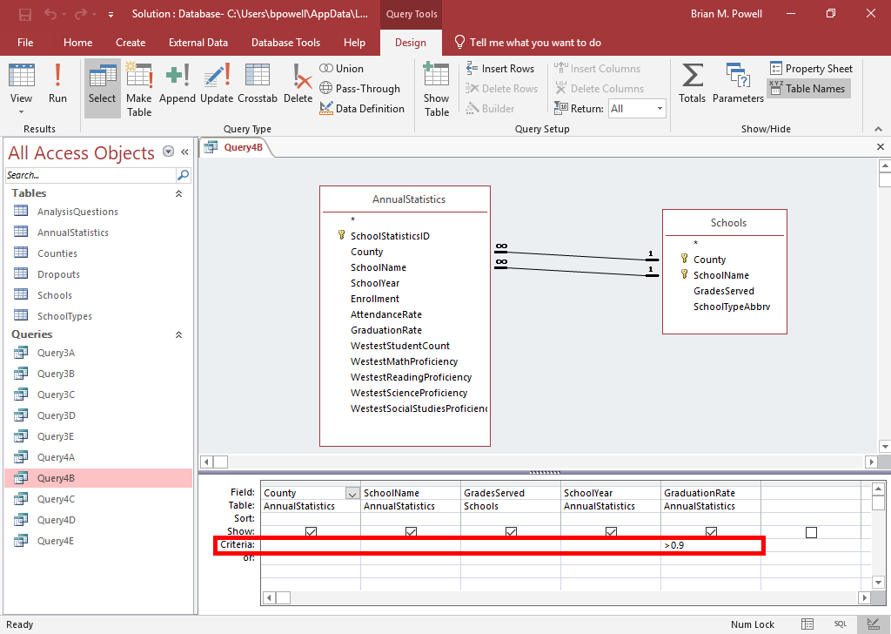
Use Criteria to Restrict results
Open the query in Design View.
Click in the Criteria row for the field containing the data to be filtered.
Enter the criteria.
  Text goes in double-quotes ("")
  Numbers should have >, <, <=, >=, or = signs

Slide 14
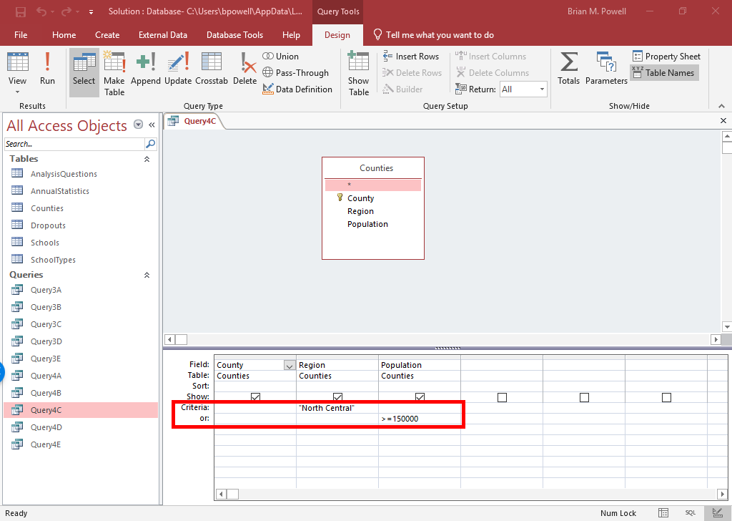
And/OR Criteria: part 1
For a record to be included in the results, it must satisfy all criteria on the same row in the query grid.
To specify multiple different criteria that a record may match, put them on different rows in the query grid. As long as at least one row is satisfied, the record will display.
In the example to the right, counties from the North Central region or with a population of at least 150,000 (or both) will be shown.

Slide 15
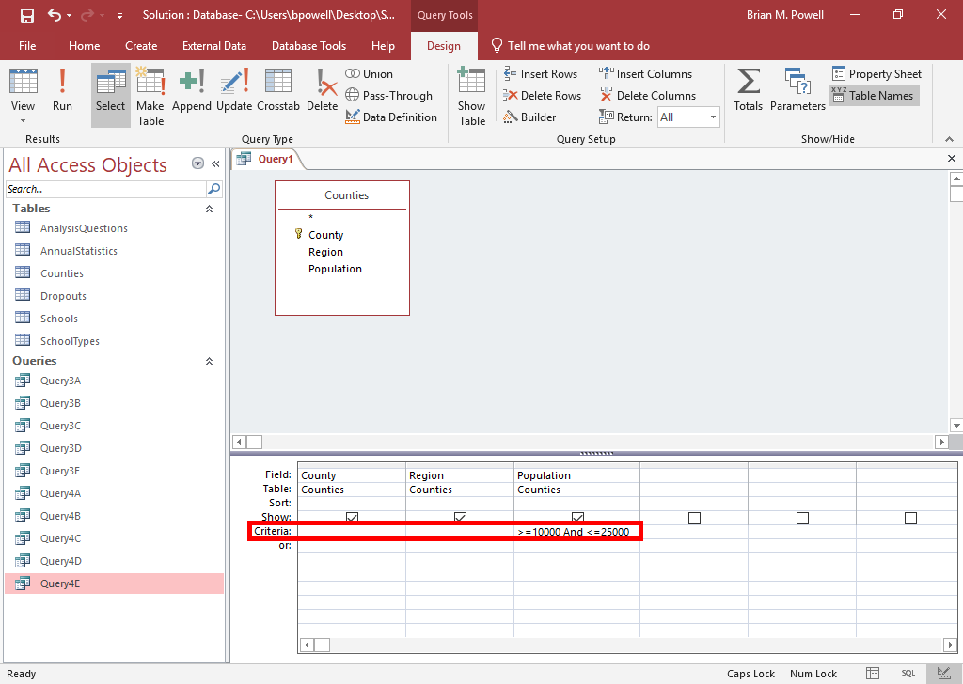
And/OR Criteria: part 2
You can also use the AND and OR keywords when specifying criteria.
  Both conditions in AND must be satisfied to display record
  One or both conditions in OR must be satisfied to display record
AND/OR keywords appear between criteria (e.g., >5 AND <10).
Example to right displays records for counties with populations between 10,000 and 25,000.

Slide 16
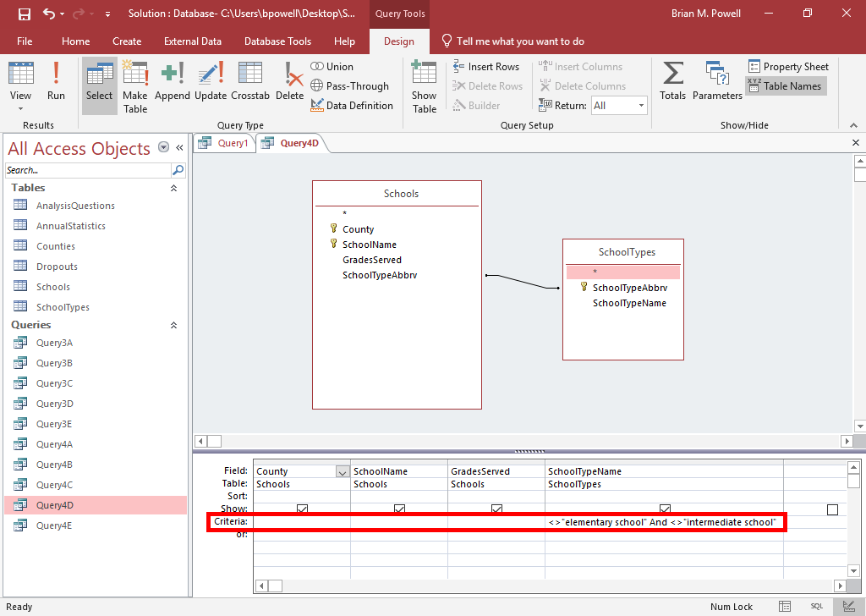
NOT Criteria
Using the NOT keyword or symbol (<>) in criteria only includes displays records that do not contain the listed value.
For example, the query on the right shows records that are not elementary schools and not intermediate schools. All other types of schools will display.

