Slide 1
Access: Queries IV
Participation Project
WV K-12 Education Problem
WV Senate Problem

Slide 2
Topics Covered
Use results from another query in a new query
Copy an existing query
Use wildcards in query criteria
Display unique values in query results
Use a parameter query
Create a query to update records
Create a query to delete records

Slide 3
Use Results from One Query in Another Query
Both tables and queries can be used as data sources for queries.
For complex situations, it can be helpful to perform initial calculations and processing in earlier queries and then to include those results in a later query.

Slide 4
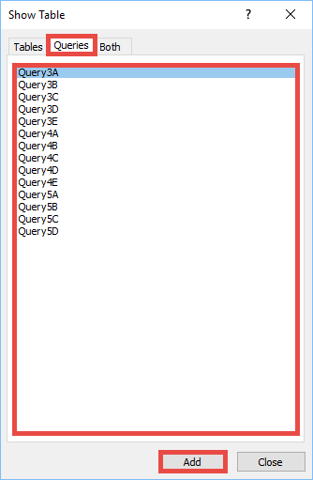
Use results from another Query in a new Query: Part 1
Go to the Create ribbon.
In the Queries section, click the Query Design button.
In the Show Table dialog box, go to the Queries tab and add an existing query.

Slide 5
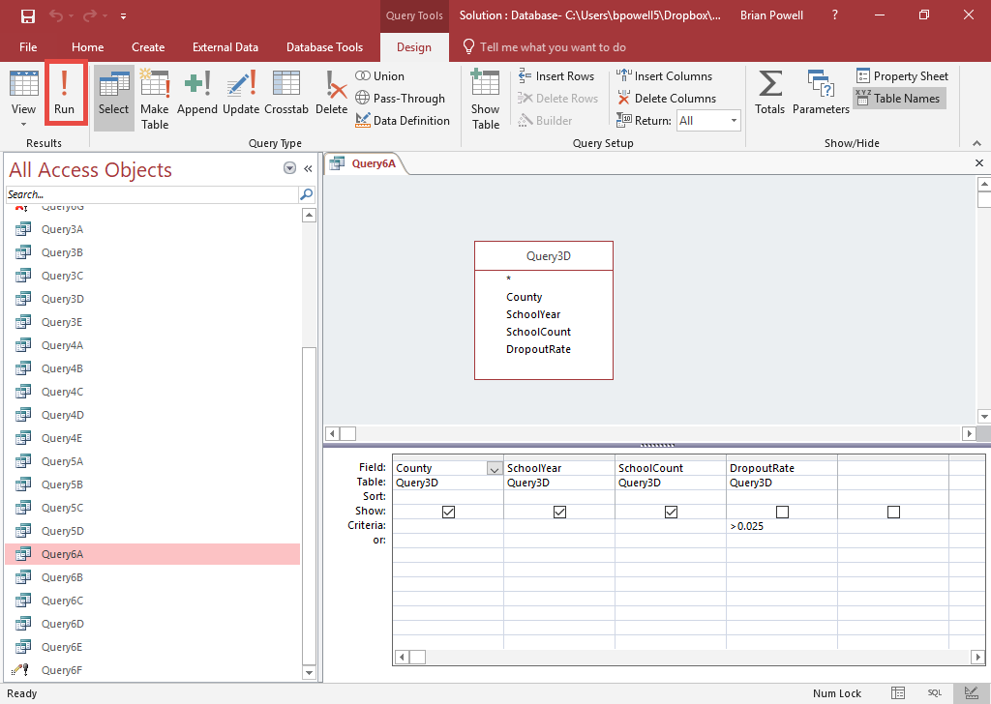
Use results from another Query in a new Query: Part 2
Add needed fields from the existing query to the design grid.
Click the Run button.
Remember that criteria set on your included queries will impact the records coming into this query.

Slide 6
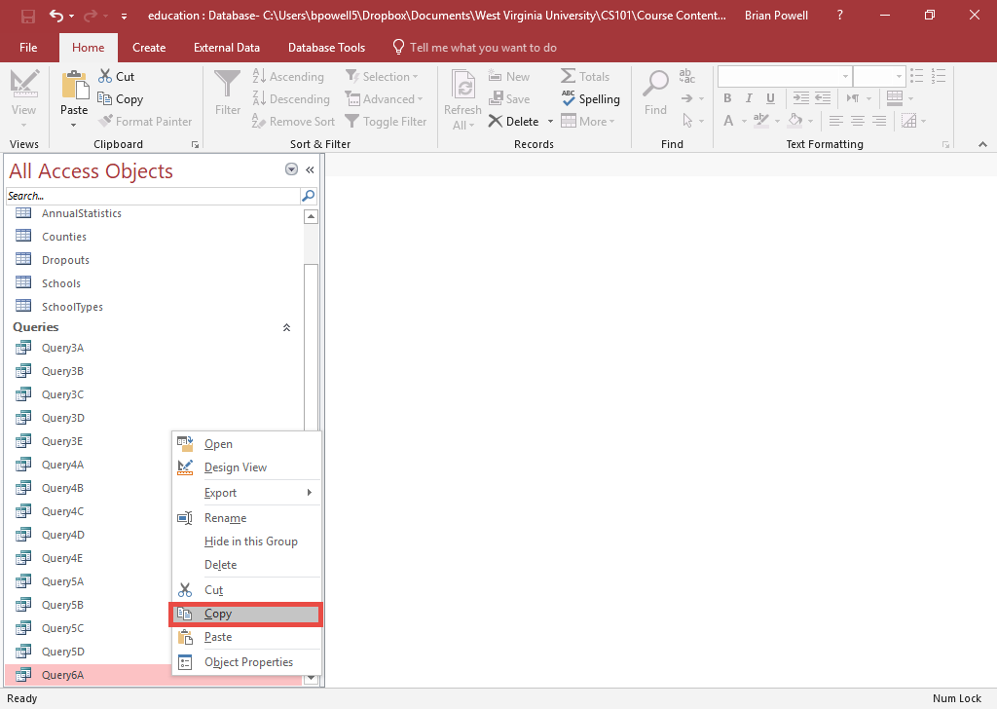
Copy An Existing Query
Right-click on the query in the Query Objects pane and select Copy.
Right-click in an empty area on the Query Objects pane and select Paste.
When prompted, give your query its own unique name.
Click the OK button.

Slide 7
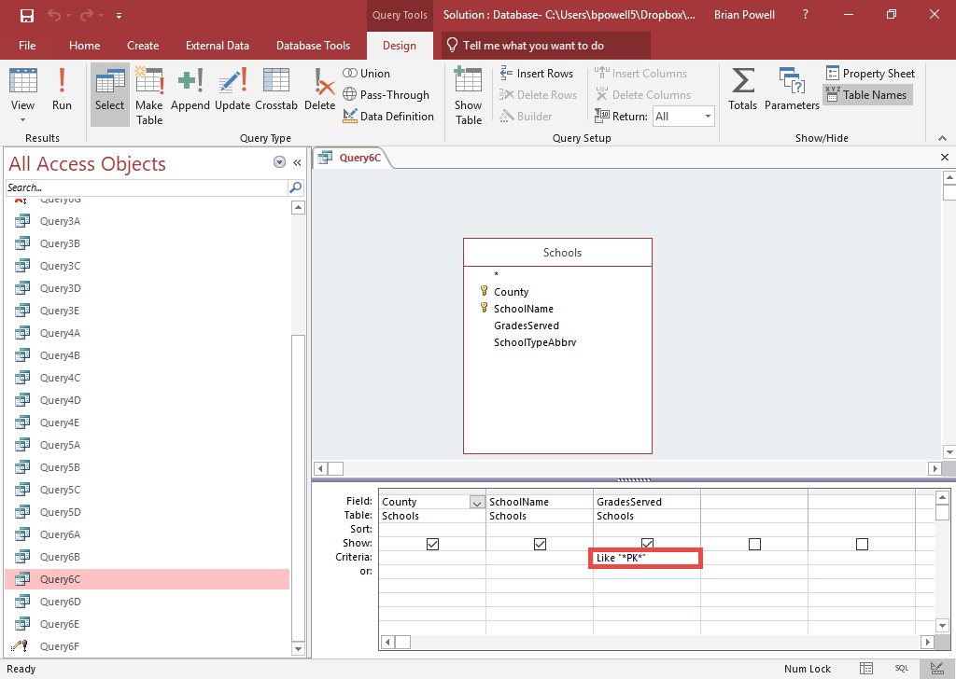
Use Wildcards In Query Criteria:
Part 1
By using the LIKE statement with the wildcard symbol (*), you can display records including specific words plus other text.
Syntax for criteria:
LIKE "*required_text*"
In a query, add LIKE criteria on the field which must contain the text.
  For example, to search for schools that include PK (pre-K), add criteria of
  LIKE "PK*"
  Use * wherever you want to allow any other letters

Slide 8
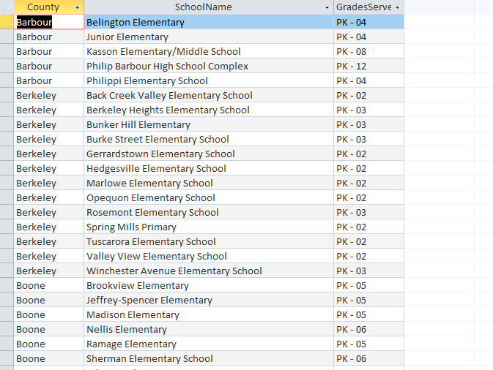
Use Wildcards In Query Criteria:
Part 2
Click the Run button to run the query.
Look at the results.
  Notice that all the grades listed begin with PK as specified in the criteria

Slide 9
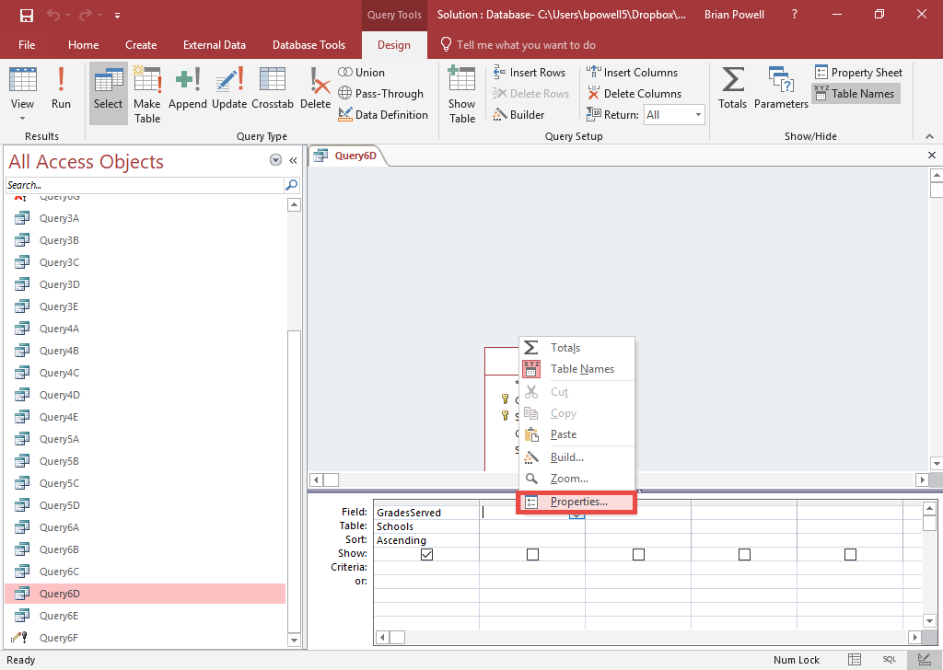
Display Unique Values In Query Results: Part 1
By displaying only unique (distinct) values, each value will only be shown once even if it appears in multiple records.
Go to the Create ribbon.
In the Queries section, click the Query Design button.
Add fields to the query.
In the gray space of the query, right-click and select Properties.

Slide 10
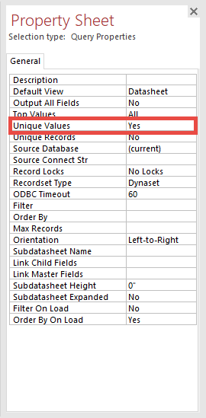
Display Unique Values In Query Results: Part 2
In the Property Sheet pane, make sure the Query Properties are shown.
Change the Unique Values option to Yes.
Close the Property Sheet pane.
Click the Run button.

Slide 11
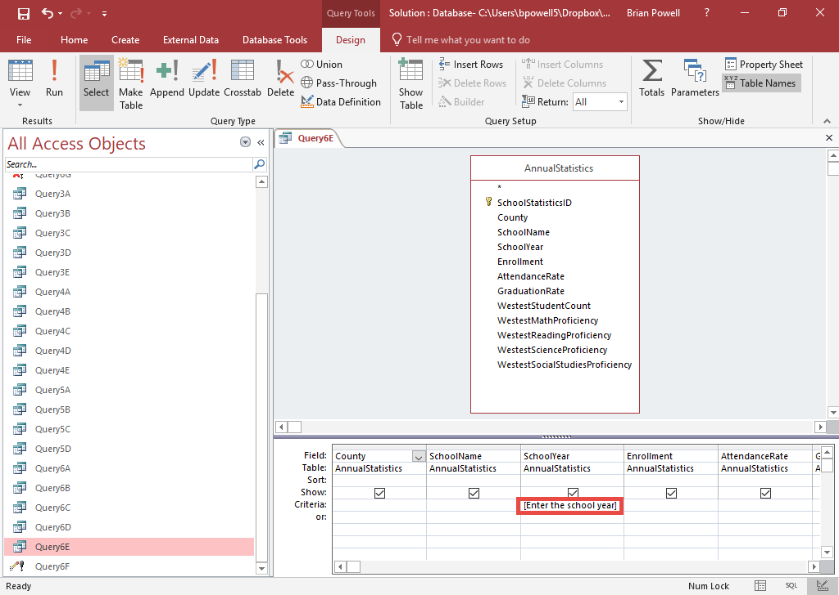
Use a Parameter Query:
Part 1
Parameter queries prompt for query criteria to use when query is run rather than writing it into the query directly.
Syntax for criteria:
[Prompt to ask user]
In a query, add parameter criteria on the field to be filtered.
  Put the prompt that users will be asked inside of square brackets (e.g., [Enter the school year] )

Slide 12
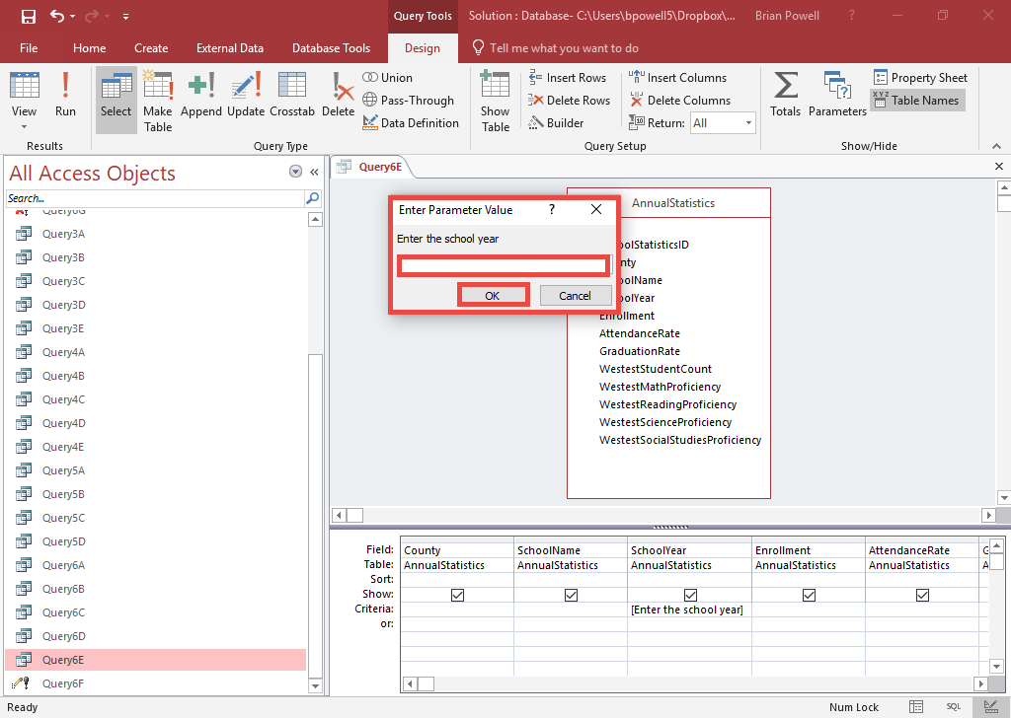
Use a Parameter Query:
Part 2
Click the Run button.
When prompted, enter a valid criteria.
Click the OK button.
The results will now only show records which meet the entered criteria.

Slide 13
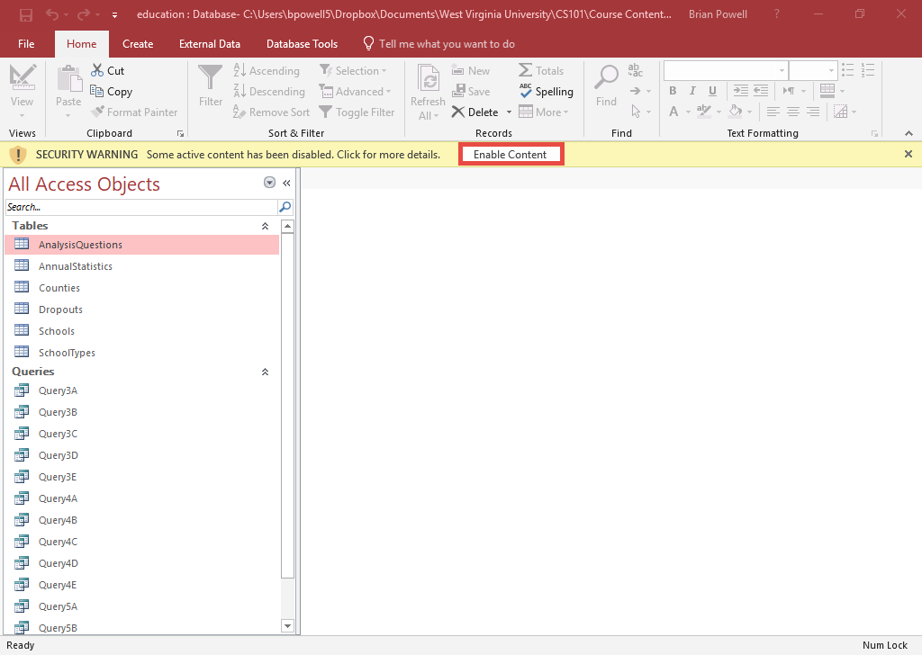
Enable Active Content
By default, Access does not run queries that will modify existing data.
You must enable active content to run update or delete queries.
If present, click the Enable Content button in the Security Warning bar near top of screen.

Slide 14
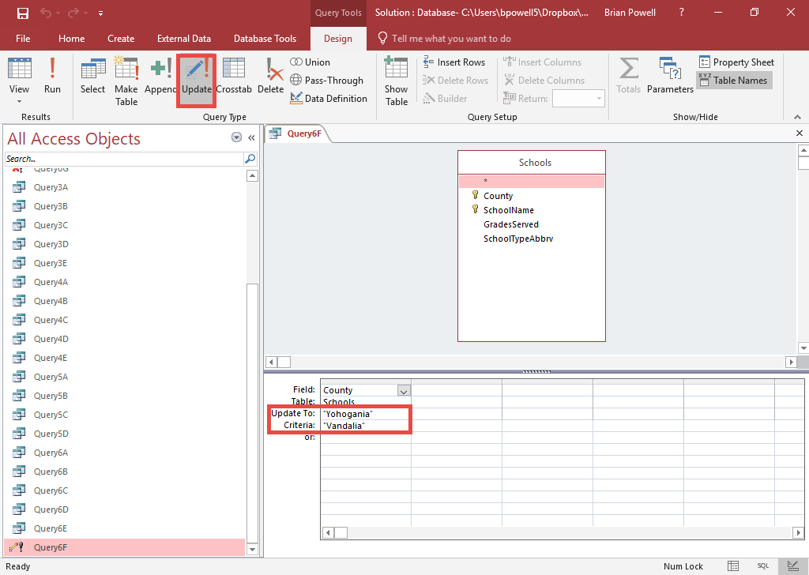
Create a Query to Update Records:
Part 1
Update queries modify the values of existing records.
Go to the Create ribbon.
In the Queries section, click the Query Design button.
Add the table containing records to update.
In the Query Type section, click the Update button.
Select the field you wish to update.
In Update To field, enter the new value.
In Criteria field, enter old value to replace.

Slide 15
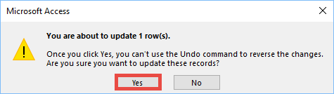
Create a Query to Update Records:
Part 2
Click the Run button.
Access will display a warning about how many rows are going to be updated. Click the Yes button to finish updating the records.

Slide 16
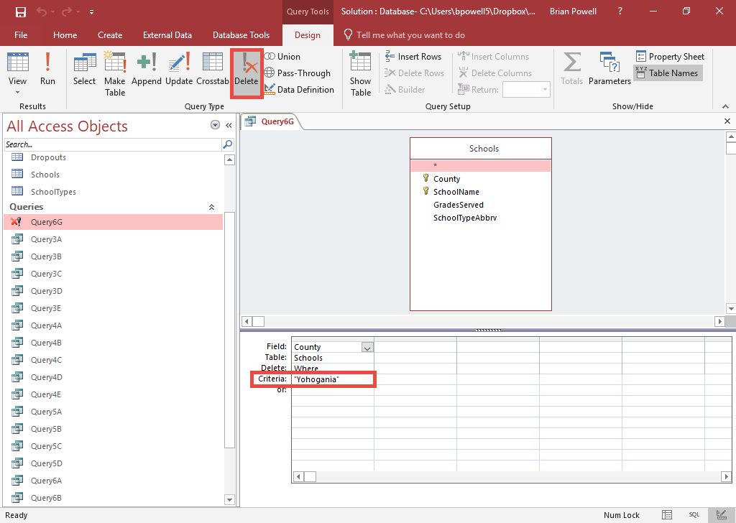
Create a query to delete records:
Part 1
Delete queries remove existing records from the database.
Go to the Create ribbon.
In the Queries section, click the Query Design button.
Add the table containing records to be deleted.
Add field(s) you are going to set criteria on.
In the Query Type section, click the Delete button.
Add criteria for records to delete.

Slide 17
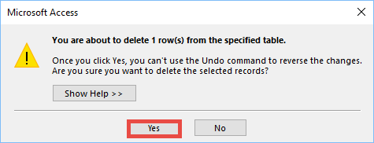
Create a query to delete records:
Part 2
Click the Run button.
Access will display a warning about how many rows are going to be deleted. Click the Yes button to finish deleting the records.

Slide 18
'ff' WestVuginiaUniversity.
COMPUTER
SCIENCE 101

