Slide 1
Excel: Formulas & Functions I Participation Project
Housing Problem
WV Mining Problem

Slide 2
Topics Covered
Use statistical functions
Use cell references
Use AutoFill
Write formulas
Use the RANK.EQ function

Slide 3
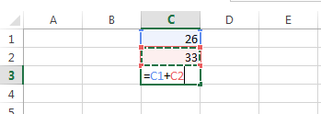
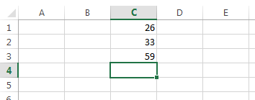
Write Formulas
One of the major features of Excel is its ability to perform math on the values in your workbook.
Select the cell where you wish to insert the function or formula.
When entering a formula, it must always start with “=” and there should be no space between = and formulas.
Use cell references combined with arithmetic operators and functions as required
For example: In cell C3, calculate the sum of C1 and C2 as =C1+C2

Slide 4
Cell references: Relative References
Cell references are how you point to values stored in a worksheet.
The most common type, relative references, are just the column letter and row number like A1 or C3.
Relative cell references automatically update when you copy or AutoFill a formula.
If you copy a formula referencing cell A1 to the right by one cell, the copied version will refer to cell B1
If you copy a formula referencing cell A1 down by one cell, the copied version will refer to cell A2
These automatic updates are normally helpful, but there are some times when you don’t want them.
When pointing to cells storing fixed values, like interest rates for PMT()
When calculating percentages of a total
When using RANK.EQ() or VLOOKUP() to refer to a range of cells

Slide 5
Cell references: Absolute and Mixed References
Absolute references never change, even when the formula is copied or AutoFilled.
They will always refer to the same cell
Put $ before the column and $ before the row, like $B$2
Row-absolute mixed references change only the column part when the cell is copied. The row stays the same.
Put $ before the row part only, like B$2
Column-absolute mixed references change only the row part when the cell is copied. The column stays the same.
Put $ before the column part only, like $B2
Clicking in the middle of a cell reference and pressing the F4 key will cycle through options.
 | Absolute Column | Relative Column
Absolute Row | $(column)$(row) $A$1 | (column)$(row) A$1
Relative Row | $(column)(row) $A1 | (column)(row) A1

Slide 6
Use Statistical functions
Excel includes common math and statistical functions that you can use for a variety of calculations.
There are no space between “=” and functions; functions start with “(” and end with “)”; the range of cells are separated by “:”.
Statistical Functions
Function | Description
=average( : ) | Calculate mean value of range
=count( : ) | Tallies number of cells in range that contain values
=max( : ) | Highest value in range
=median( : ) | Midpoint value in range
=min( : ) | Lowest value in range
=sum( : ) | Total of all values in range

Slide 7
Insert functions using the Insert Function Dialog box: part 1
Select the cell where you wish to insert the formula.
Click the Insert Function button by the Formula Bar.
In the Insert Function dialog box, type the function name in the Search for a function textbox and click the Go button.
Select the function you wish to insert in the search list.
Click the OK button.

Slide 8
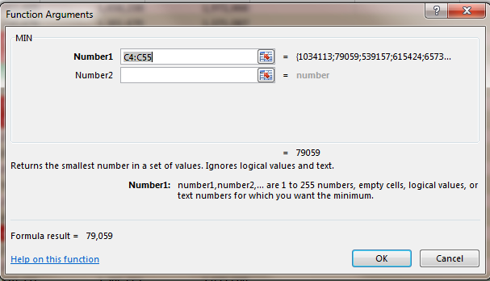
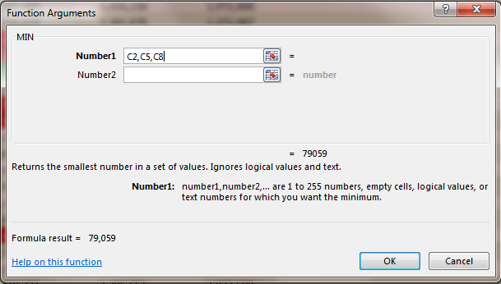
Insert functions using the Insert Function Dialog box: part 2
Different functions have different arguments. For this example, we use the MIN() function.
If you want to calculate the minimum number of a range of cells, enter that range of cells (C4: C55) in Number1
If you want to calculate the minimum number of discrete cells, enter those cells (e.g., C2, C5, C8) in Number1
Once you have entered the function’s arguments, click the OK button.

Slide 9
Directly Inserting functions
Select the cell where you wish to insert the formula.
Directly type the functions in the cell
Type “=” first
Type the function name followed by “(”
Type the range of cells for calculation
End with “)”
For example: =MIN(C3:C55)
Press Enter key to get the result of the function.

Slide 10
Use AutoFill
AutoFill copies formulas or values from one cell to a range of other cells.
Select the cell where you have entered the function or formula.
Click and drag the fill handle (green square in bottom right corner of cell) either down or across to the desired cells.
Release the mouse button.

Slide 11
Write formulas
Select the cell where you wish to enter the formula.
Directly type the formula in the cell.
Type “=” first
Click first cell used in the formula
Type the arithmetic operator
Click second cell used in the formula
Press Enter on the keyboard to get the result.

Slide 12
Use the RANK.EQ function: Part 1
The RANK.EQ() function gives the order of a number in a list.
If you were to sort the list, the rank of the number would be its position in the list.
Duplicate values are assigned the same rank.
If your numbers are 5, 20, 20, and 5, their respective ranks would be 1, 2, 2, and 4

Slide 13
Use the RANK.EQ function: Part 2
Click the cell where you wish to enter the RANK.EQ() function.
Click the Insert Function button.
In the Insert Function dialog box, Search for rank.eq.
Click the Go button.
Select the RANK.EQ function.
Click the OK button.

Slide 14
Use the RANK.EQ function: Part 3
In Function Arguments dialog box, enter the following information:
Number: specific cell to rank.
Ref: the range of cells to rank
Order: not used
Click the OK button.

