Slide 1
Microsoft word
Chapters 4, 5, 6 & 7
Nagendra Vemulapalli
Nagendra.vemulapalli@mail.wvu.edu

Slide 2
Word Continued
Equation Editor
Bullets & Numbers
Footnotes / Endnotes

Slide 3
Equation Editor
Can build Equation objects with symbols otherwise not available
Do not need to know math to make them, just build them on piece at a time…

Slide 4
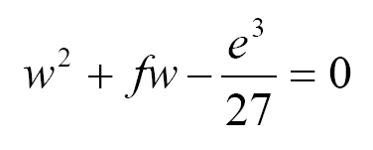
Equation Editor
We are going to build this
We do 1 character at a time and pick what we need from the menus for exponents and fractions

Slide 5
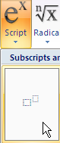
Equation Editor
First, select Script to add the boxes for number with exponent (Superscript)
Type w 2 in the individual resulting boxes
Click to the right of “2” to return to the main line

Slide 6

Equation Editor
Type + f w –
Click Fraction and select Stacked Fraction
Place another Superscript exponent pair in the top half
Enter e 3

Slide 7
Equation Editor
Enter 27 in the lower half of the fraction
Click to the right of the 27 to return cursor to the main line
Type = 0
Press [Enter] and click once on equation
Increase the font size to Cambria Math 28

Slide 8
Bullets & Numbers
Create a new Word document
Type the following:
  Books
  Tables
  Chairs
Highlight them and click the Numbering button
Try using the Bullets button
Add a subtype novels under books

Slide 9
Footnotes/Endnotes
Footnotes put a superscripted symbol by a word and place the corresponding reference information at the bottom of that page
Endnotes do the same thing, but the information is place on the last page of the document

Slide 10
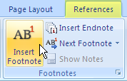
Footnotes/Endnotes
Position the cursor to the right of any thing in the list
References ribbon > Insert Footnote
Type some information about the thing in the footnote area, then view it by the thing name

Slide 11
Word Continued
Tabs
Wordart
Pictures & Clipart
Symbols

Slide 12
Tabs
A tab is a marker for aligning text in a document.
A left tab marks the position to align text on the left
A right tab marks the position to align text on the right
A center tab marks where text centers as you type
A decimal tab marks where numbers align on a decimal point as you type

Slide 13
Setting Tab Stops
* If rulers are missing: View > Show/Hide > Ruler
To create a new tabs…
Use Tab Alignment Selector to choose a type
Use Horizontal Ruler to set location
Press [Tab] key to move text to next tab

Slide 14
Left Tab
Create a Left Tab
  Insert a few blank lines
  Select the left tab symbol
  Click to place the tab at 1.5” on the top ruler
  In the document, press [Tab]
  Type your last name

Slide 15
Center Tab
Create a Center Tab
  Insert a blank line after your last name
  Select the center tab symbol
  Click to place the tab at 2.5” on the top ruler
  [Tab] twice in the document
  Type your first name

Slide 16
Right Tab
Create a Right Tab
  Insert a blank line after your first name
  Select the right tab symbol
  Click to place the tab at 4” on the top ruler
  [Tab] 3 times in the document
  Type “Computer Science”

Slide 17
Decimal Tab
Create a Decimal Tab
  Insert some blank lines after “Computer Science”
  Select the decimal tab symbol
  Click to place the tab at 5” on the top ruler
  [Tab] 4 times for each of the below…
  Type to the following on separate lines:
  3.14 310.49

Slide 18
WordArt
Insert ribbon > WordArt
Select a style
Enter desired text

Slide 19
Pictures & Clipart
Pictures
Insert ribbon > Picture > Select one > Resize
Clip Art
Insert ribbon > Clip Art > Select one > Resize

Slide 20
Symbols and Special Characters…
Two methods to enter these:
  Insert ribbon> Symbols group > Symbol > More Symbols > Special Characters tab
  Or, Word will automatically convert some standard characters into typographic symbols…

Slide 21
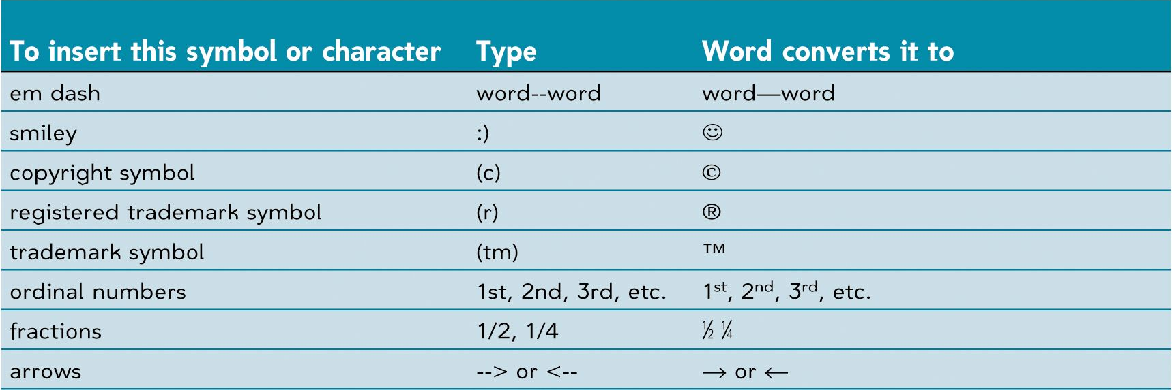
Common typographic symbols

