Slide 1
Excel: Excel Basics Participation Project
Housing Problem
WV Mining Problem

Slide 2
Topics Covered
Download data and extract ZIP file contents
Create a new workbook
Adjust sheets
Import XML data
Import CSV data
Import from an Access database
Enter data

Slide 3
Download data
Right-click on the link or button for the file to download.
Select the Save link as or similar option.
Choose where to save your file.
Desktop is a convenient location
Click the Save button to download the file.

Slide 4
Extract ZIP files
CS101 data files are provided in a ZIP file. The ZIP file must be extracted before use.
Right-click on the ZIP file you wish to extract.
Select the Extract All option.
Click the Extract button.
View the contents of the extracted ZIP archive.
You can close the Explorer window when you are done.

Slide 5
Create a New workbook: Part 1
Open Excel from the Start Menu.
Select the Blank workbook option.
Always save your workbook after creating a new blank workbook.

Slide 6
Create a New workbook: Part 2
It’s a good idea to save your workbook at the start so it is named correctly.
After creating a new blank workbook, go to the File ribbon.
Click the Save as button.
Click the Browse button.
Choose where to save your Excel workbook.
In File name, enter the name listed in the instructions.
Click the Save button.

Slide 7
Elements specific to the Excel window
M. A. Poatsy, K. Mulbery, J. Davidson, A. Rutledge, and R. Grauer, Exploring Microsoft Office Excel 2016 Comprehensive, 1st ed. Upper Saddle River, NJ: Pearson Education, 2016.
Notes:
Image from Exploring Office 2016.

Slide 8
Adjust sheets: rename sheet
Giving each worksheet a descriptive name makes it easier to find your data.
At the bottom of the workbook, right-click on the tab for the worksheet to rename and select Rename.
Type in the new sheet name.
Press the Enter key.

Slide 9
Adjust sheets: add sheet
At the bottom of the workbook, click the New Sheet button.
Rename the newly added sheet.

Slide 10
Adjust sheets: copy sheet
At the bottom of the worksheet, right-click the sheet you want to copy and select Move or Copy.
Choose the sheet you want to copy.
Choose where the new sheet is to be positioned.
Check the Create a copy box.
Click the OK button.
Rename the newly copied sheet.

Slide 11
Adjust sheets: delete sheet
At the bottom of the workbook, right-click the sheet to delete, and select Delete.
Click the Delete button when a warning window pops out.

Slide 12
Import XML Data: Part 1
XML files are one common way of sharing data. Excel for Mac does not support them.
Click the cell where you want to import the XML file.
Go to the Data ribbon.
Click the Get Data button, select From File and then From XML.
Select the XML file to import.
Click the Import button.

Slide 13
Import XML Data: Part 2
On the left pane of the Navigator dialog box, select the table you wish to import.
Click the Edit button.

Slide 14
Import XML Data: Part 3
Look at the table of data to ensure that the heading at the top contains names for the columns and not data.
If column headings aren’t shown, click the Use First Row as Headers button.

Slide 15
Import XML Data: Part 4
Click the dropdown arrow below the Close & Load button and select Close & Load To.
Select that you would like to view this data as a table in the existing worksheet. The cell you selected will be listed.
Click the OK button.

Slide 16
Import XML Data: Part 5
In the Import Data dialog box, choose to put the data on an Existing sheet.
Check the cell location. Fix it if it’s not the right cell.
Click the OK button to perform the import.

Slide 17
Import CSV Data: PART 1
Click the cell where you want to import the CSV file.
Go to the Data ribbon.
Click the From Text/CSV button.
Select the CSV file to import.
Click the Import button.
Click the Edit button.

Slide 18
Import CSV Data: PART 2
Click the Edit button.

Slide 19
Import CSV Data: PART 3
Look at the table of data to ensure that the heading at the top contains names for the columns and not data.
If column headings aren’t shown, click the Use First Row as Headers button.

Slide 20
Import CSV Data: Part 4
Click the dropdown arrow below the Close & Load button and select Close & Load To.
Select that you would like to view this data as a table in the existing worksheet. The cell you selected will be listed.
Click the OK button.

Slide 21
Import CSV Data: Part 5
In the Import Data dialog box, choose to put the data on an Existing sheet.
Check the cell location. Fix it if it’s not the right cell.
Click the OK button to perform the import.

Slide 22
Import From an Access Database: Part 1
Excel for Mac does not support importing from Access databases.
Exit Access before doing the import.
Click the cell where you want to import the Access database.
Go to the Data ribbon.
Click the Get Data button, select From Database and then From Microsoft Access Database.
Select the database to import.
Click the Import button.

Slide 23
Import From an Access Database: Part 2
On the left pane of the Navigator dialog box, select the table or query you wish to import.
Click the dropdown arrow beside Load and choose Load To.

Slide 24
Import From an Access Database: Part 3
In the Import Data dialog box, choose to put the data on an Existing sheet.
Check the cell location. Fix it if it’s not the right cell.
Click the OK button to perform the import.

Slide 25
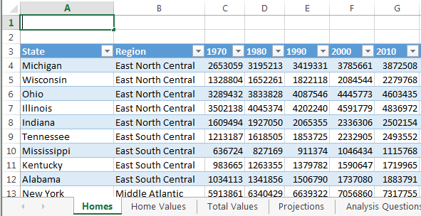
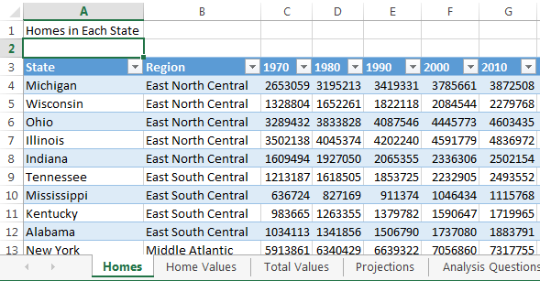
Enter data
Double-click the cell where you want to enter your data.
Type in the data.
When you’re done, press the Tab key to go to the next cell to the right or press Enter to go to the next cell below.

