Slide 1
Excel: Tables
Participation Project
Housing Problem
WV Mining Problem

Slide 2
Topics Covered
Create and format tables
Insert rows and/or columns
Use the table total row
Sort data

Slide 3
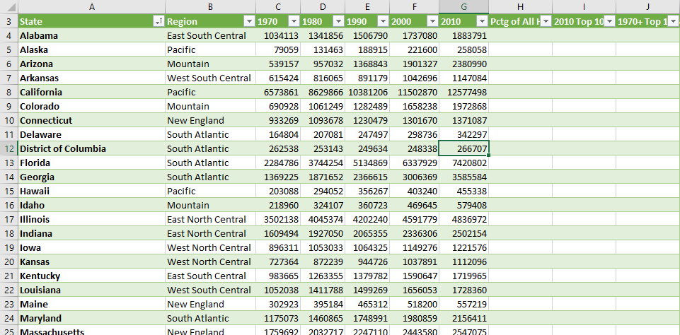
Tables
Tables are a tool for organizing related data.
  Allow data to be referenced by name rather than cell references (e.g., A3)
  Provides easy visual formatting
  Includes options for calculating common column statistics
  Has tools for sorting and filtering data

Slide 4
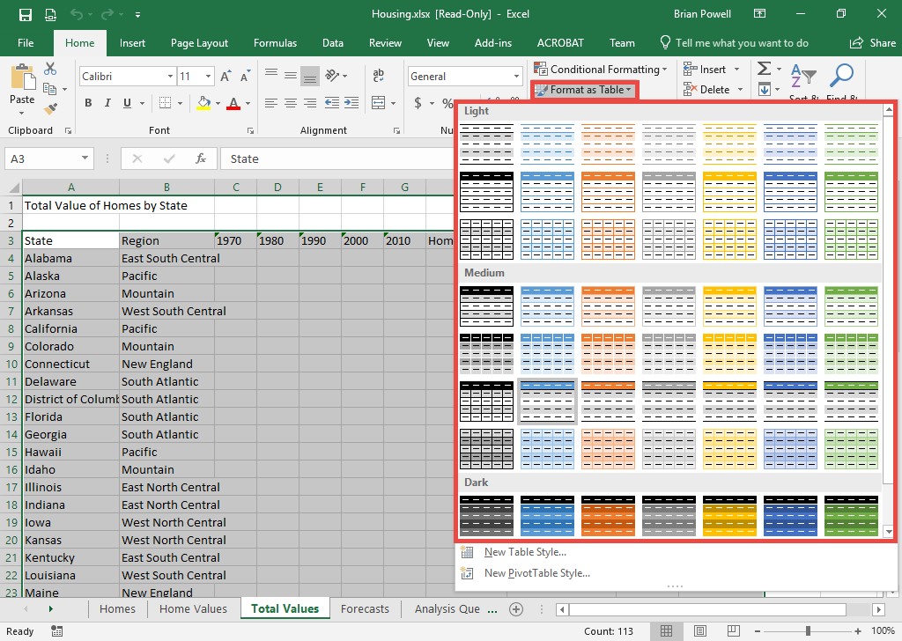
Create and Format tables
Select the range of cells for the table:
  First way: in the Name box, type A3:K54, and then press Enter
  Second way: click the first cell A3, and drag the mouse to the last cell K54
Go to the Home ribbon.
In the Styles section, go to Format as Table and pick a table style to apply.
When prompted, select the My table has headers box and click OK.
If a warning appears, click Yes to convert the selection to a table.

Slide 5
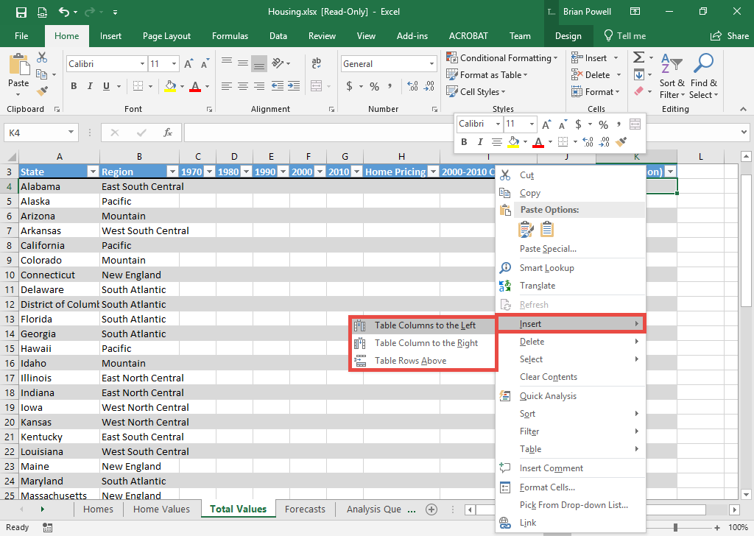
Insert Rows and Columns
If new column will be rightmost in a table:
  Click in any cell in rightmost table column.
  Right-click, choose Insert and then Table Columns to the Right.
If inserting a table column anywhere else:
  Click in the column immediately to right of where the new one will go.
  Right-click, choose Insert and then Table Columns to the Left.
If inserting a column outside a table:
  Click in column immediately to right of where the new one will go.
  Go to the Home ribbon, choose Insert and then Insert Sheet Columns.
Inserting rows works similarly.

Slide 6
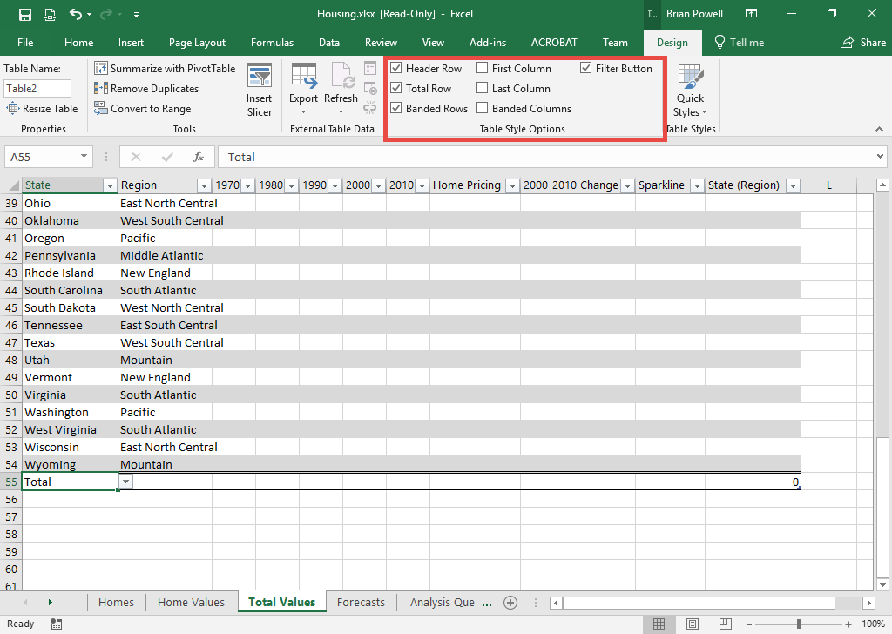
Turn on total row and/or first column
Click anywhere inside the table where you want to add a total row or using First Column formatting.
Go to the Design ribbon.
In Table Styles Options section:
  Check Total Row to display a total row
  Check First Column to turn on the First Column formatting option

Slide 7
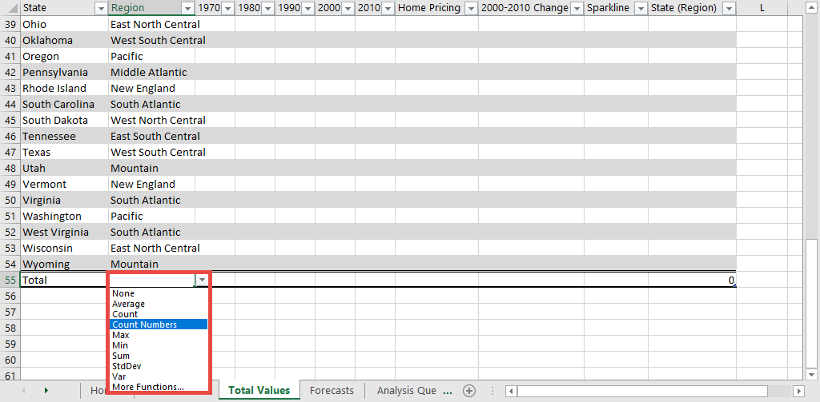
Use The table Total row
In the total row (always at the bottom of the table), click the cell where you wish to display the statistics.
Click the dropdown arrow to display the statistics function list.
Select the needed statistical function.
  To not display any statistics in a column, choose the None option

Slide 8
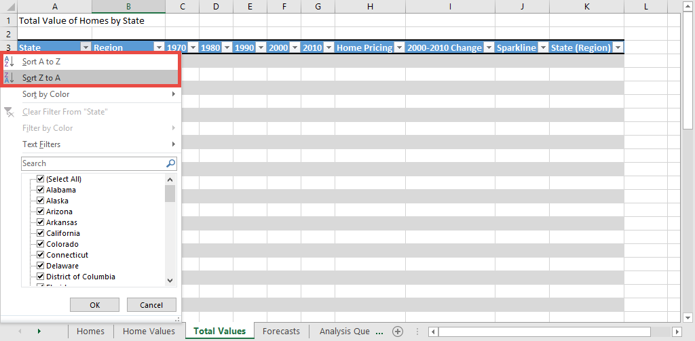
Sort data
Click the dropdown arrow in the header for the column to sort.
Click Sort A to Z or Sort Z to A as needed.
  Sort A to Z: ascending (smallest to biggest)
  Sort Z to A: descending (biggest to smallest)

Slide 9
Answer Analysis Questions
Analysis questions are to help you think critically about the data in the assignment and to apply your own knowledge and reasoning.
Appear in Participation Projects, Homeworks, and Exams.
Give 2-3 sentences answering question and providing your rationale.
For Homeworks and Participation Projects, you can use the Internet to help figure out your answer.
Sample Question
The median age in Highland County, Virginia is 59.8 years old. Assuming nobody moves in or out, do you think its population is more likely to increase or decrease over time?
Good Answer
Highland County’s population is likely to decrease. A huge percentage of its population is beyond child-bearing years. Younger people would need to have abnormally large families to make up for older people who die.

