Slide 1
Excel: Formulas & Functions II Participation Project
Housing Problem
WV Mining Problem

Slide 2
Topics Covered
Write 3-D formulas
Use the IF function
Use AND/OR criteria
Use nested IF functions

Slide 3
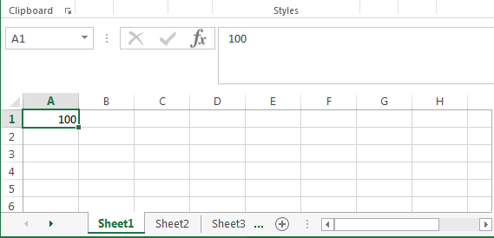
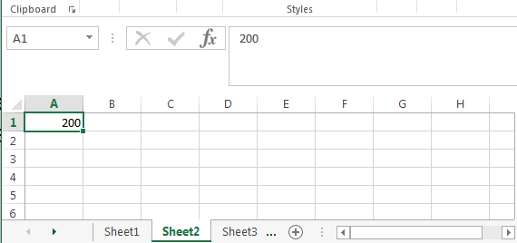
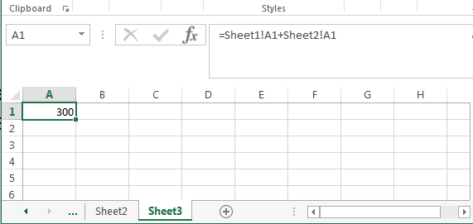
3-D formulas
3-D formulas are used to reference data on another worksheet in the same workbook.
This is helpful for combining information from larger datasets.
Example: Adding cells A1 on Sheet1 and A1 on Sheet2, placing the result in cell A1 on Sheet3.

Slide 4
Write 3-D formulas
Select the cell where you wish to insert your 3-D formula.
Type “=” to begin the formula.
Go to the worksheet that contains the first cell and click the cell.
Enter the arithmetic operator.
Go to the worksheet that contains the second cell and click that cell.
Continue building your formula, pressing the Enter key when done.

Slide 5
Logical conditions: Part 1
In logic, a sentence or proposition is of the form “If A then B.”
A is logical condition
If taking a flight, then 50 min
If driving, then 3 h 30 min
If walking, then 67 h
Morgantown
Washington D.C.

Slide 6
Logical conditions: Part 2
If a logical condition is satisfied, then its result is TRUE.
Different logical conditions lead to different results.
In Excel, a logical condition is a comparison using mathematical symbols that evaluate to true or false.
If the comparison is correct, the result is TRUE
If the comparison is wrong, the result is FALSE
Comparison Operators
Operator | Description
= | Equal to
<> | Not equal to
< | Less than
> | Greater than
<= | Less than or equal to (at most)
>= | Greater than or equal to (at least)
For example, 3 < 5 is TRUE
4 > 6 is FALSE
9 <= 10 is TRUE
8 >= 12 is FALSE

Slide 7
IF function
The most common logical function is IF() function in Excel.
The IF() function has three arguments:
A logical condition
What to do if condition is met (TRUE)
What to do if condition is not met (FALSE)
$$=IF(8<10 ,\text{"}\text{Yes}\text{"} , "\text{No}\text{"})$$
Condition
What to show if TRUE
What to show if FALSE

Slide 8
Use the IF function: Part 1
The IF() function can be typed into the cell directly or by using the Logical Function Library.
Select the cell where you wish to insert IF function.
Go to the Formulas ribbon.
In the Function Library section, click Logical, and then select IF.

Slide 9
Use the IF function: Part 2
In Function Arguments dialog box, set the following values:
Logical_test: Test to use
Value_if_true: What to do if the logical condition is true
Value_if_false: What to do if the logical condition is false
Click the OK button.

Slide 10
AND function
The AND() function requires all logical conditions to be true to return TRUE.
If all conditions are true, then the result is TRUE
If one or more conditions are false, then the result is FALSE

Slide 11
Insert AND function: Part 1
AND() functions can be typed into the cell directly or by using the Logical Function Library.
Select the cell where you wish to insert the AND() function.
Go to the Formulas ribbon.
In the Function Library section, click Logical, and then select AND.

Slide 12
Insert AND function: Part 2
In Function Arguments dialog box, set the following values:
Logical1: First logical condition
Logical2: Second logical condition
Logical3: Third logical condition, if there is one
Click the OK button.

Slide 13
OR Function
The OR() function is opposite of the AND() function.
If one or more conditions is true, then the result is TRUE
If all conditions are false, then the result is FALSE

Slide 14
Insert OR Function: Part 1
OR() functions can be typed into the cell directly or by using the Logical Function Library.
Select the cell where you wish to insert the OR() function.
Go to the Formulas ribbon.
In the Function Library section, click Logical, and then select OR.

Slide 15
Insert OR Function: Part 2
In Function Arguments dialog box:
Logical1: First logical condition
Logical2: Second logical condition
Logical3: Third logical condition, if there is one
Click OK.

Slide 16
Nested IF functions
Nested means putting an IF() function inside another IF() function.
Nested IF() functions are used to make three or more comparisons.
Example: The points are stored in cell A1 and the comments in A2.
A1 = 100 -----> Excellent
A1 = 90 -----> Good
A1 = 50 -----> Bad

Slide 17
Use Nested IF functions: Part 1
Nested IF() functions can be typed into the cell directly or by using the Logical Function Library.
Select the cell where you wish to insert the nested IF function.
Go to the Formulas ribbon.
In the Function Library section, click Logical, and then select IF.

Slide 18
Use Nested IF functions: Part 2
In Function Arguments dialog box, set the following values:
Logical_test: First test to use
Value_if_true: Type your second IF function here if the logical condition on the first is true (see slide 10 “Insert IF function”)
Value_if_false: Type your second IF function here if the logical condition on the first is false (see slide 10 “Insert IF function”)
Click the OK button.

