Slide 1
Excel: Formulas & Functions III
Participation Project
Housing Problem
WV Mining Problem

Slide 2
Topics Covered
Use the SUMIF and AVERAGEIF functions
Use the VLOOKUP function
Use the PMT/FV function
Use the CONCATENATE function

Slide 3
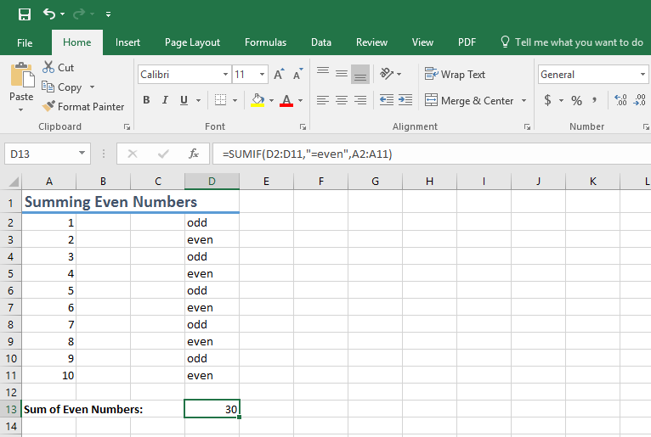
SUMIF Function
The SUMIF() function is similar to the SUM function except it only sums values satisfying a specified condition.
Syntax: =SUMIF(range, criteria, [sum_range])

Slide 4
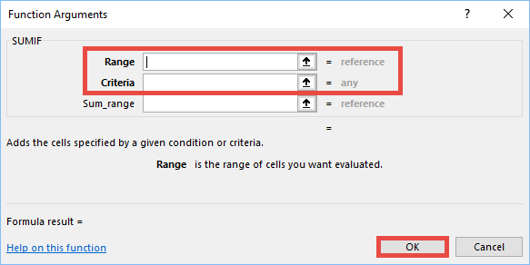
Use the SUMIF Function
In the Function Arguments dialog box, set the following values:
  Range: The range of cells that you want evaluated by criteria
  Criteria: A number, expression, cell reference, text, or function that defines which cells will be added
  Sum_range: The actual cells to add, if you want to add cells other than those specified by Range

Slide 5
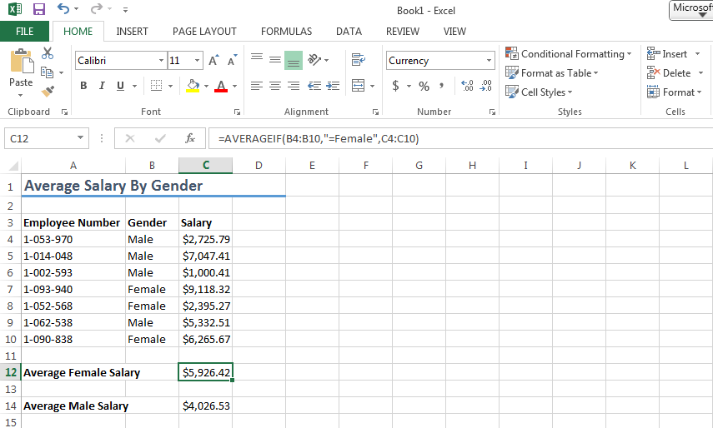
AVERAGEIF Function
The AVERAGEIF() function only averages values satisfying the specified condition.
Syntax: =AVERAGEIF(range, criteria, [average_range])

Slide 6
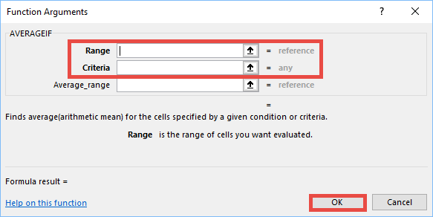
Use the AVERAGEIF Function
In the Function Arguments dialog box, set the following values:
  Range: Range of cells that you want evaluated by criteria
  Criteria: A number, expression, cell reference, text, or function that defines which cells will be averaged
  Sum_range: Cells to average, if you want to average cells other than those specified by Range

Slide 7
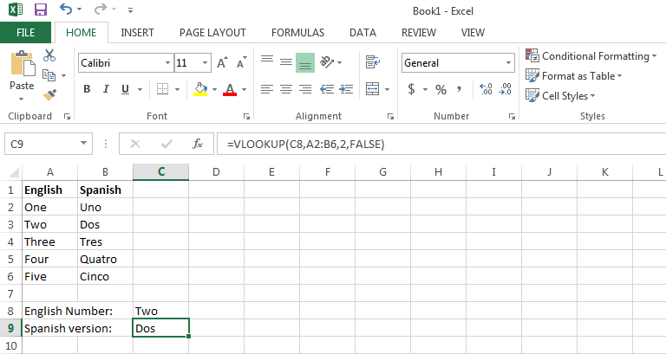
VLOOKUP Function
VLOOKUP() accepts a value, looks the value up in a vertical lookup table, and returns the result.
It’s useful for finding paired values.
  e.g., find postal abbreviation based on state name
Syntax: VLOOKUP(lookup_val,
table_arr,col_index,
[range_lookup])

Slide 8
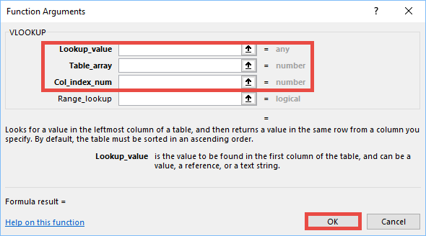
Use the VLOOKUP Function
In the Function Arguments dialog box, set the following values:
  Lookup_value: Value to search in table
  Table_array: table of values
  Col_index_num: which column to return information
  Range_lookup: used to determine exact or close match

Slide 9
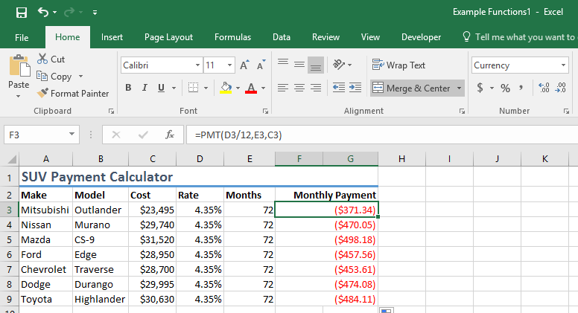
PMT Function
The PMT() function calculates loan payments based on constant payment amounts and a constant interest rate.
Syntax: =PMT(rate, nper, pv, [fv], [type])

Slide 10
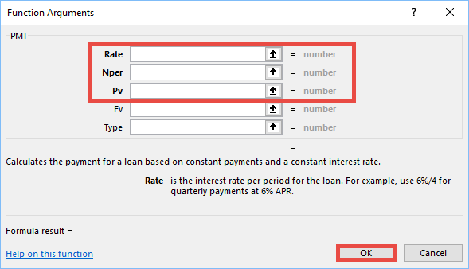
Use the PMT Function
In the Function Arguments dialog box, set the following values:
  Rate: periodic interest rate
  Nper: total number of payment periods
  Pv: present value
  Fv: future value
  Type: 0 (default) if payments are due at beginning of period, 1 if payments are due at end

Slide 11
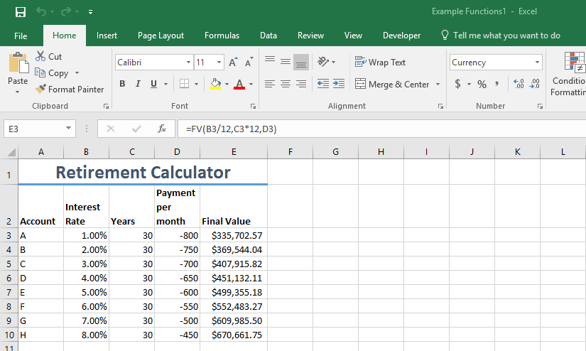
FV Function
The FV() function calculates the future value of an investment based on a constant interest rate.
Syntax: =FV(rate,nper,pmt,[pv],[type])

Slide 12
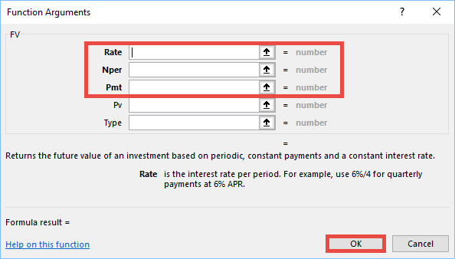
Use the FV Function
In the Function Arguments dialog box, set the following values:
  Rate: periodic interest rate
  Nper: total number of payment periods
  Pmt: the payment made each period
  Pv: present value
  Type: 0 (default) if interest is paid at beginning of period, 1 if paid at end

Slide 13
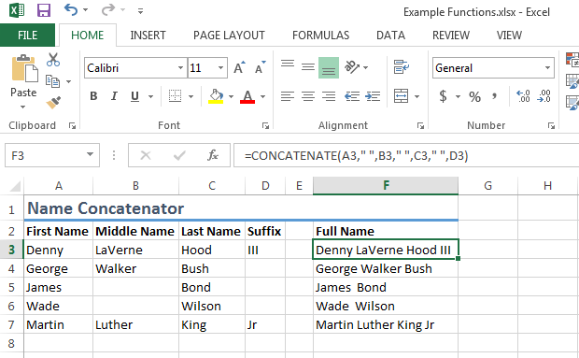
CONCATENATE Function
The CONCATENATE() function joins two or more text strings into one text string.
Can be helpful for building full names from separate first and last name fields.
Syntax: =CONCATENATE(text1,text2,[…])

Slide 14
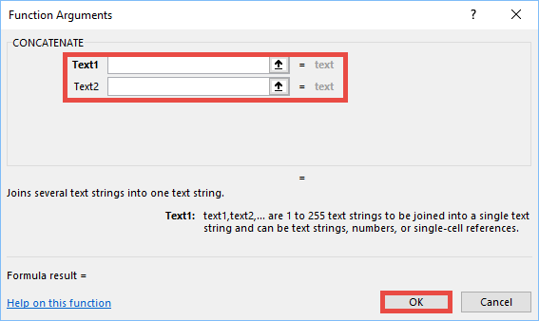
Use the CONCATENATE Function
In the Function Arguments dialog box, set the following values:
  Text1: The first item to join. The item can be a text value, number, or cell reference
  Text2: Additional text items to join
  Text3…: Optionally, additional text items to join

