Slide 1
Excel: Solver
Participation Project
Housing Problem
WV Mining Problem

Slide 2
Topics Covered
Use Solver
Specify constraints for Solver

Slide 3
Solver
The Solver Add-In provides advanced features for solving complex problems.
It’s Goal Seek on steroids.
Includes options to:
  Modify multiple variable cells at the same time.
  Set constraints (maximum and minimum values) on those variable cells.
  Use different solving methods to find the best values.

Slide 4
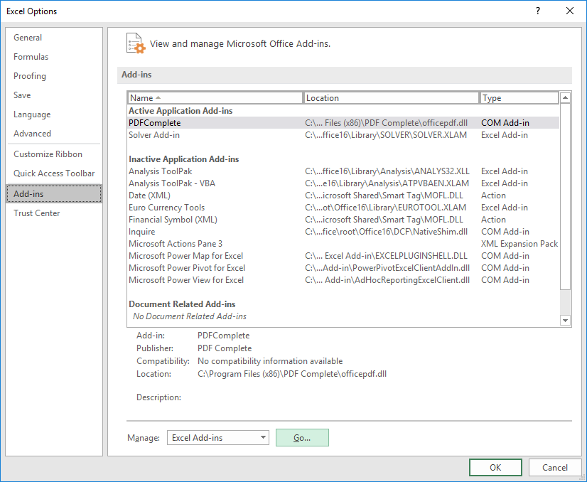
Adding The Solver Add-In:
Part 1
The Solver Add-In must be added before it can be used.
Go to the File ribbon.
Select Options.
In the Excel Options dialog box, select Add-Ins from the left pane and click the Go button.

Slide 5
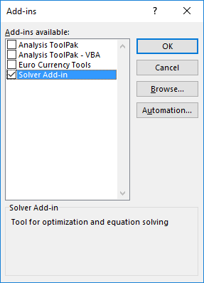
Adding The Solver Add-In:
Part 2
Select Solver Add-in from the Add-ins available list.
Click the OK button.

Slide 6
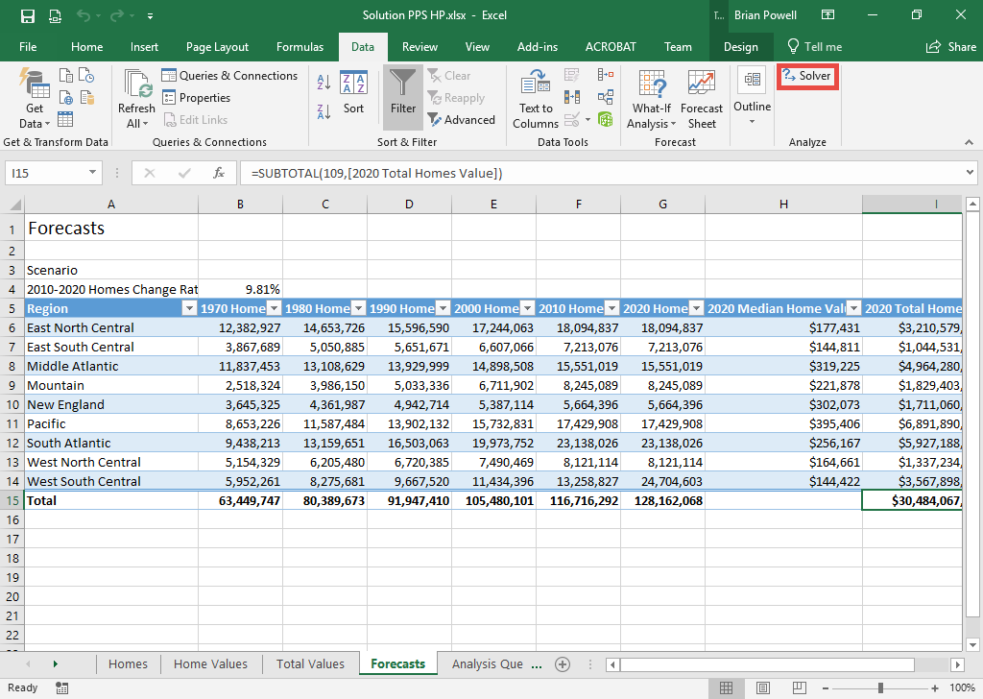
Using Solver
Open the worksheet you wish to use Solver in.
Go to the Data ribbon.
In the Analyze group, click Solver.

Slide 7
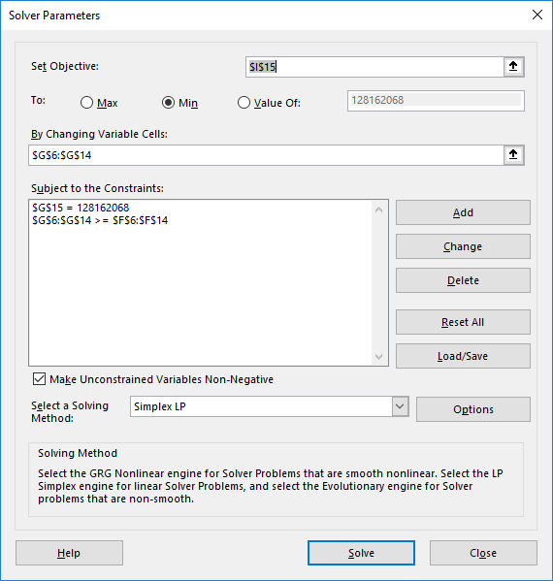
Using Solver
In the Solver Parameters Dialog Box, set the following values:
  Set Objective: Cell(s) you want to modify
  To: Target value for solved cell
  By Changing Variable Cells: Cells Excel is allowed to modify
  Subject to the Constraints: Criteria the cells must meet

