Slide 1
Word: Layout & Pagination
Participation Project
Lewis Carroll Problem
McAlpine Locks & Dam Problem
US 1 Problem

Slide 2
Topics Covered
Insert a cover page
Create headers and footers
Insert section breaks
Adjust margins and orientation
Create and format tables
Use bulleted lists

Slide 3
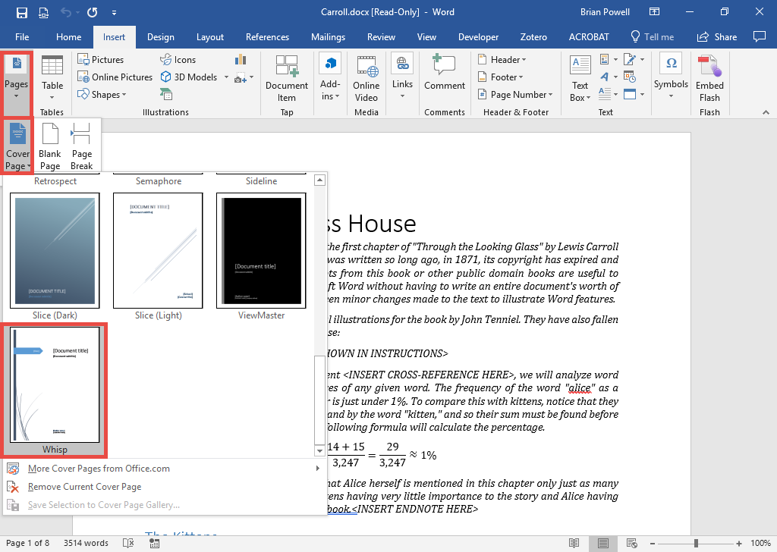
Insert A Cover Page
Cover pages provide a professional start to a document.
Go to the Insert ribbon.
In the Pages section, click the Cover Page button.
Choose the preferred design to add that cover page to the document.
Edit the title, author name, and other fields on the inserted cover page.

Slide 4
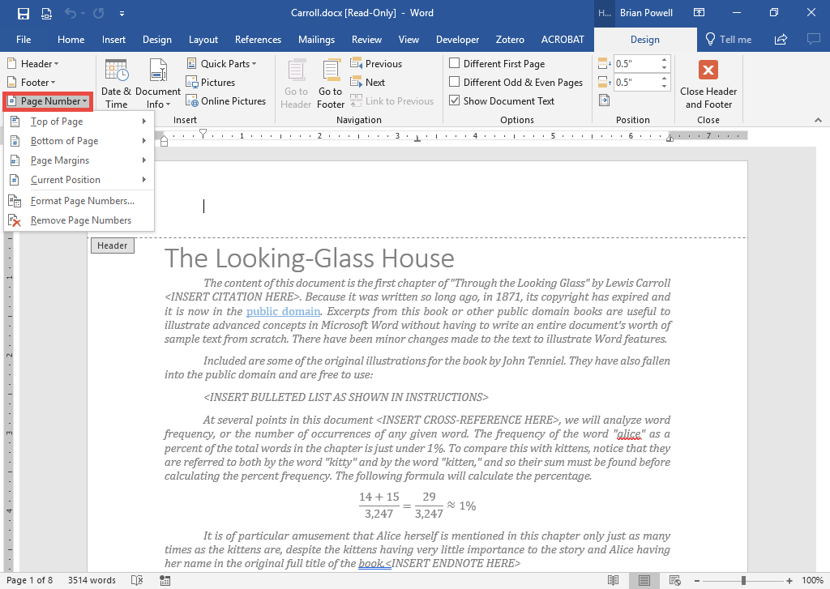
Create Headers and Footers
Headers and footers appear at the top and bottom of every page.
Double-click in the header at the top of a page to open Headers & Footers view.
Type and format text as normal in the header (top of page) and footer (bottom of page) areas.
To insert a page number, go to the Header & Footer Tools Design ribbon. Under Page Number, select Current Position to insert the page number at the current cursor location.

Slide 5
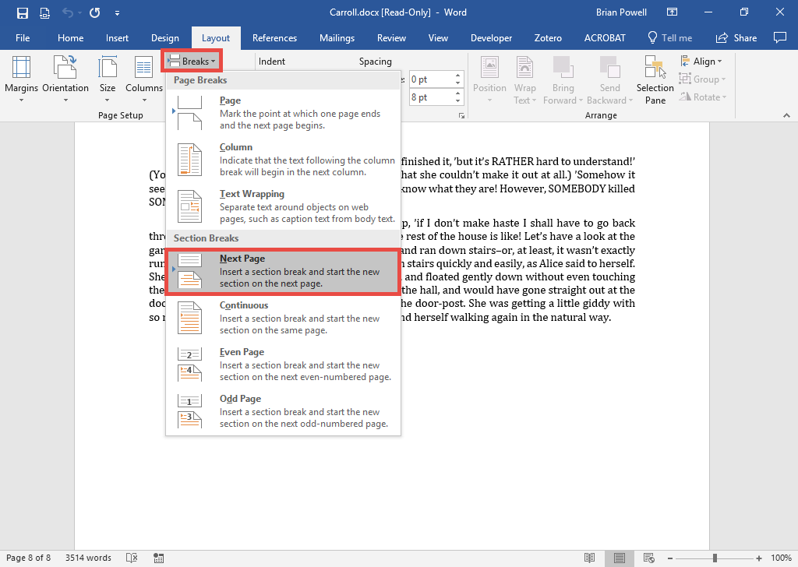
Insert Section Breaks
Section breaks divide the document into different parts to apply different numbering, page orientation, margin, and column settings.
Go to the Layout ribbon.
In the Page Setup section, click the Breaks button.
Select Next Page from the list to start a new page in a new section.

Slide 6
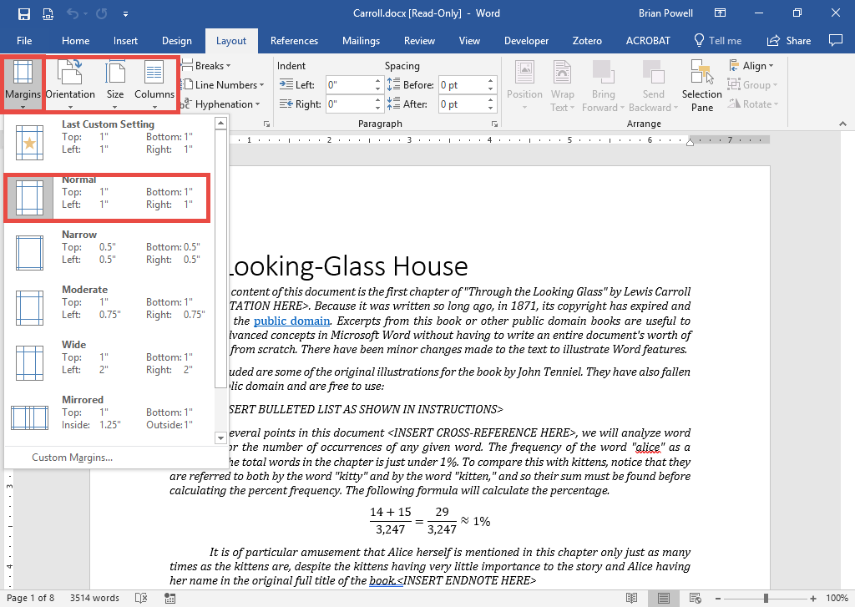
Adjust Margins and Orientation
Margins (blank space around page) and page orientation affect how your page is displayed.
Go to the Layout ribbon.
Use the menus in the Page Setup section to control margins, page orientation, page size, and other settings.

Slide 7
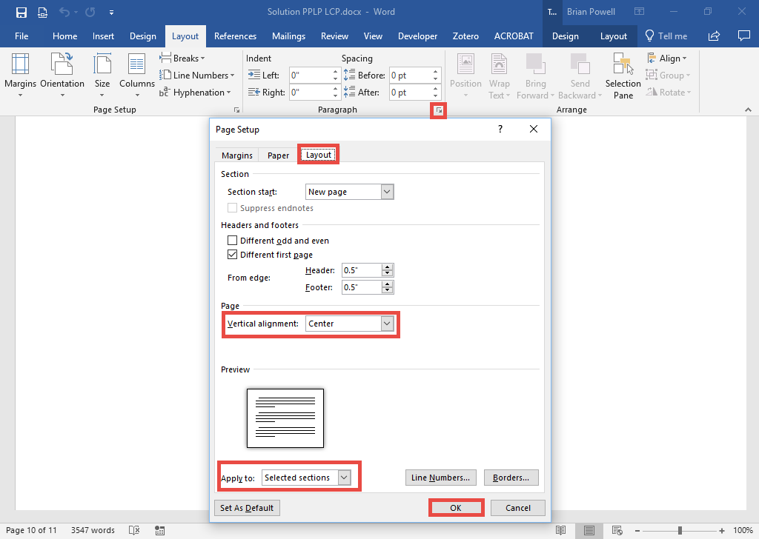
Set page Vertical alignment
The vertical positioning of text can be changed.
Place the cursor in the area whose alignment is to be changed.
Go to the Layout ribbon.
In the Page Setup section, arrow in the bottom right corner.
Go to the Layout tab.
Change the Vertical alignment option.
Set the Apply to as needed for specific sections or the entire document.
Click the OK button.

Slide 8
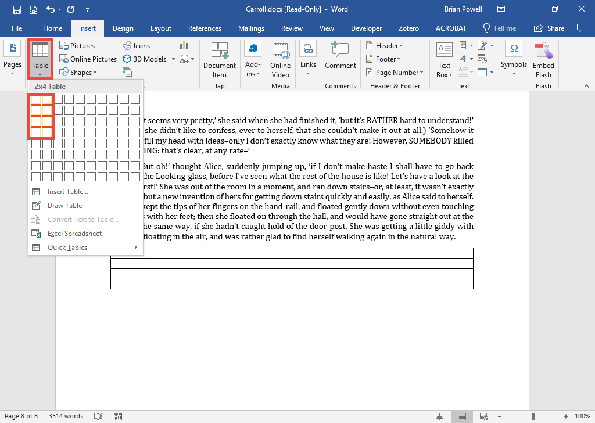
Create and Format Tables:
Part 1
Tables provide a grid for neatly organizing information.
Go to the Insert ribbon.
In the Tables section, click the Table button.
Drag to select the required number of rows and columns.

Slide 9
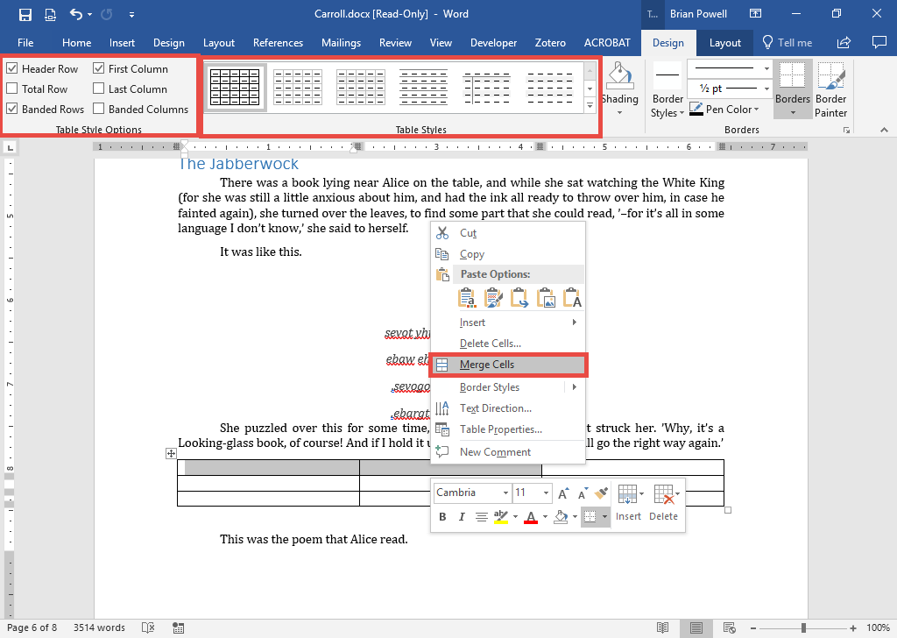
Create and Format Tables:
Part 2
To merge cells:
  Drag to select the cells to merge.
  Right-click and choose Merge Cells.
Format the table options:
  Go to the Table Tools Design ribbon.
  Choose an appropriate table style from the Table Styles section.
  In the Table Style Options section, select options like First Column formatting as needed.

Slide 10
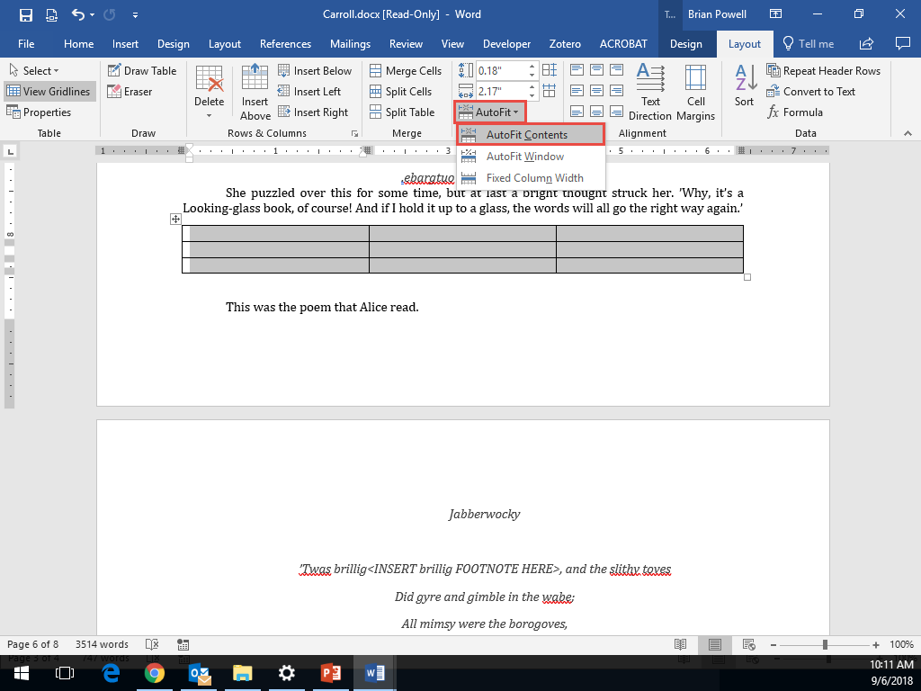
Create and Format Tables:
Part 3
To resize table columns:
  Select the cells or columns to be resized.
  Go to the Table Tools Layout ribbon.
  In the Cell Size section, select the AutoFit menu and then AutoFit Contents.

Slide 11
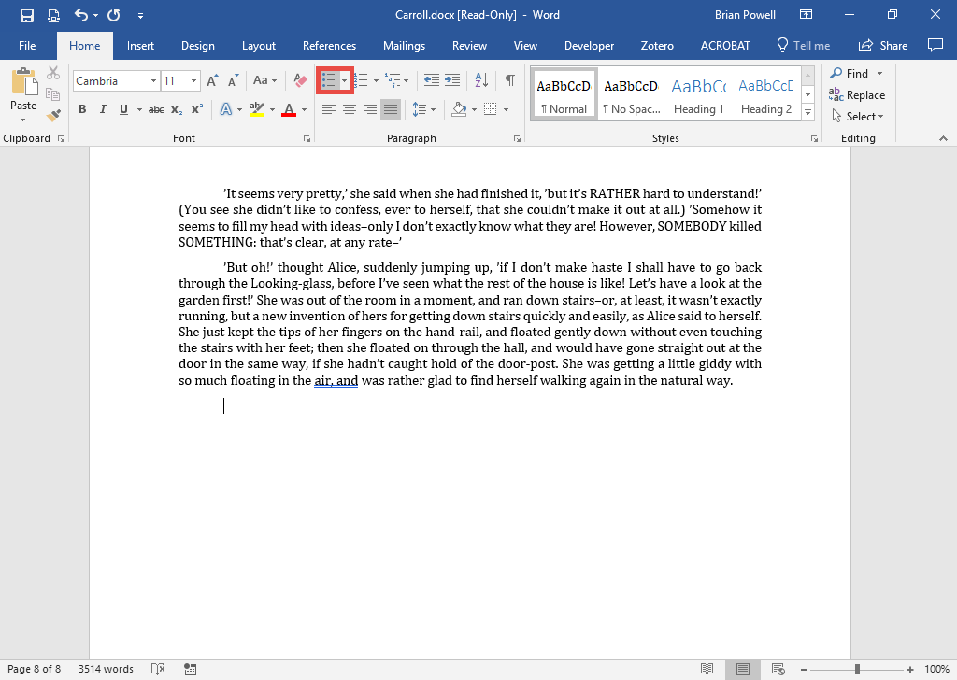
Use Bulleted Lists
Bulleted lists allow lists of items to be easily read.
If you have existing text to format, select the text first. Each paragraph will become its own bullet.
Go to the Home ribbon.
In the Paragraph section, click the Bullets button.

