Slide 1
Word: References & Workflow
Participation Project
Lewis Carroll Problem
McAlpine Locks & Dam Problem
US 1 Problem

Slide 2
Topics Covered
Insert a table of contents
Insert endnotes and footnotes
Add captions
Use cross-references
Manage and insert citations
Insert a bibliography
Enable tracking of changes
Review tracked changes
Compare document differences

Slide 3
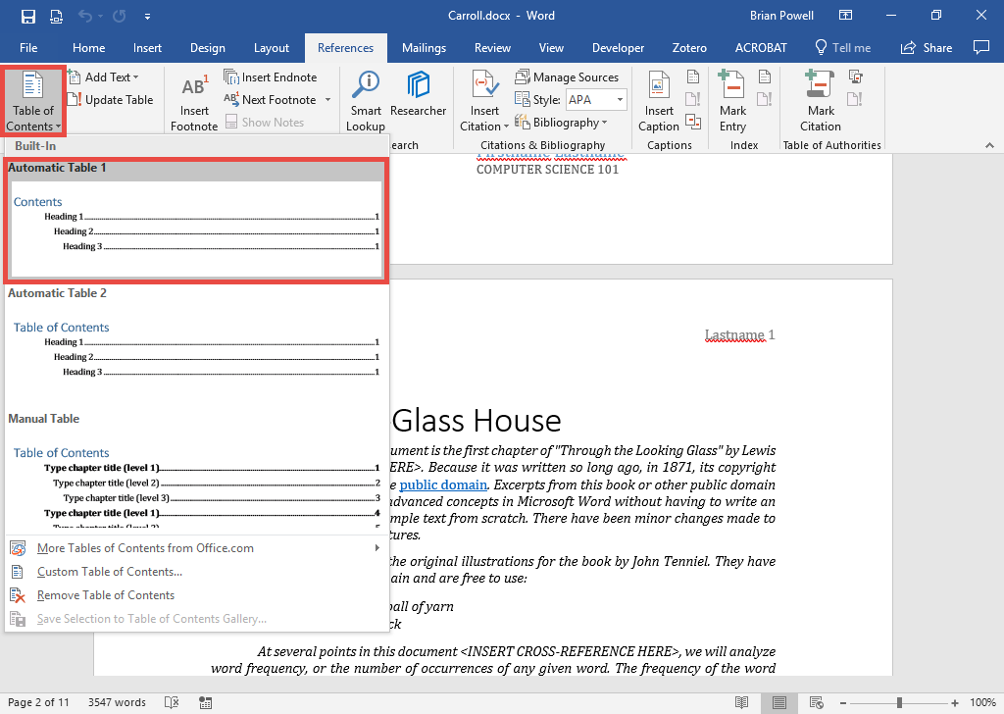
Insert a Table of Contents
Tables of Contents allow people to easily find sections in documents.
Listed items in TOCs are based on headings in the document.
Go to the References ribbon.
In the Table of Contents section, click the Table of Contents button.
Select the table of contents style you wish to use.

Slide 4
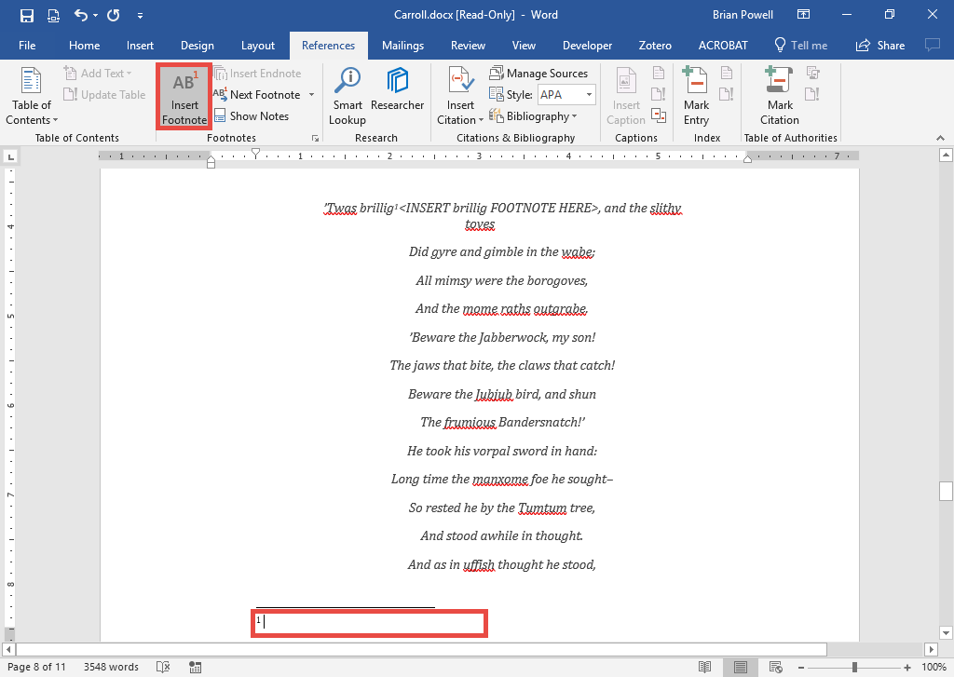
Insert Footnotes
Footnotes appear at the bottom of a page and are used to provide additional detail without interrupting the flow of the document.
Go to the References ribbon.
In the Footnotes section, click the Insert Footnote button.
Type-in text with the footnote at the bottom of page.

Slide 5
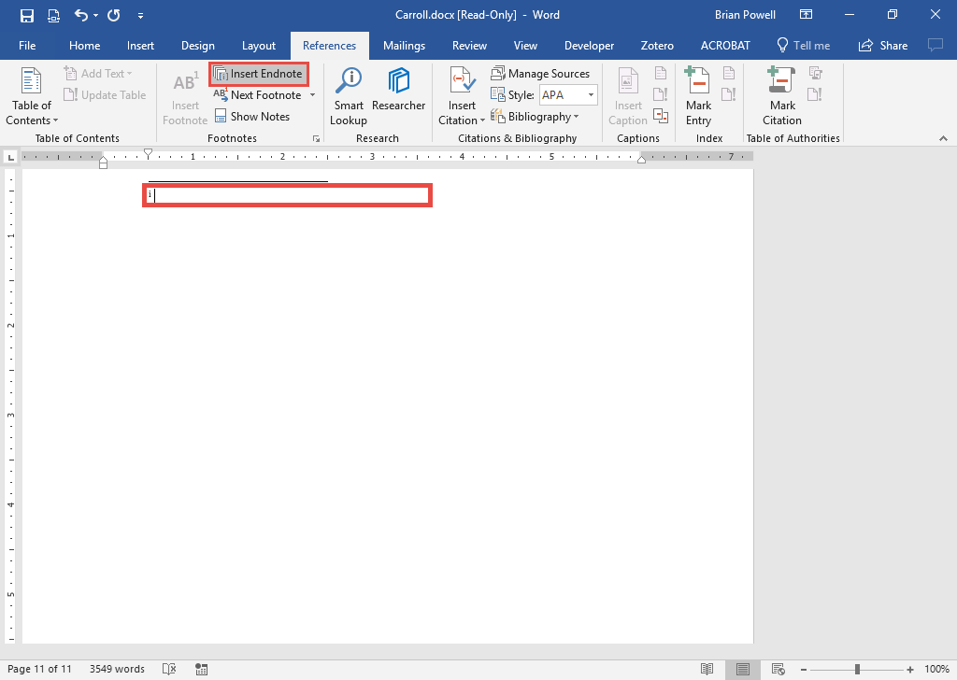
Insert Endnotes
Endnotes are similar to footnotes but appear at the end of a document.
Some fields favor one style over the other.
Go to the References ribbon.
In the Footnotes section, click the Insert Endnote button.
Type-in text with the endnote at the end of the document.

Slide 6
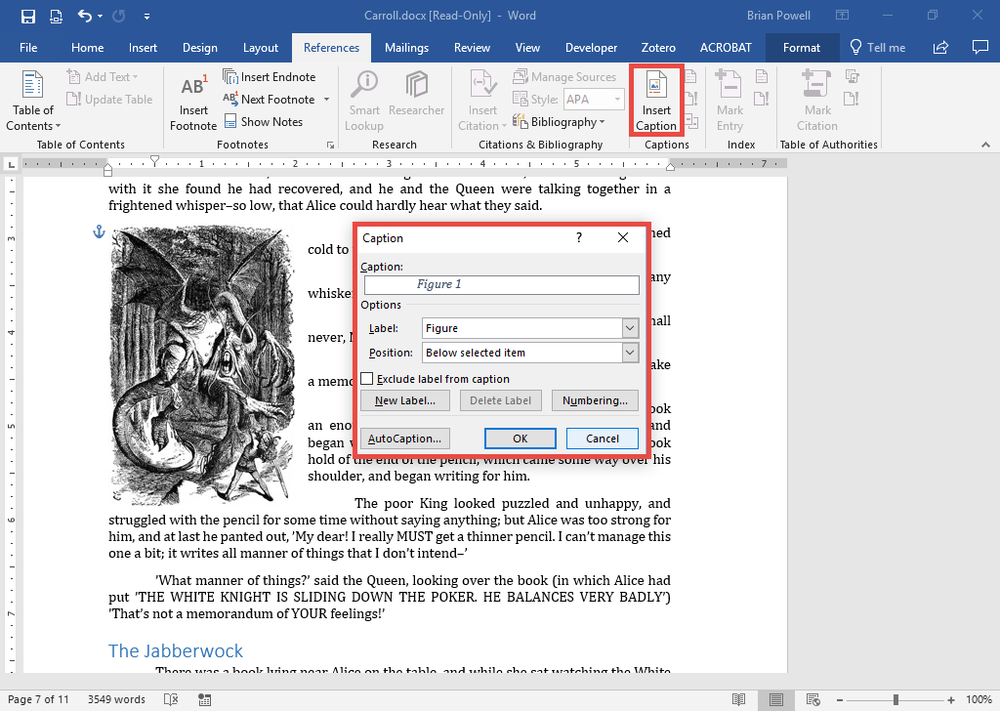
Add Captions
Captions label images, tables, and figures.
Select the item being captioned.
Go to the References ribbon.
In the Captions section, click the Insert Caption button.
In the Caption dialog box, select the label type (e.g., Figure, Table).
Type-in the caption text.
Click the OK button.

Slide 7
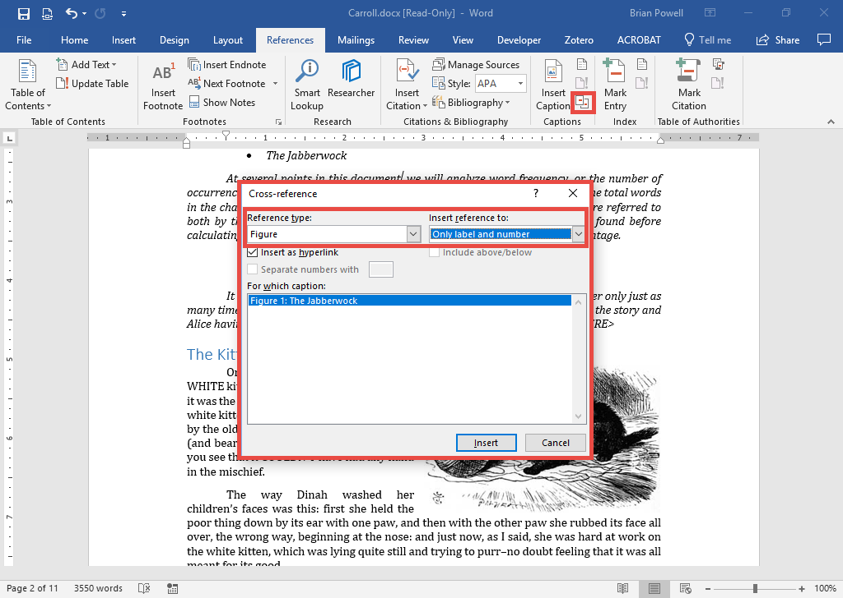
Use Cross-references
Cross-references link to captioned figures/tables and document sections.
Cross-reference labels automatically update if caption item’s number changes.
Place cursor where cross-reference goes.
Go the References ribbon.
In the Captions section, click the Insert Cross-reference button.
In the dialog box, select the reference type. Normally, insert reference to only the label and number.
Click the Insert button.

Slide 8
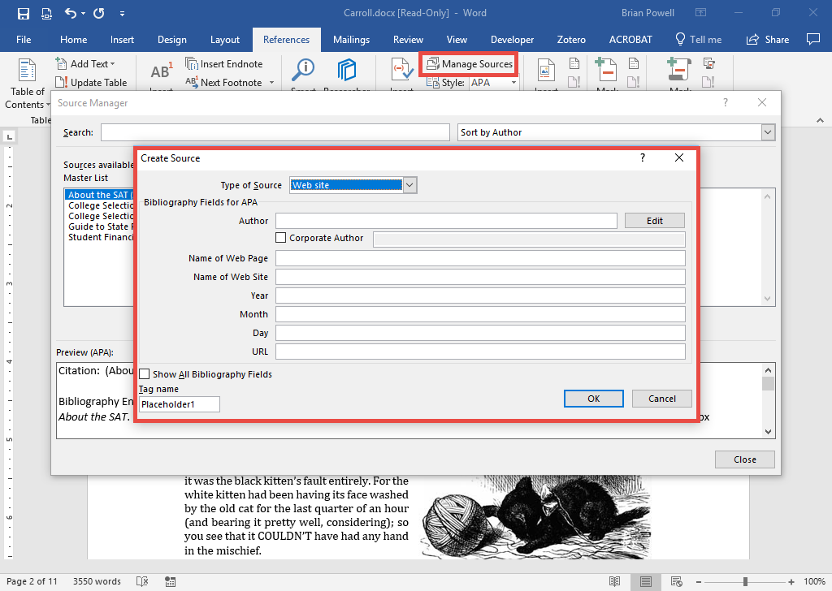
Manage Citation Sources
Word’s built-in reference tools can generate APA, MLA, and other citation types.
Go to the References ribbon.
Click the Manage Sources button.
In the Source Manager dialog box, click the New button to add a new source.
Choose the Type of Source, then specify the appropriate fields for each source. Click OK when done and repeat Steps 3-4 as needed.

Slide 9
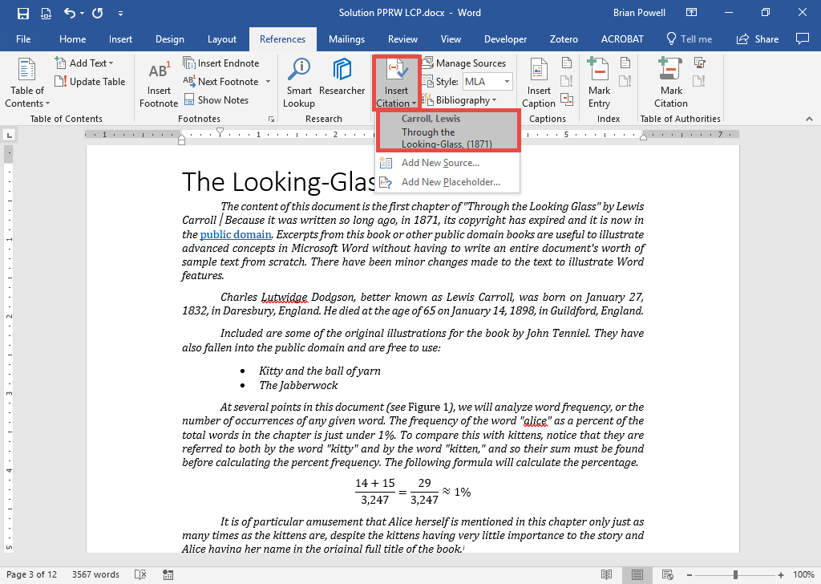
Insert citations
Position the cursor where the citation is to be added.
Go to the References ribbon.
Click the Insert Citation button and select the citation to insert.

Slide 10
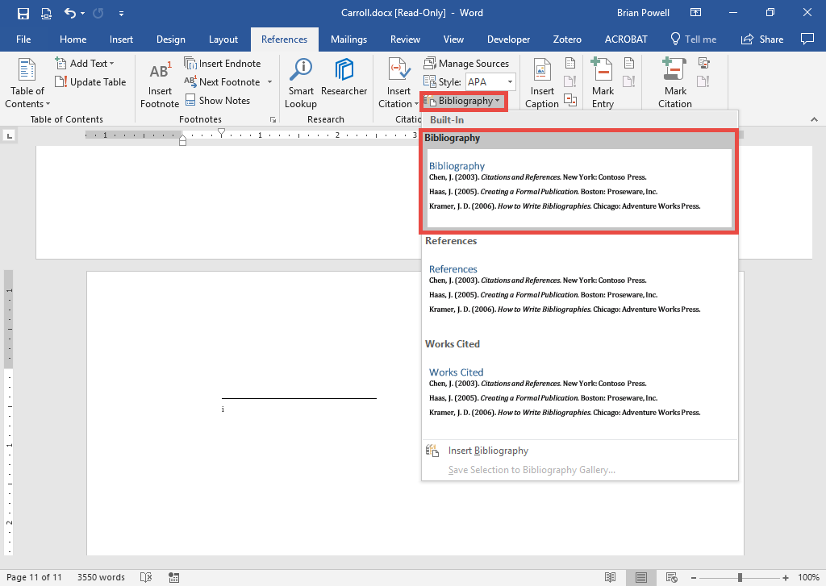
Insert a Bibliography
The bibliography displays a list of all the document’s citations.
Position the cursor where the bibliography will be added.
Go to the References ribbon.
In the Citations & Bibliography section, click the Bibliography button.
Select the type of bibliography from the list.

Slide 11
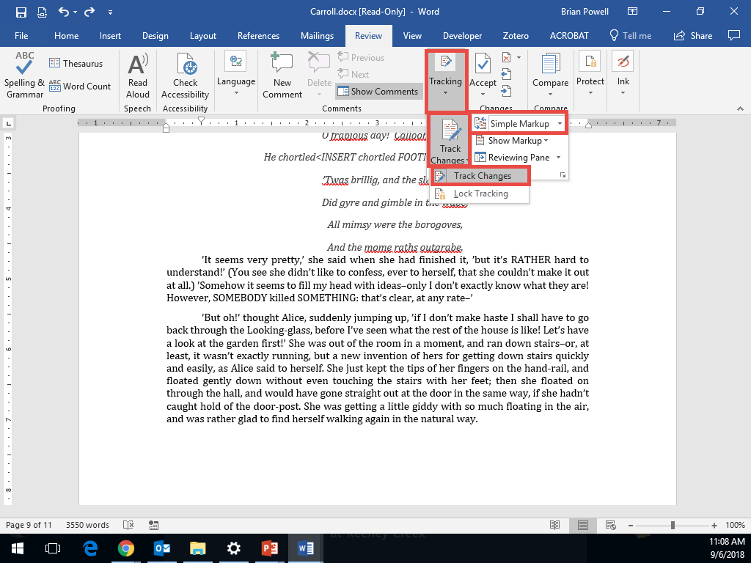
Enable Tracking of Changes
The Track Changes feature records edits made to a document. They can later be accepted or rejected.
Go to the Review ribbon.
In the Tracking section, Click the Track Changes button.
Select Track Changes from the list to start tracking. Choose what type of change markup should be displayed.
Repeat this process to later stop tracking changes.

Slide 12
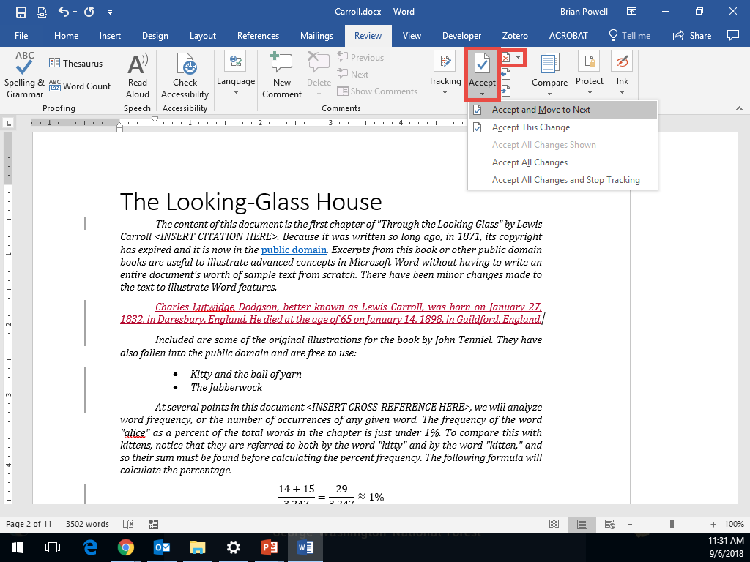
Review Tracked Changes
Reviewing changes allows users to accept or reject (undo) previously made changes.
Go to the Review ribbon.
In the Changes section, look at the Accept and Reject menu options. Users can go through changes one-by-one (Accept and Move to Next), Accept All Changes, or other choices.

Slide 13
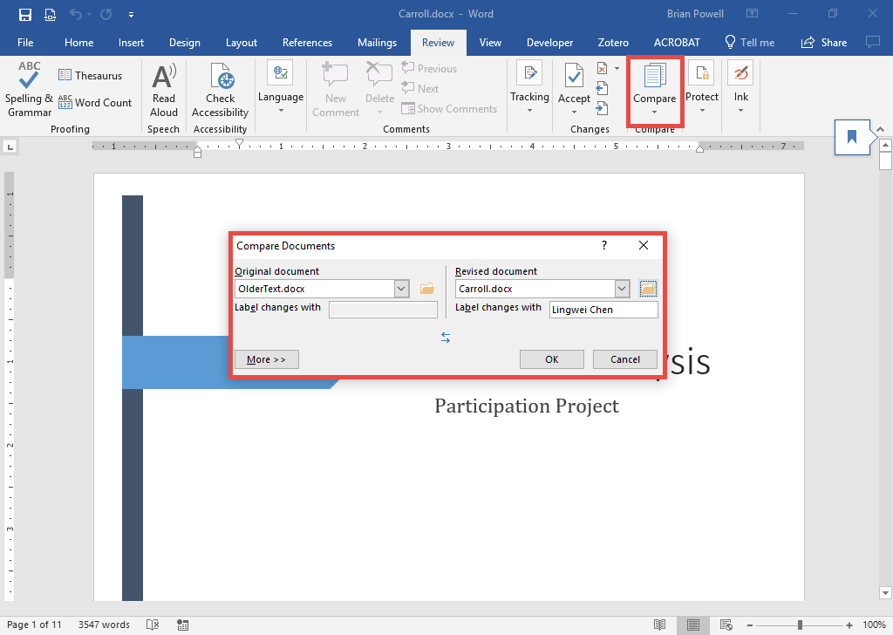
Compare Document differences
The Compare tool shows differences between two files.
Go to the Review ribbon.
On the Compare menu, choose the Compare option.
In the dialog box, choose the original and revised documents. Click OK.
A third document will be creating with legal blackline to show the changes made between the two versions.

