Slide 1
PowerPoint: Presentation Techniques
Participation Project
Lewis Carroll Problem
McAlpine Locks & Dam Problem
US 1 Problem

Slide 2
Topics Covered
Use bulleted lists
Embed online video
Add speaker notes
Rehearse timings
Hide slides
Run a slideshow

Slide 3
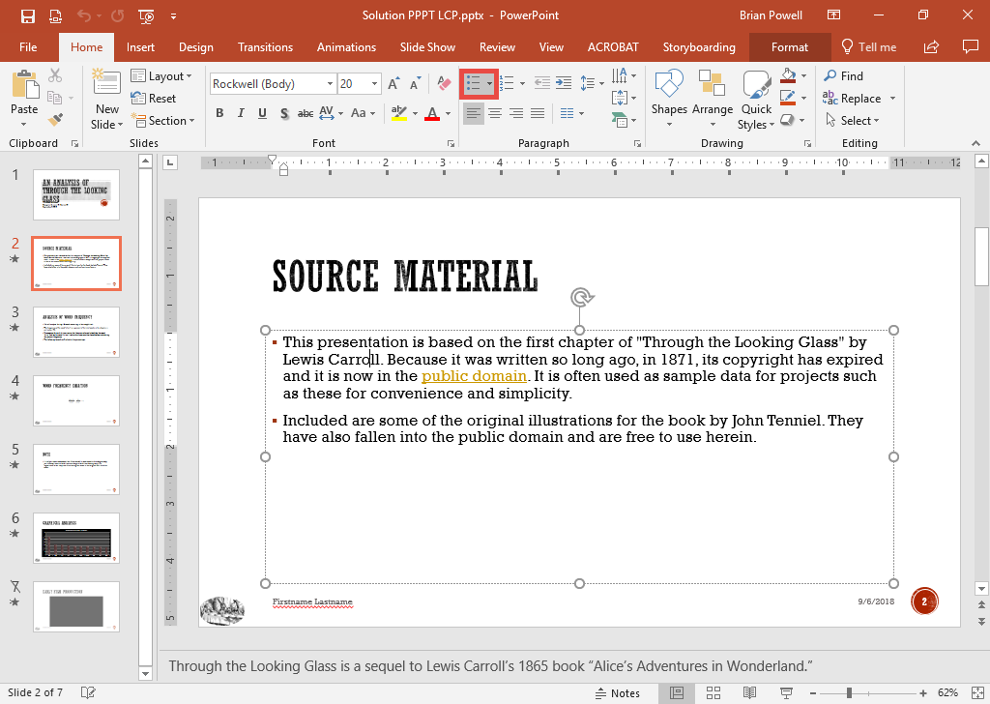
Use Bulleted Lists
Bulleted lists are the most common way of organizing slide content.
Go to the Home ribbon.
Click the Bulleted List button in the Paragraph section to add a bullet to the current paragraph.
Press the Enter key to create an additional bullet.

Slide 4
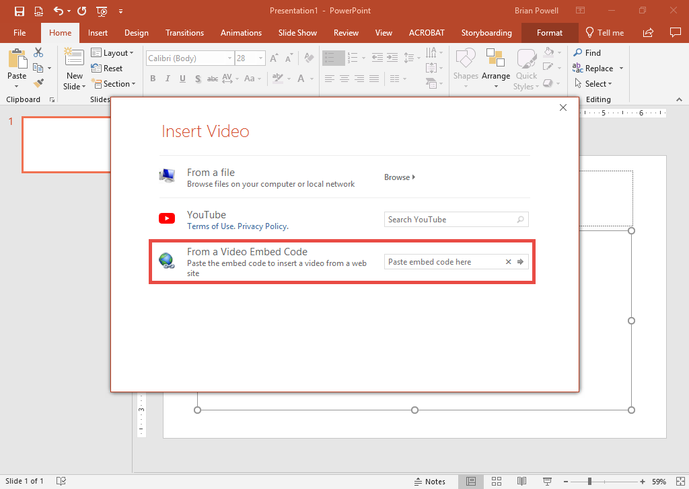
Embed online video
Embedded YouTube videos are a good way to spice up a presentation, but be careful to ensure you have Internet access when you give your presentation.
Click to select the content placeholder where the video will be embedded.
Click the Video button.
In the Insert Video dialog box, enter the embed code in Paste embed code here textbox and press Enter.

Slide 5
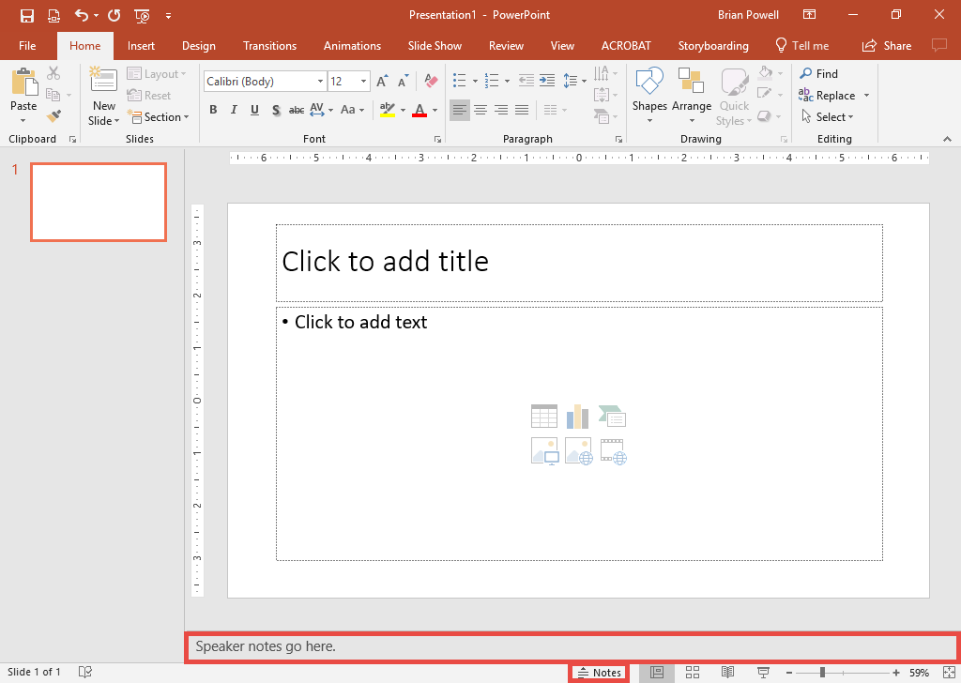
Add speaker notes
Speaker notes are comments that only you can the presenter can see. They’re a good way to remind yourself of key points to emphasize.
Open the slide where you wish to add speaker notes.
Click the Notes button at bottom of screen to display speaker notes if not already shown.
Type-in the speaker notes.

Slide 6

Rehearse Timings
The rehearse timings features allows presenters to practice how long it takes to go through each slide.
It can also be used to set slides to automatically advance.
Go to the very first slide.
Go to the Slide Show ribbon.
In the Set Up section, click the Rehearse Timings button.
Start the full-screen slide show to figure out the perfect timings for each slide.

Slide 7
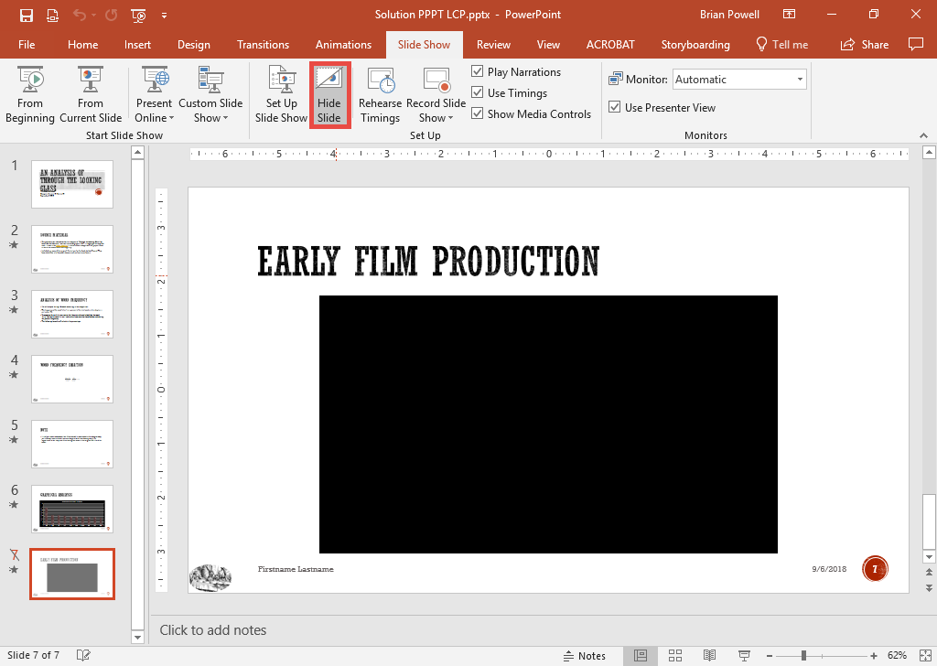
Hide slides
Slides that are not needed to be shown to the audience can be hidden instead of being deleted.
Go to the slide you wish to hide.
Go to the Slide Show ribbon.
In the Set Up section, click the Hide Slide button.

Slide 8
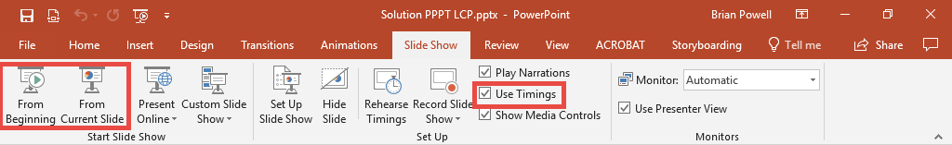
Run a slide show
Go to the Slide Show ribbon to choose option for running your slide show.
In the Set Up section, click the Use Timings checkbox depending on if you want to use timings (if set).
Click From Beginning or From Current Slide to begin your slideshow depending on the first slide you wish to show.

