Slide 1
Access: Queries I
Participation Project
WV K-12 Education Problem
WV Senate Problem

Slide 2
Topics Covered
Create a single table query
Use sorting in a query
Use multiple tables in a query
Sort on multiple fields
Use a SQL SELECT query

Slide 3
Queries
Input table
Queries display information from one or more database tables.
Queries are the key element of relational databases. If you didn’t have queries, there wouldn’t be a reason to use a database.
Bob | $100,000
Sally | $100,000
Fred | $200,000
Jane | $300,000
Query:
“Show me people who make $100,000”
Results
Bob
Sally

Slide 4
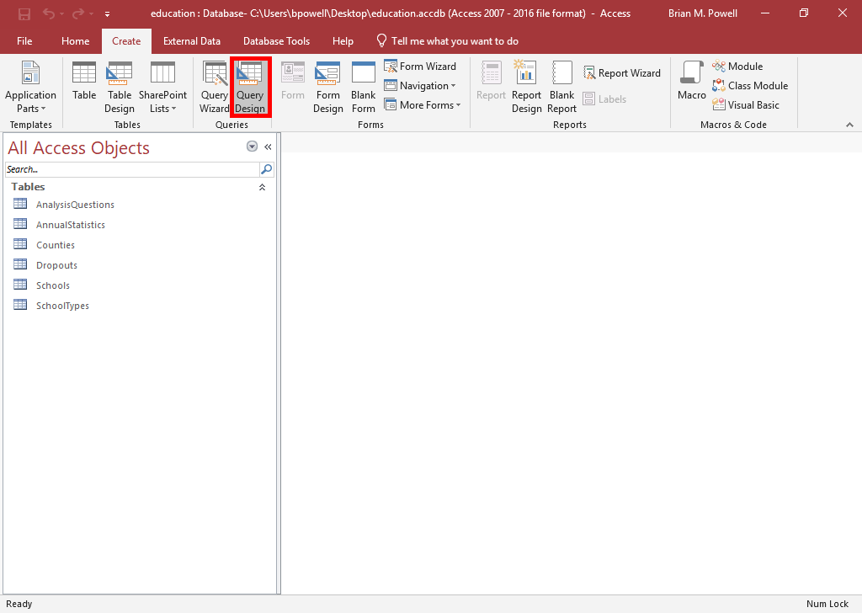
Create a Single-Table Query:
Part 1
The simplest queries retrieve records from a single table.
Go to the Create ribbon.
In the Queries group, click the Query Design button.
  Query Wizard is very basic and not recommended

Slide 5
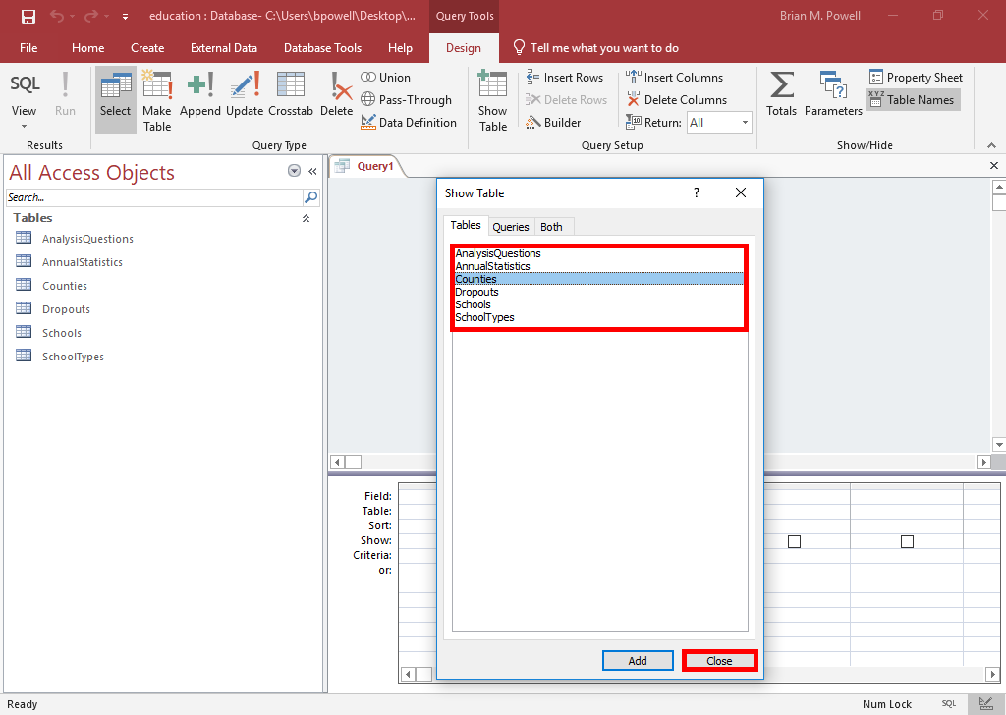
Create a Single-Table Query:
Part 2
In the Show Table dialog box, double-click on the table(s) containing the fields you will use in this query.
  Only include:
    The tables with the fields you need to display, set criteria on, or sort by
    The other tables needed so there are relationship lines connecting all of the tables you have added
  Don’t add unnecessary tables.
Click Close when done.

Slide 6
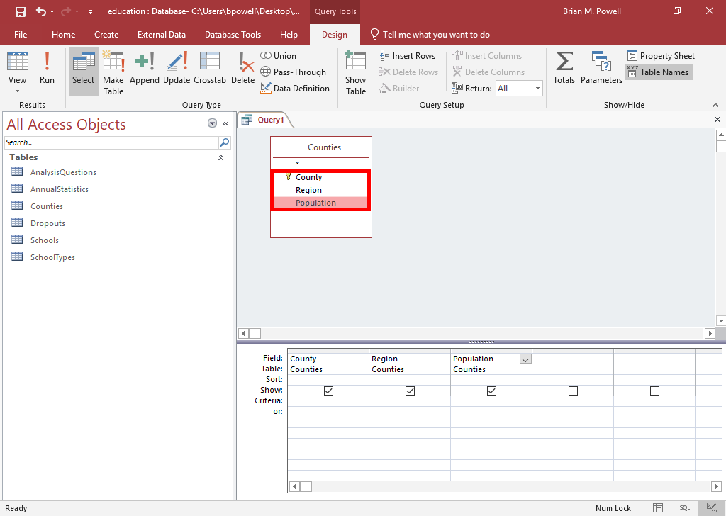
Create a Single-Table Query: part 3
In the table(s) at the top of the query, double-click on the names of the field(s) you wish to display, sort by, or set criteria on.
  Added fields will show in the query grid at the bottom
  You can drag to reorder fields if needed

Slide 7
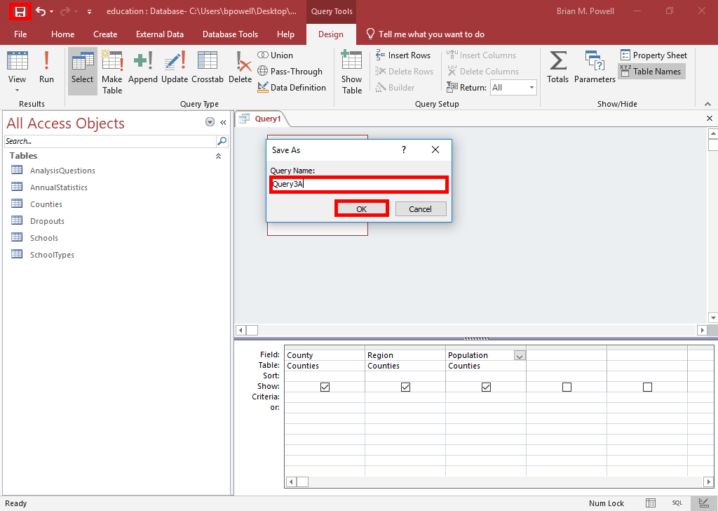
Create a Single-Table Query:
Part 4
Once you have finished building your query, click the Save button on the Quick Access Toolbar.
Give your query a descriptive name when prompted.
  For CS101 assignments, name the query after the step in which it appears like Query3A
Click the OK button to save.

Slide 8
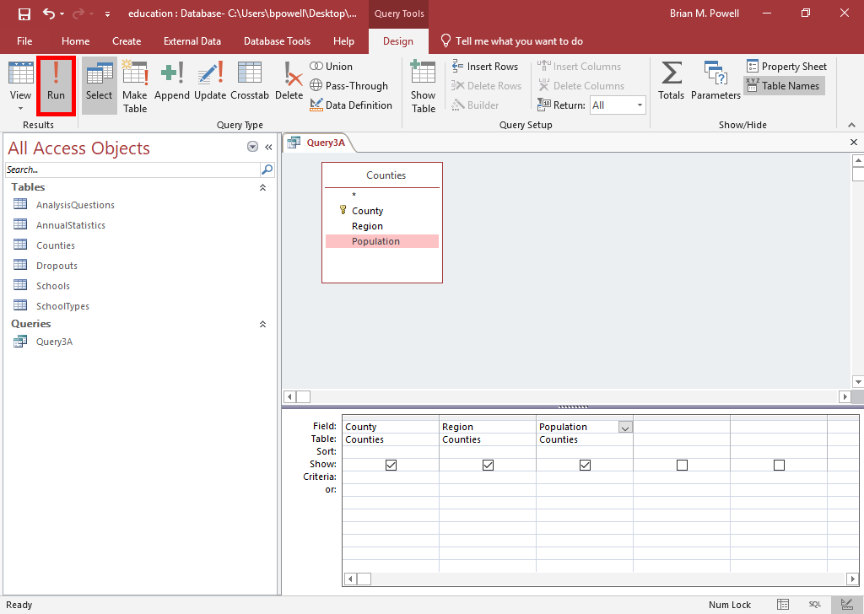
Create a Single-Table Query: part 5
Go to the Table Tools Design ribbon.
Click the Run button to run your query.

Slide 9
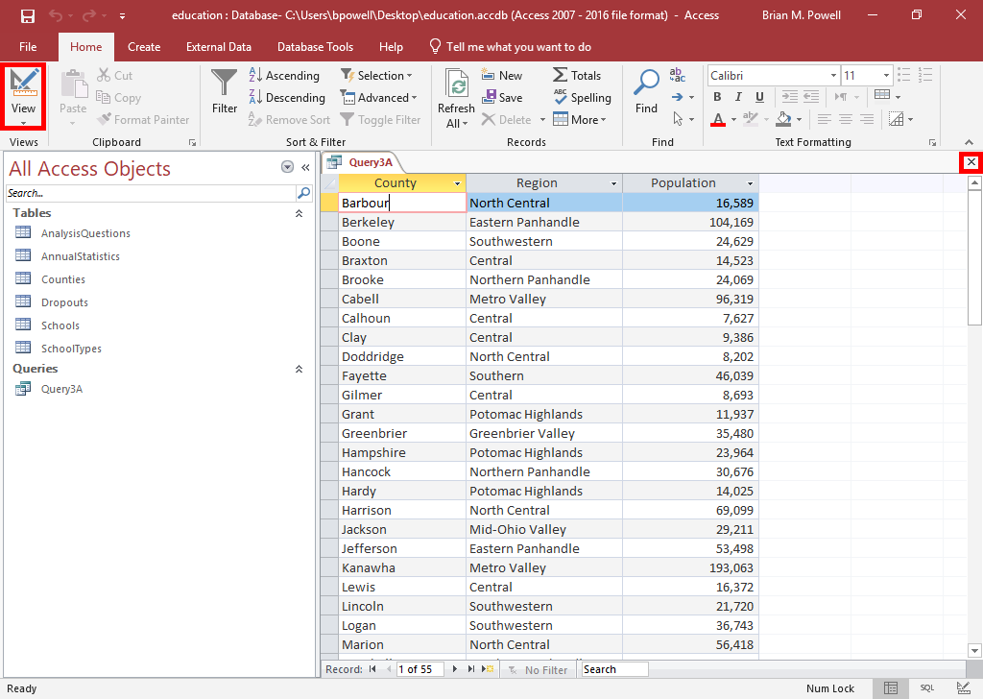
Create a Single-Table Query: part 7
Look at the results to ensure they appear correct.
  CS101 assignments will generally list the number of records and fields that should be shown
  If the results look OK, click the X button to close the query.
  Otherwise, click Query Design button to edit the query further.

Slide 10
SorTing
Query results can be sorted in ascending (alphabetical/smallest to largest) or descending (reverse alphabetical/largest to smallest order).
When results are sorted by multiple fields, Access sorts the fields in order from left to right.
  You can drag the fields around to reorder them to the desired sort order
  You can also turn off the Show option and add multiple instances of fields if you need fields to be displayed in a different order than they are sorted

Slide 11
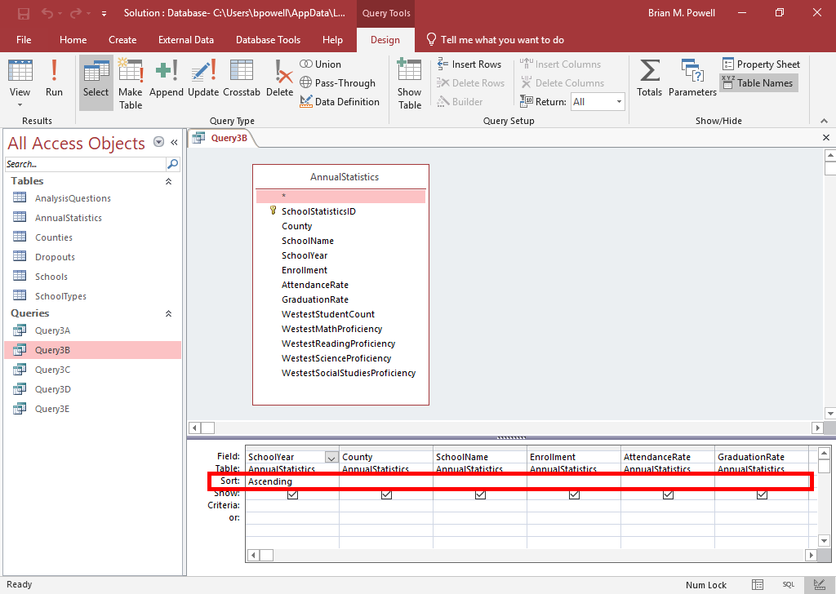
Sort Query Results:
Part 1
Open the query in Design View.
In the Sort row of the query grid, select the Ascending or Descending options for the fields to be sorted. Leave this field blank for fields not to be sorted.
If multiple fields are being sorted, drag the fields to reorder them so the fields being sorted first appear further to the left.

Slide 12
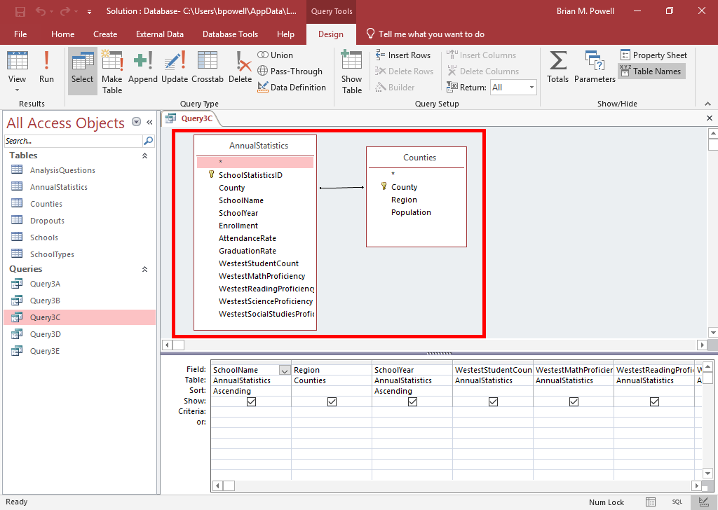
Use Multiple Tables in a Query
Creating queries with multiple tables is nearly identical to creating single-table queries.
  Difference is adding multiple tables rather than a single one in Show Table dialog box
Be sure to define your relationships before creating a multi-table query. Relationships added after won’t be reflected in the query.
There should be relationship (join) lines connecting all of the tables shown in the query.

Slide 13
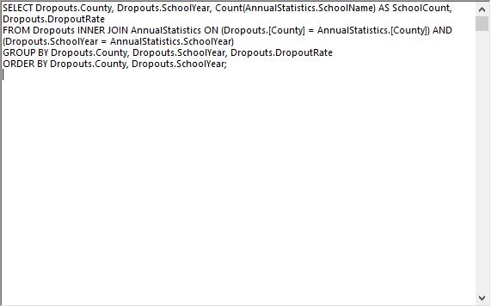
SQL Select Queries
Structured Query Language (SQL) is the language used to write database queries.
Access uses SQL SELECT queries behind the scenes to retrieve your data. Design View is a graphical layer to make things easier to use.
Sometimes, you may wish to write SQL yourself for complex queries.

Slide 14
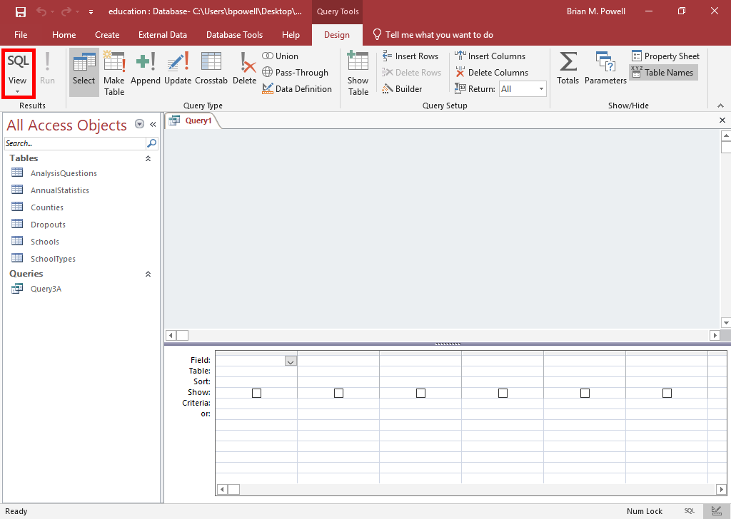
Use a SQL Select Query:
Part 1
Go to the Create ribbon.
Click the Query Design button.
Click Close on the Show table dialog box.
Go to the Table Tools Design ribbon.
Click the SQL View button.

Slide 15
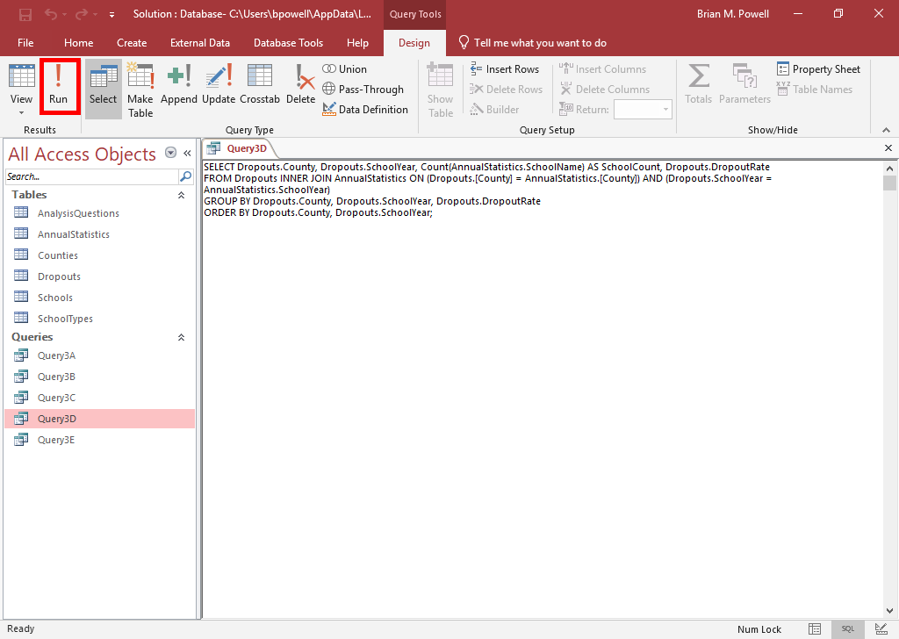
Use a SQL Select Query:
Part 2
Write or copy-and-paste your SQL query.
Once you have finished building your query, click the Save button on the Quick Access Toolbar.
Give your query a descriptive name when prompted.
Click the OK button to save.
Go to the Query Tools Design ribbon.
Click Run to run the query.

