Slide 1
Access: Queries III
Participation Project
WV K-12 Education Problem
WV Senate Problem

Slide 2
Topics Covered
Use grouping in a query
Use IIF function in a calculated field
Set criteria on fields not displayed in query results
Use an outer join in a query

Slide 3
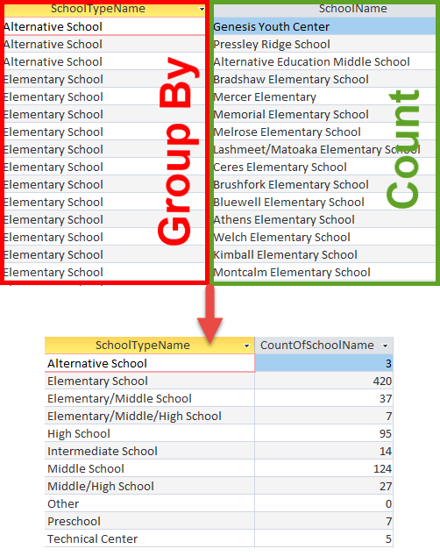
Grouping:
Part 1
Grouping (Totals option in Access) summarizes values in a database.
  Finds averages, sums (totals), minimums, maximums, and other measures
Records are collected into sets for each combination of the grouped fields, then the statistics are calculated for each set.
  For example, we can find out how many schools are of a particular type using the Count option

Slide 4
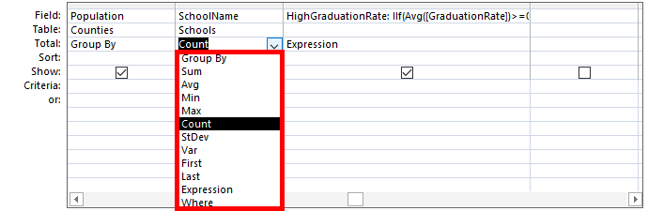
Grouping:
Part 2
The following total row grouping functions are available:
  Sum: Adds the items in the column
  Avg: Calculates average value of column
  Min: Shows item with the lowest value
  Max: Shows item with the highest value
  Count: Counts the number of items in column
  StDev: Calculates standard deviation
  Var: Calculates variance
  First: Shows value of first record
  Last: Shows value of last record
  Expression: Used with a formula or IIF()
  Where: Used when column is not shown

Slide 5
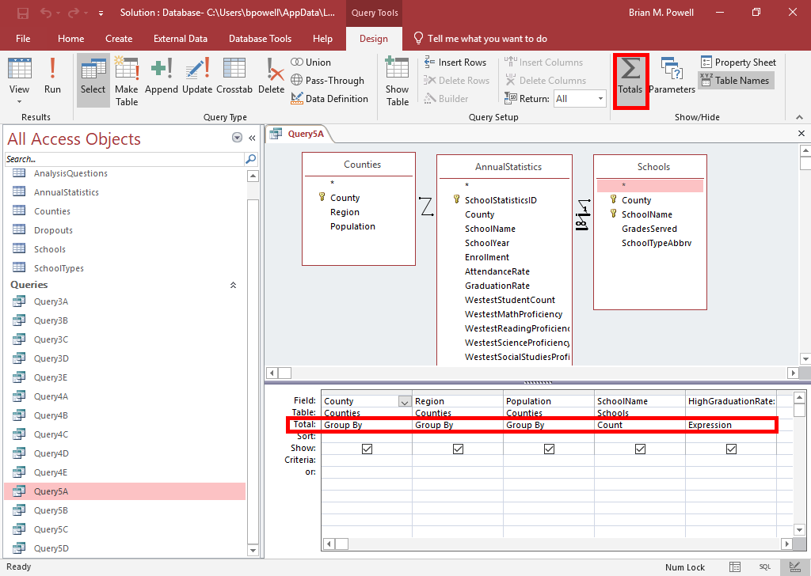
Use Grouping in a query
Open the query in Design View.
Go to the Table Tools Design ribbon.
In the Show/Hide section, click the Totals button.
Go to the new Total row in the design grid and choose the desired grouping function.
  Use Group By for fields that will define the groups
  Choose calculated function for statistics on other fields

Slide 6
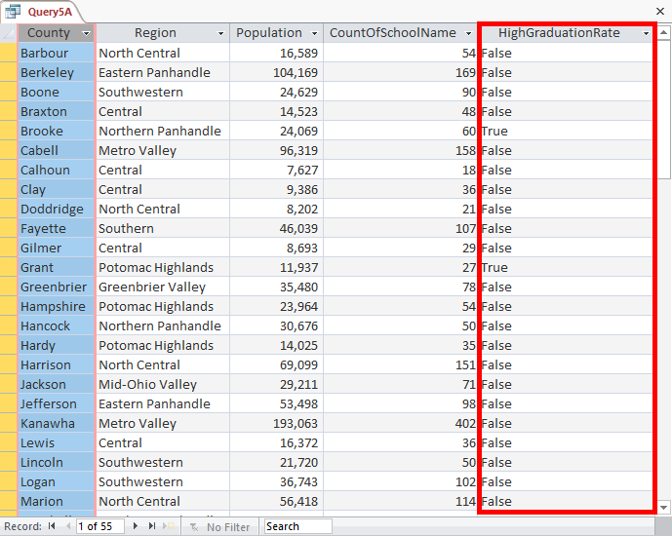
IIF Function
The IIF() function creates conditional output.
  Similar to an IF() function in Excel
  Evaluates an expression and displays one value when expression is true and another value when false
  Three parts: question, what to do if yes, what to do if no
Syntax:
IIf(«expression», «truepart», «falsepart»)

Slide 7
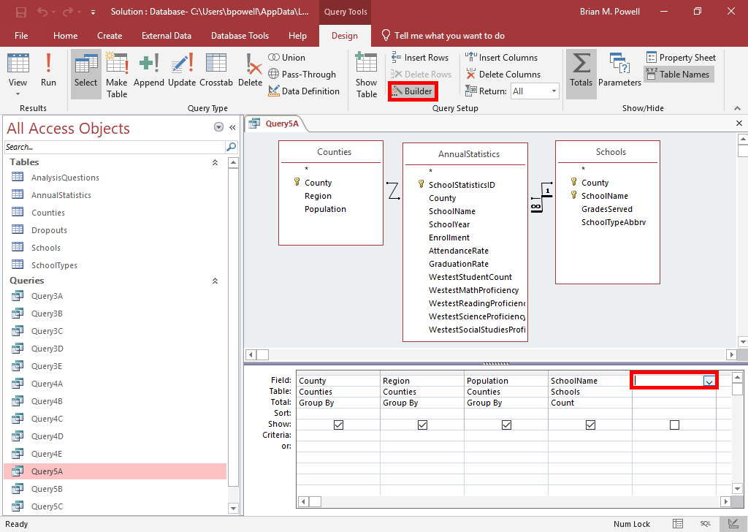
Use IIF Function in a Calculated field:
Part 1
Open the query in Design View.
Click in an empty column.
Go to the Query Tools Design ribbon.
Click the Builder button.

Slide 8
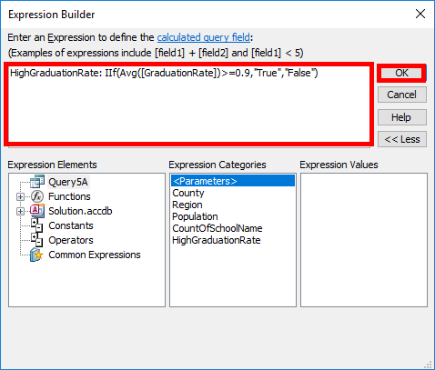
Use IIF Function in a Calculated field:
Part 2
In the Expression box, enter
ColumnName:, substituting what you wish to name the column.
Then, enter IIf(«expression», «truepart», «falsepart») and substitute values as appropriate.
  Using the Expression Elements items near the bottom of the dialog box can help avoid spelling errors when referencing fields
Click the OK button when done.

Slide 9
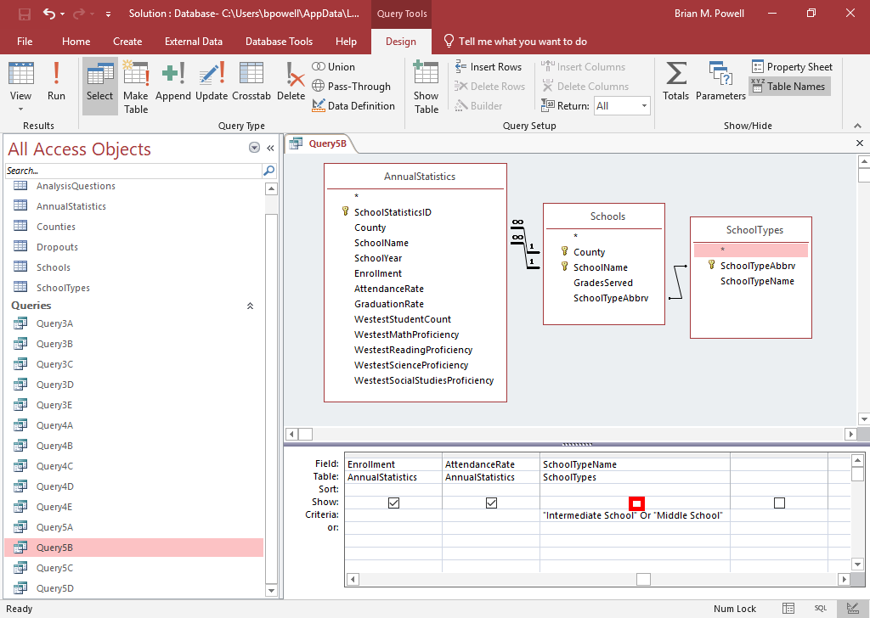
Hide Display of Fields
In order to sort by a field or use it in criteria, we must add it to the query’s field grid.
We can hide (un-show) a field if we do not wants its values to display in the results when the query is run.
To hide a view, uncheck its Show checkbox.

Slide 10
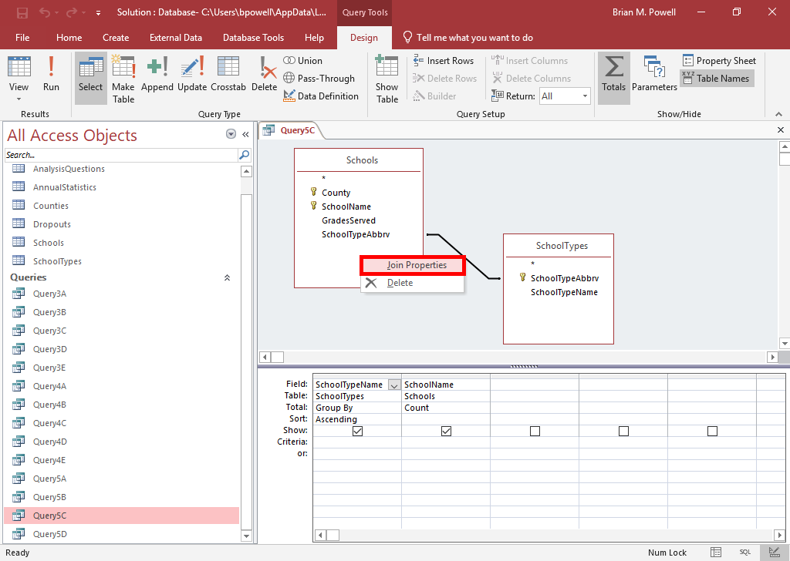
Use An Outer Join in a query:
Part 1
By default, queries only display records from related tables when there are matching records in both tables.
In some cases, you might want to display results with matching records and missing values. This is called an outer join.
With the query open in Design View, right-click on the join line for the relationship that needs modified.
Select Join Properties from the menu.

Slide 11
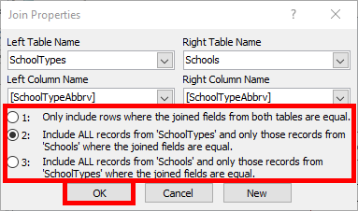
Use An Outer Join in a query:
Part 2
In the Join Properties dialog box, select the option corresponding with the results you wish to display.
  Option #1 is an inner join, where there must be corresponding values in each table for the record to display
  Options #2 and #3 are outer joins, where the results from one table call be missing or null
  Access does not support full outer joins, where results can either table can be missing or null
Click the OK button when done.

Slide 12
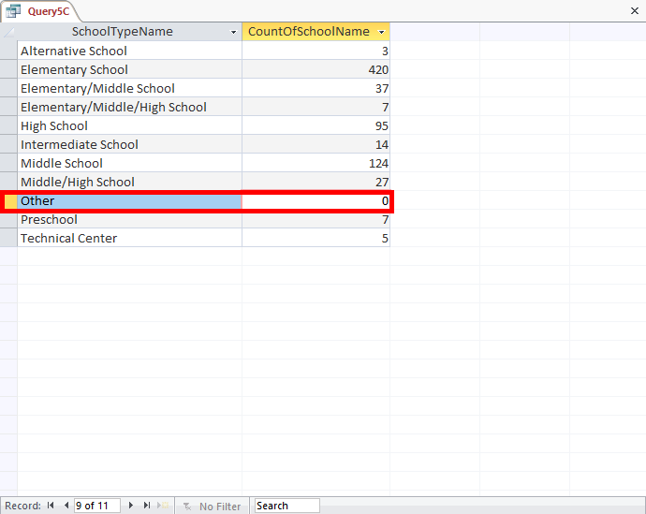
Use An Outer Join in a query:
Part 3
When the query is run, you may see missing or null values.
In the example to the right, there are no “other” type schools so the county of that school type is 0. If we had not set to display all SchoolTypes records, the “Other” type wouldn’t have been shown at all.

