Slide 1
Access: Forms
Participation Project
WV K-12 Education Problem
WV Senate Problem

Slide 2
Topics Covered
Create a form using the Form tool
Create a form using the Form Wizard

Slide 3
Forms
Forms can provided a customized way of editing data in the database instead of using Datasheet View.
Forms can interact with multiple tables at the same time.
While forms can be manually created, it’s easier to use the Form Tool or Form Wizard to make them.

Slide 4
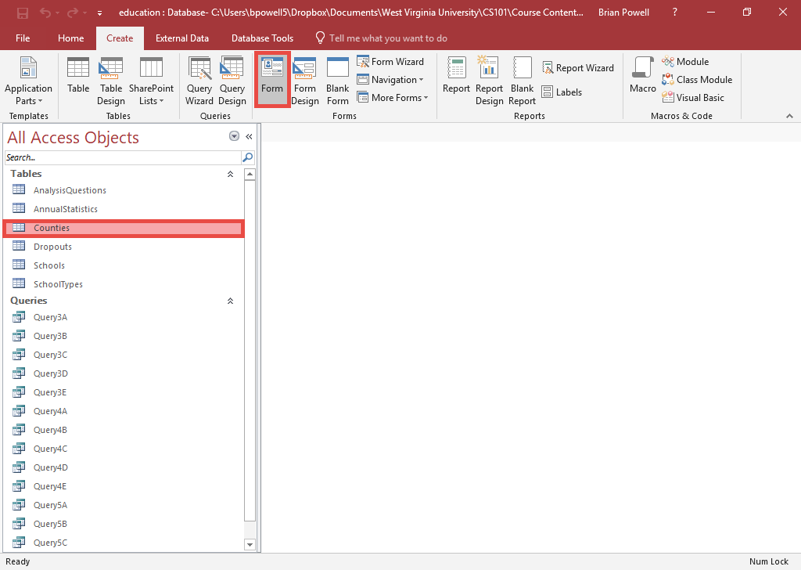
Create a Form using the Form Tool
The Form Tool is a one-click way to create a basic form.
Select the table you wish to use to create the form.
Open the Create ribbon.
In the Forms section, click the Form button.

Slide 5
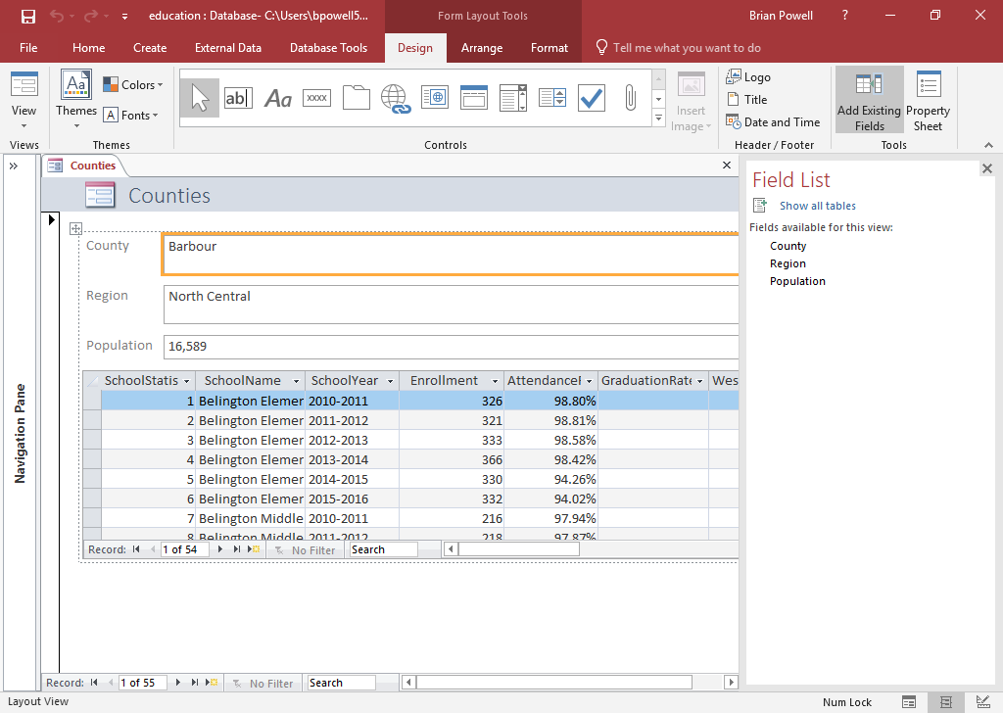
FoRM Layout View
After you create a form, it will open in Layout View.
From here, you can edit:
  Field labels
  Field fonts, background colors
  Field text box sizes

Slide 6
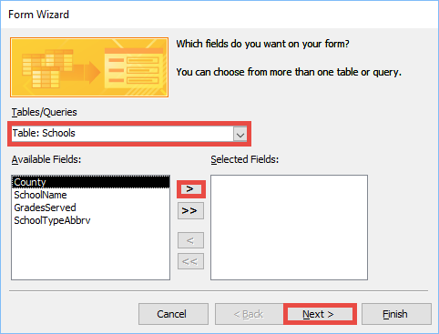
Create a Form using the Form Wizard:
Part 1
The Form Wizard provides a customizable way to create forms.
Go to the Create ribbon.
In the Forms section, click the Form Wizard button.
In the Form Wizard, go to the Tables/Queries dialog box and select the table or query to use in the form.
Click the > button to move the fields to show in the form to the Selected Fields box.
Repeat Steps 3-4 if you must add fields from multiple tables or queries.
Click the Next button.

Slide 7
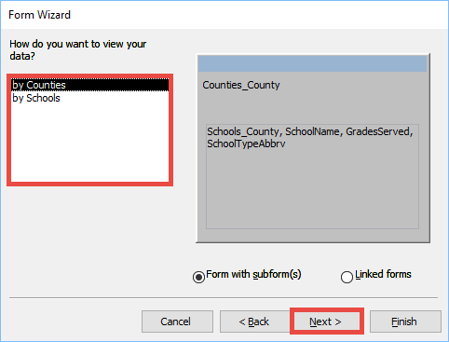
Create a Form using the Form Wizard:
Part 2
If you selected fields from multiple tables or queries, you will be asked how to view the data.
  In most cases, Form with subform(s) is preferred.
  Look at the option previews to see how each looks.
  Click the Next button when done.

Slide 8
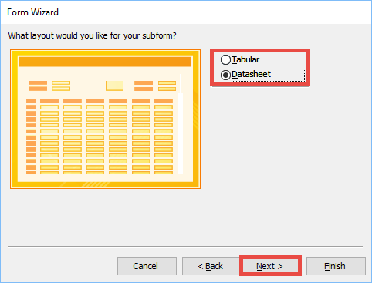
Create a Form using the Form Wizard:
Part 3
Select how the form will be organized. Options may vary depending on the fields selected:
  Columnar (one record)
  Tabular (multiple records)
  Datasheet
  Justified (one record)
Click the Next button.

Slide 9
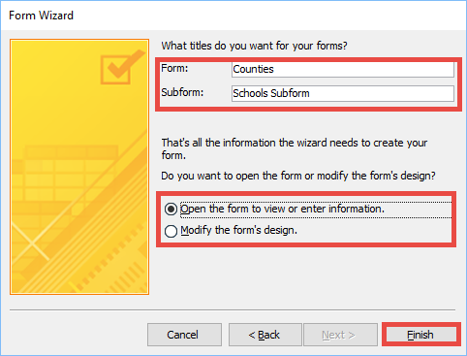
Create a Form using the Form Wizard:
Part 4
Enter the title(s) of the form and subform in the boxes.
Select whether you wish to open the form or modify its design.
Click the Finish button.

Slide 10
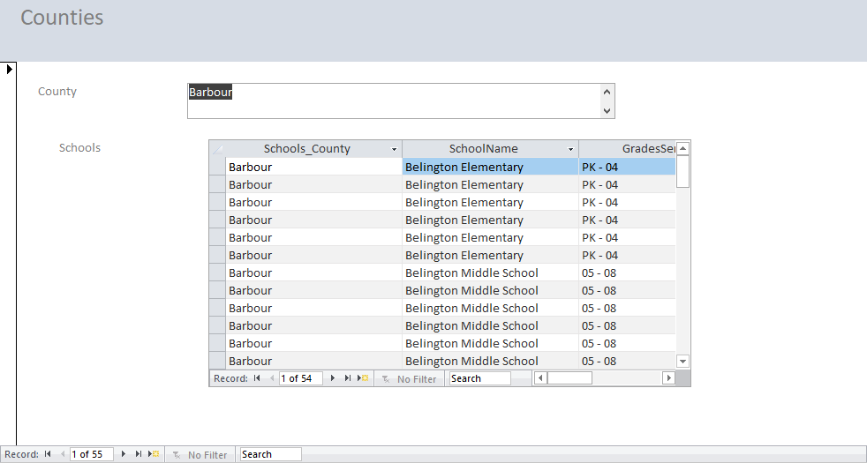
Create a Form using the Form Wizard:
Part 5
Your created form should look similar to the one of the right.
You can change to Layout View to edit the form.

