Slide 1
Access: Reports
Participation Project
WV K-12 Education Problem
WV Senate Problem

Slide 2
Topics Covered
Create a report using the Report tool
Modify report fields
Create a report using the Report Wizard

Slide 3
Reports
Reports provide a formatted view of the data in the database.
Reports can be based on table contents or query results.
While reports can be manually created, it’s easier to use the Report Tool or Report Wizard to make them.

Slide 4
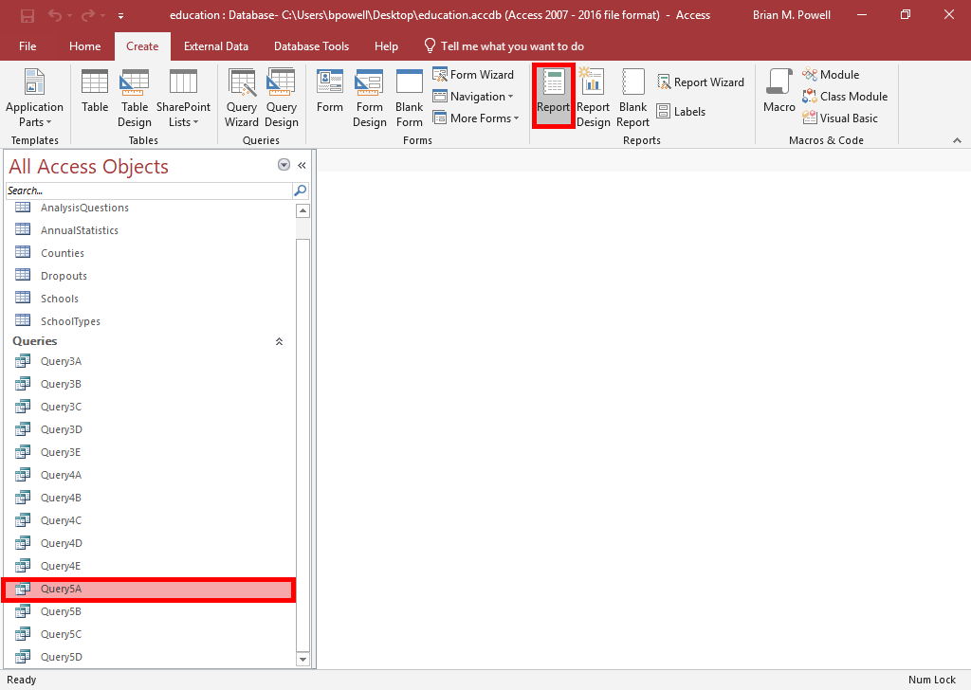
Create a report Using the report Tool
The Report Tool is a one-click way to create a basic report.
Select the table or query you wish to use to create the report.
Go to the Create ribbon.
In the Reports section, click the Report button.

Slide 5
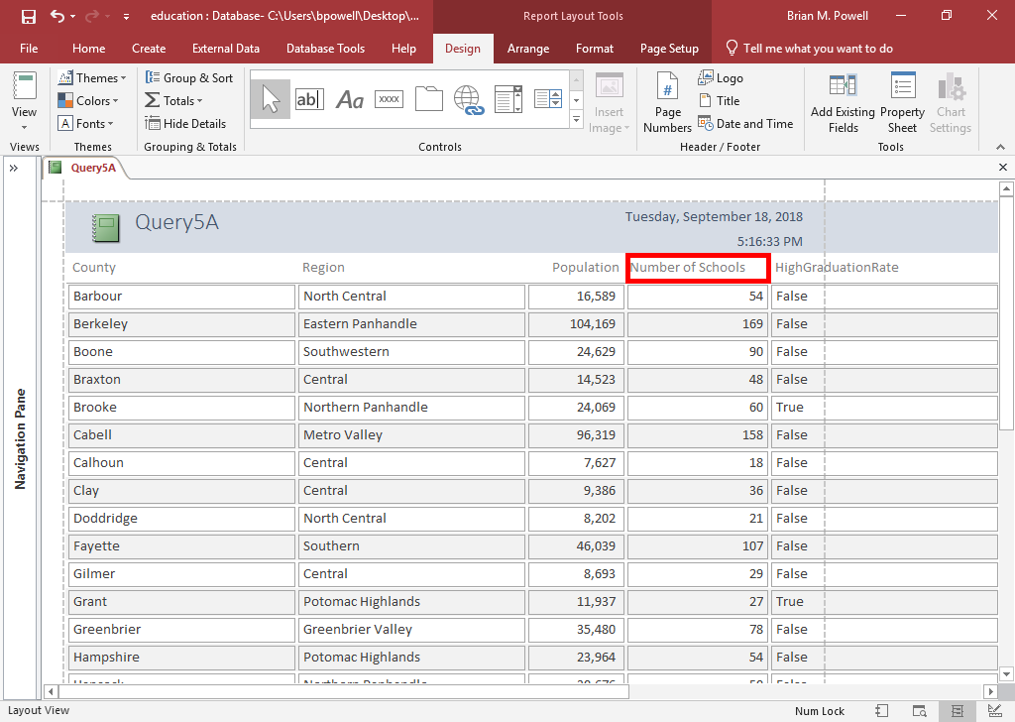
Renaming Column headings
By default, the column headings will be the field names from the original table or query.
These might not be the most logical name.
To rename a heading, double-click on the column heading.
Inside the highlighted box, type a new name for the field.

Slide 6
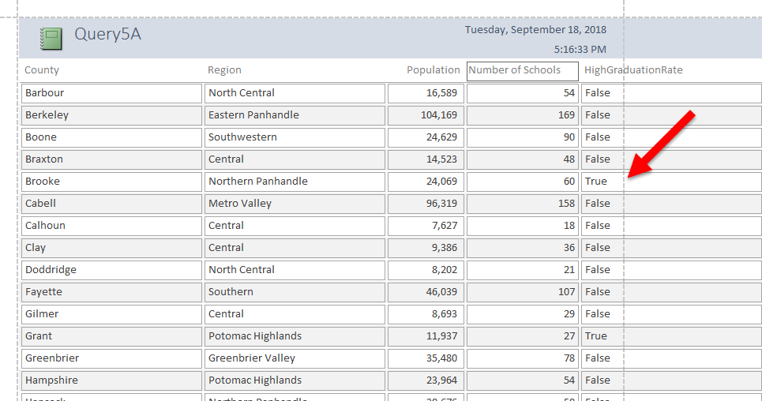
Report Page Width
When viewing the report in Layout View, you will see light gray dotted lines indicating the edge of the page when printed.
You will want to make sure all of your report fields fit within the page.
Resizing fields can fix problems with not fitting on the page.

Slide 7
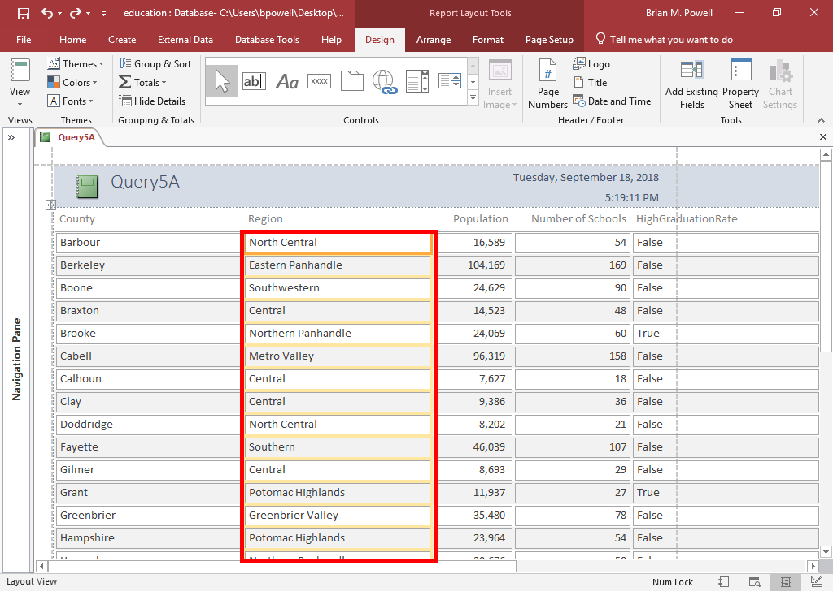
REsize field widths
Click within the column you wish to resize.
Bring your mouse pointer to the left or right edge of the column until your pointer becomes a double arrow.
Click and drag until the column is the desired width.
  Be sure both the heading and column are resized.

Slide 8
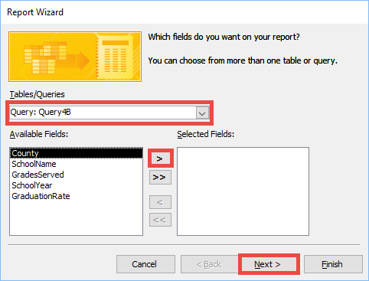
Create a Report using the Report wizard: Part 1
The Report Wizard provides a customizable way to create reports.
Go to the Create ribbon.
In the Reports section, click the Report Wizard button.
In the Report Wizard, go to the Tables/Queries dialog box and select the table or query to use in the report.
Click the > button to move the fields to show in the report to the Selected Fields box.
Repeat Steps 3-4 if you must add fields from multiple tables or queries.
Click the Next button.

Slide 9
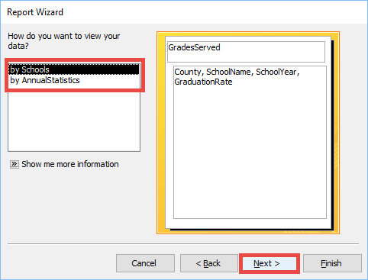
Create a Report using the Report wizard: Part 2
If your report includes fields from more than one table, Access gives you options about how you want to group your data.
  Select the option that is how you want to organize your report.
  Click the Next button.

Slide 10
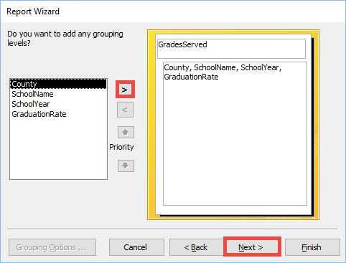
Create a Report using the Report wizard: Part 3
Adding grouping levels allows you to refine your report to group records.
  If you need to perform more grouping, add those grouping levels to the report by clicking the > button.
  Click the Next button when done.

Slide 11
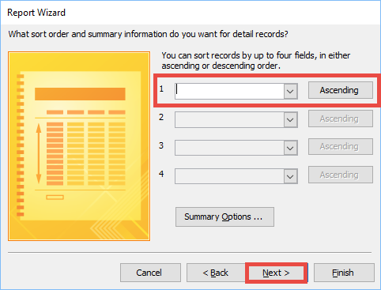
Create a Report using the Report wizard: Part 4
Specify how to sort the report data.
  In the first box, select which field you would like to sort first.
  By default, fields will be sorted in ascending order. To change to descending order, click on the box that has the word Ascending.
  Repeat this process to sort by multiple fields.
  Click the Next button when done.

Slide 12
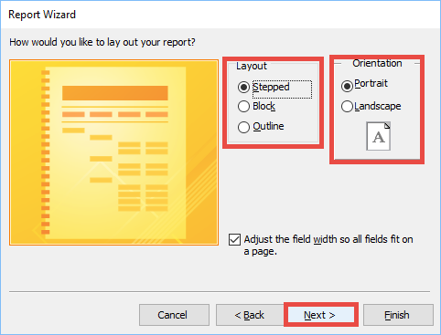
Create a Report using the Report wizard: Part 5
Select the layout for your report.
Select the orientation for your report.
Click the Next button.

Slide 13
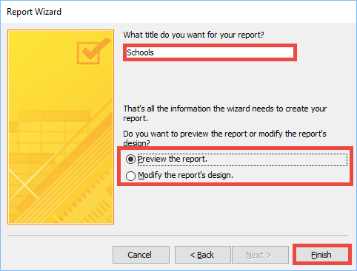
Create a Report using the Report wizard: Part 6
Enter the title of the report in the box.
Select whether you wish to preview the report or modify its design.
Click the Finish button.

Slide 14
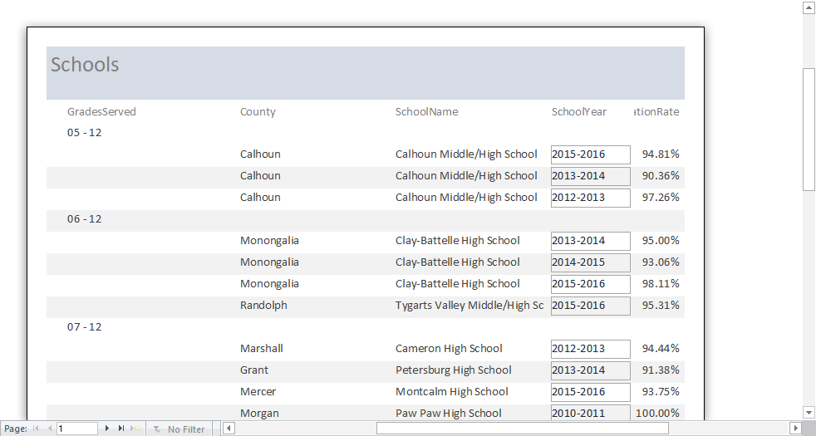
Create a Report using the Report wizard: Part 7
Your created report should look similar to the one on the right.
If needed, click the Layout View button to modify the report.

