Slide 1
Access: SQL
Participation Project
WV K-12 Education Problem
WV Senate Problem

Slide 2
Topics Covered
Create a SELECT query to retrieve data
Use a DISTINCT clause to remove duplicate results
Use an ORDER BY clause to sort query results
Use a JOIN clause to include results from multiple tables
Use a GROUP BY clause to calculate statistics
Use a WHERE clause to specify criteria
Create an INSERT query to add data
Create an UPDATE query to modify data
Create a DELETE query to remove data

Slide 3
What is SQL?
Structured Query Language (SQL) is a specialized language for updating, deleting, and requesting information from databases.
A variety of established database products support SQL, including Microsoft Access. It is widely used in both industry and academia, often for enormous, complex databases.

Slide 4
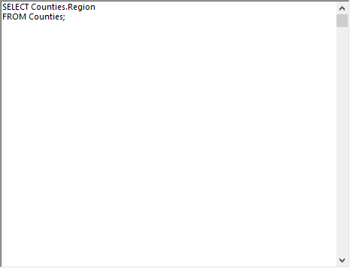
Create a SELECT query to retrieve data
The SELECT statement is used to select data from a database.
Syntax:
SELECT Field1, Field2
FROM Table1;
Notes:
In the example, we are displaying the Region field from the Counties table.

Slide 5
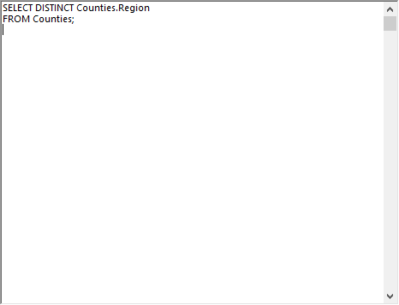
Use a DISTINCT clause to Remove Duplicate Results
The SELECT DISTINCT statement is used to return only distinct (unique) values not already shown.
Syntax:
SELECT DISTINCT Field1,
Field2 FROM Table1;
Notes:
In the example, we are displaying unique Regions from the Counties table. Each region will only be listed once, no matter how many counties are in that region.

Slide 6
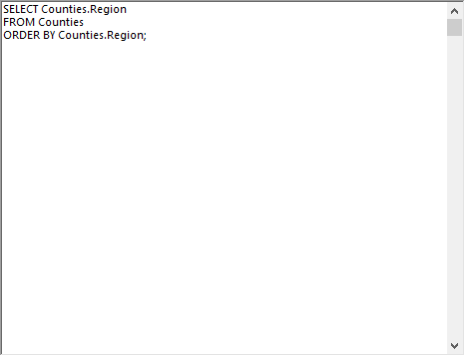
Use an ORDER BY clause to sort query results
The ORDER BY keyword sorts results in ascending (ASC) or descending (DESC) order.
Syntax:
SELECT Field1, Field2
FROM Table1
ORDER BY Field1 ASC, Field2 DESC;
Ascending sort order is used unless DESC is specified.
Notes:
In this example, the names of the regions are going to be sorted in ascending order (the default choice) since the sort order ASC or DESC isn’t explicitly specified.

Slide 7
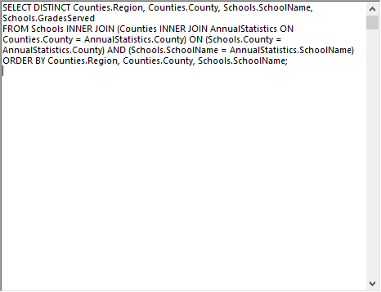
Use a JOIN clause to include results from multiple tables
An INNER JOIN clause is used to combine rows from two or more tables, based on a related column between them.
Syntax:
SELECT Table1.Field1, Table2.Field2
FROM Table1
INNER JOIN Table2
ON Table1.RelatedField = Table2.RelatedField;
RelatedField is the common field used to join Table1 and Table2.

Slide 8
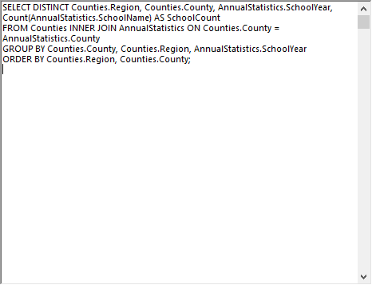
Use a GROUP BY clause to calculate statistics
The GROUP BY statement is used with aggregate functions (COUNT, MAX, MIN, SUM, AVG) to group results by one or more fields.
Syntax:
SELECT Field1, COUNT(Field2)
FROM Table1
GROUP BYField1;
Fields not being calculated must be listed in the GROUP BY clause.

Slide 9
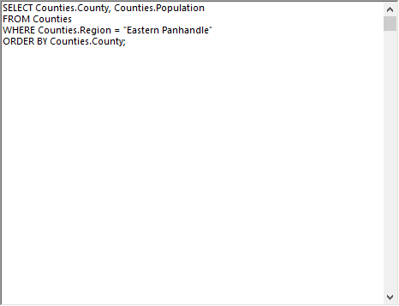
Use a WHERE clause to specify criteria
The WHERE clause is filter results. Only records meeting the criteria are shown.
Syntax:
SELECT Field1
FROM Table1
WHERE Field1 = "Value";
Notes:
In this example, only records for counties located in the Eastern Panhandle region will be shown.

Slide 10
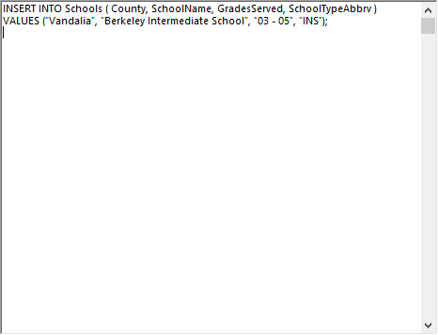
Create an INSERT query to add data
The INSERT statement is used to add new records to a table.
Syntax:
INSERT INTO Table1 (Field1, Field2)
VALUES ("Field1Value", "Field2Value");
Notes:
The example will add a record for Berkeley Intermedia School in Vandalia County.

Slide 11
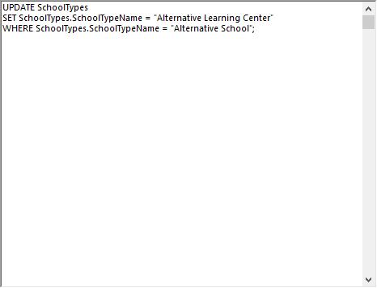
Create an UPDATE query to modify data
UPDATE statements are used to modify existing records in a table.
It’s critical to specify a WHERE clause or all records will be change.
Syntax:
UPDATE Table1
SET Field1=“NewValue"
WHERE Field1="OldValue";
Notes:
In the example, the school type “Alternative School” will be changed to “Alternative Learning Center”.

Slide 12
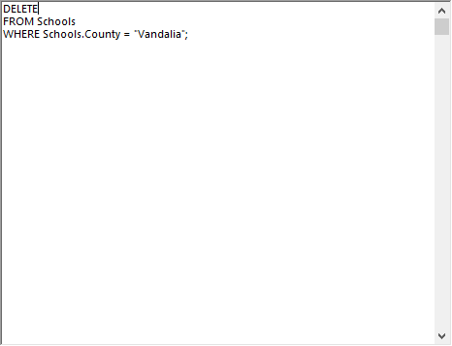
Create a DELETE query to remove data
DELETE statements are used to remove existing records from a table.
It’s critical to specify a WHERE clause or all records will be deleted.
Syntax:
DELETE
FROM Table1
WHERE Field1="Value";
Notes:
In the example, all schools from Vandalia County will be deleted from the Schools table.

