Slide 1
Word: Styles & Illustrations
Participation Project
Lewis Carroll Problem
McAlpine Locks & Dam Problem
US 1 Problem

Slide 2
Topics Covered
Insert text from a file
Apply formatting styles
Modify formatting styles
Format spacing, alignment, and indentation
Adjust font settings
Insert pictures
Insert hyperlinks
Use the Equation Editor
Insert Excel charts

Slide 3
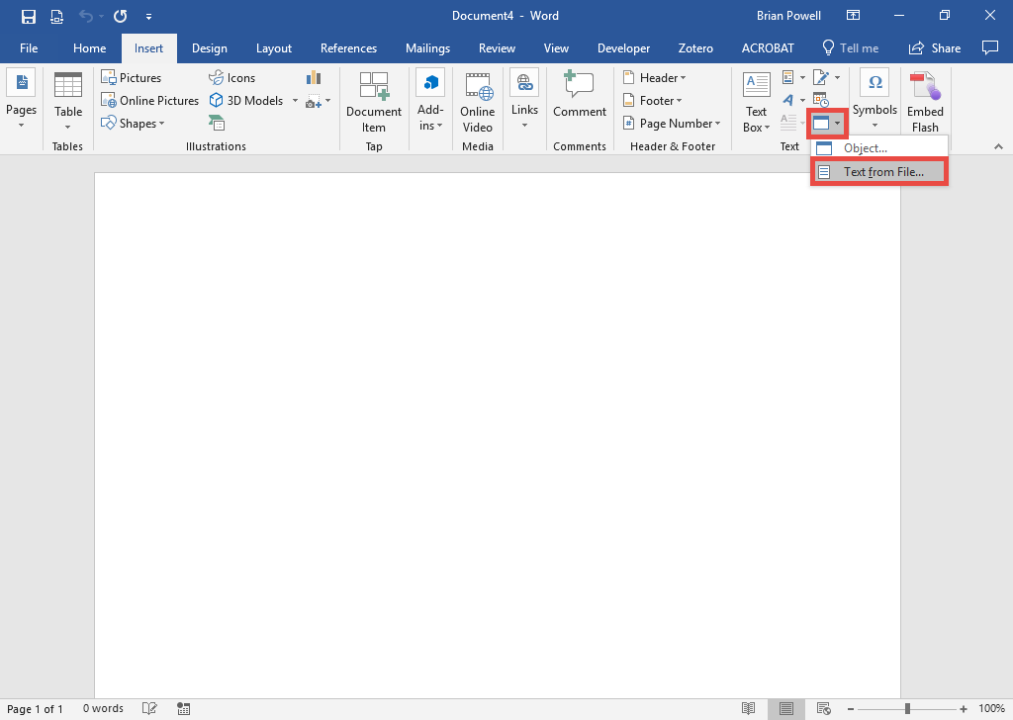
Insert Text from a File
If you are inserting the entire contents of a text file, there are alternatives to copy-and-paste.
Go to the Insert ribbon.
In the Text group, click Object and then select Text from File.
Select the file to insert.
Click the Insert button.

Slide 4
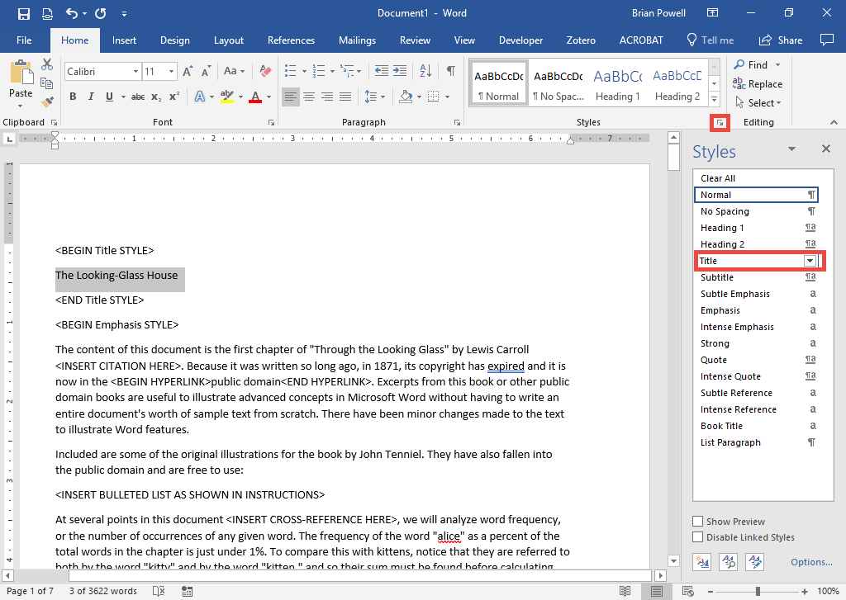
Apply Formatting Styles
Formatting styles allow for consistent formatting throughout documents.
Go to the Home ribbon.
Click arrow in bottom right corner of Styles section to open Styles pane.
Select the text you would like to apply the formatting style to.
In the Styles pane, click the name of the formatting style to apply.

Slide 5
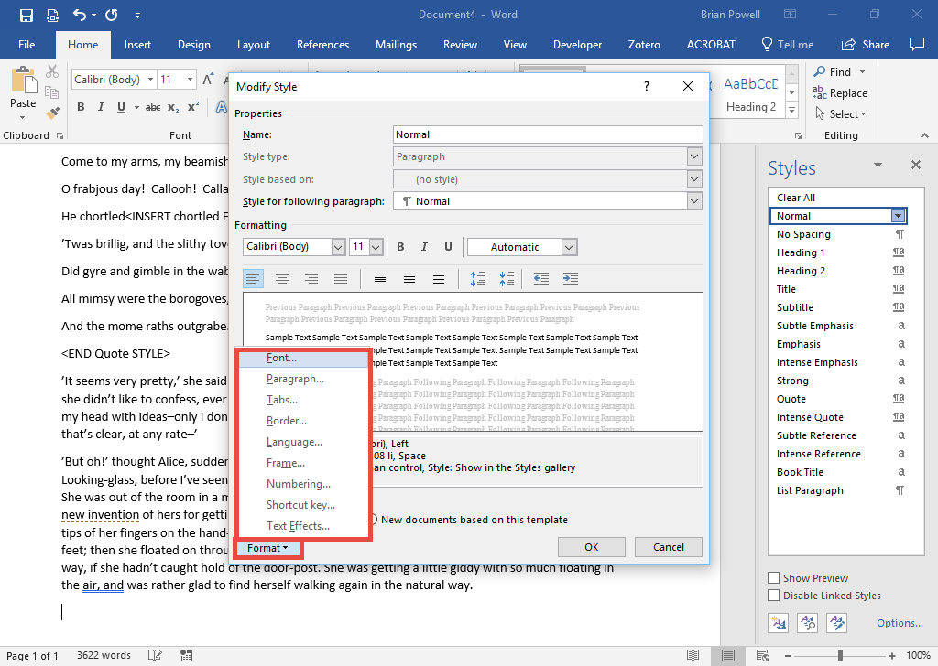
Modify Formatting Styles:
Part 1
You can edit existing styles and create your own.
To modify an existing style:
In the Styles pane, right-click on the style of interest and select Modify.
Click the Format button.
From the dropdown list, select the Font option.

Slide 6
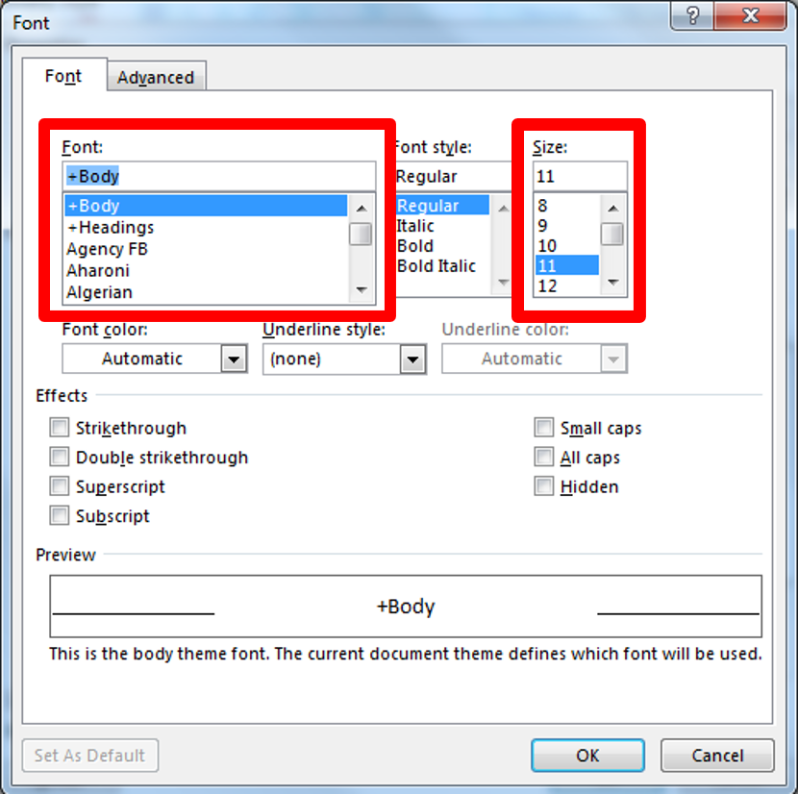
Modify Formatting Styles:
Part 2
In the Font dialog box, adjust the Font and Size settings as needed.
Click the OK button when done.
In the Modify Style dialog box, click Format and then Paragraph to adjust paragraph settings.

Slide 7
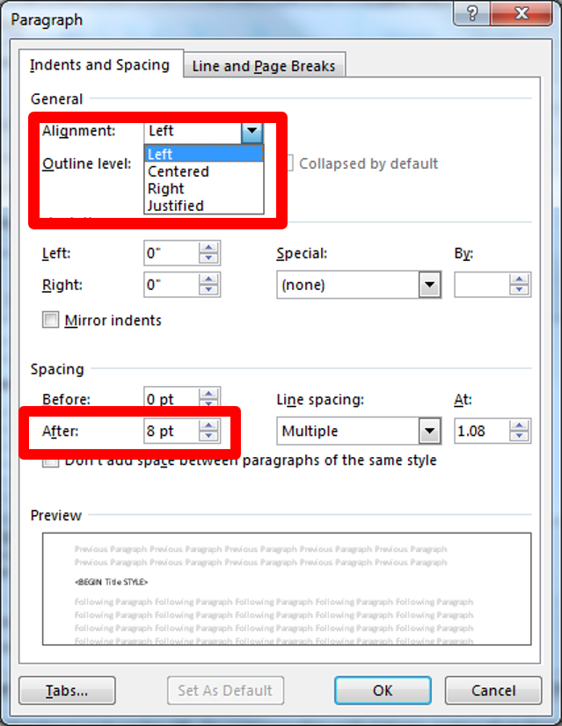
Modify Formatting Styles:
Part 2
In the Paragraph dialog box, set the Alignment option to control how paragraph text is positioned.
Under the Spacing section, specify spacing for before and after each paragraph.

Slide 8
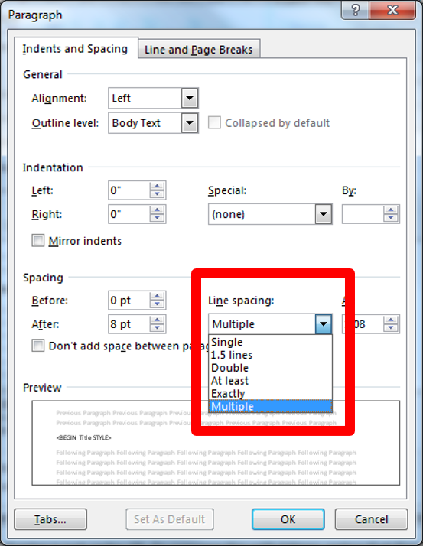
Modify Formatting Styles:
Part 3
In the Spacing section, select the appropriate line spacing from the Line spacing drop-down list.

Slide 9
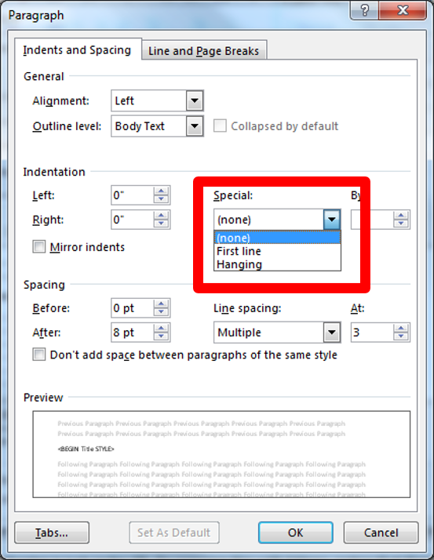
Modify Formatting Styles:
Part 4
In the Indentation section, specify first line indent by selecting the option from the Special drop-down list.
Click the OK button to close the Paragraph dialog box.
Also click the OK button in the Modify Style dialog box to commit your changes.

Slide 10
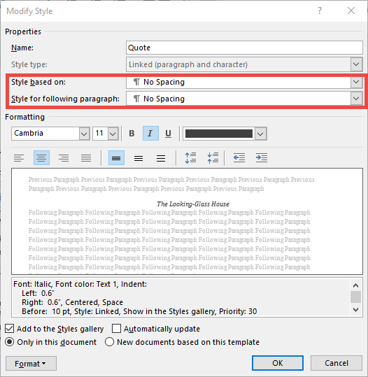
Modify Formatting Styles:
Part 5
In the Modify Style dialog box, change if needed:
  Change the Style based on option. The style being modified will have the same settings as the style it is based on except where the two are set differently.
  Change the Style for following paragraph, which can be helpful if applying special formatting for certain types of paragraphs.

Slide 11
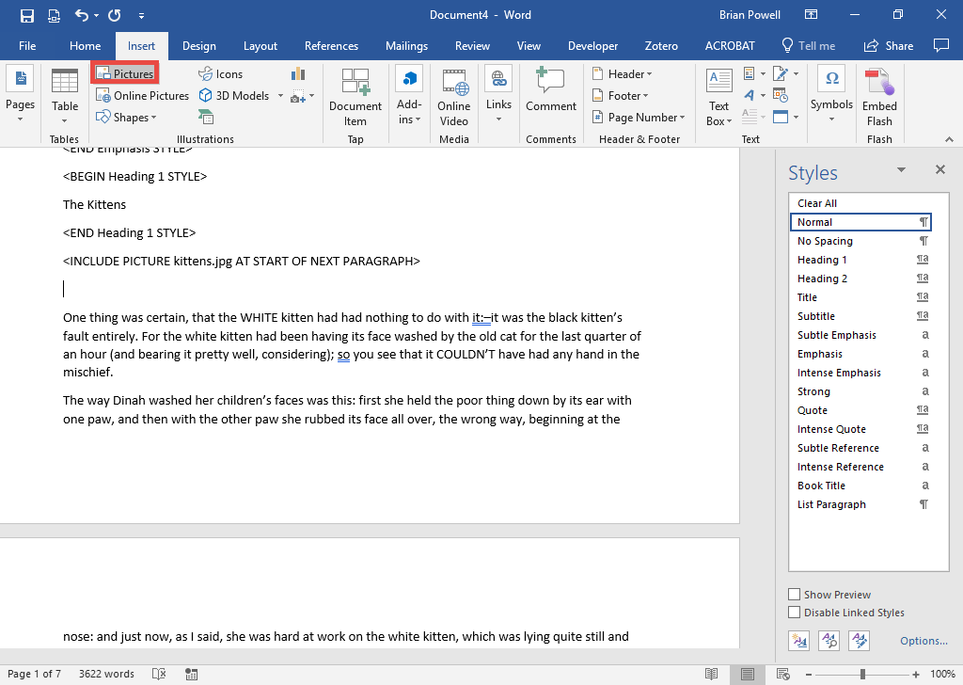
Insert Pictures:
Part 1
Move the cursor to where picture will be inserted.
Go to the Insert ribbon.
In the Illustrations section, click the Pictures button.
Select the picture file you wish to insert.
Click the Insert button.

Slide 12
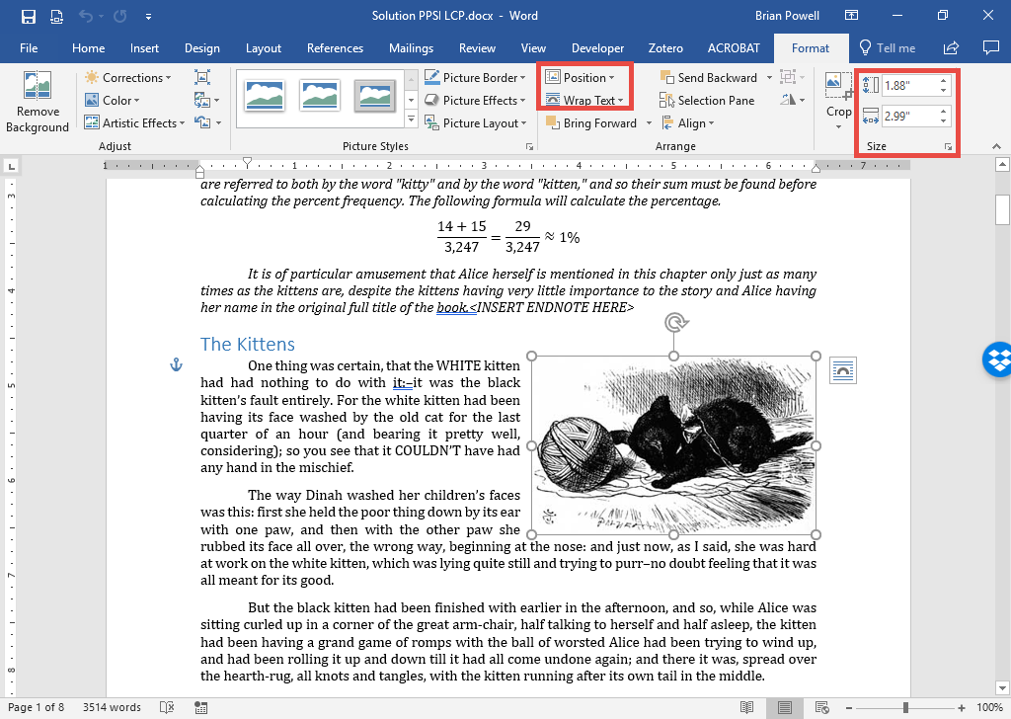
Insert Pictures:
Part 2
With the newly embedded picture selected, go to the Picture Tools Format ribbon to control how it is positioned and sized.
Use the Wrap Text menu to control text wrapping.
Use the Position menu to adjust the image’s position.
Size the image on the right side of the ribbon.

Slide 13
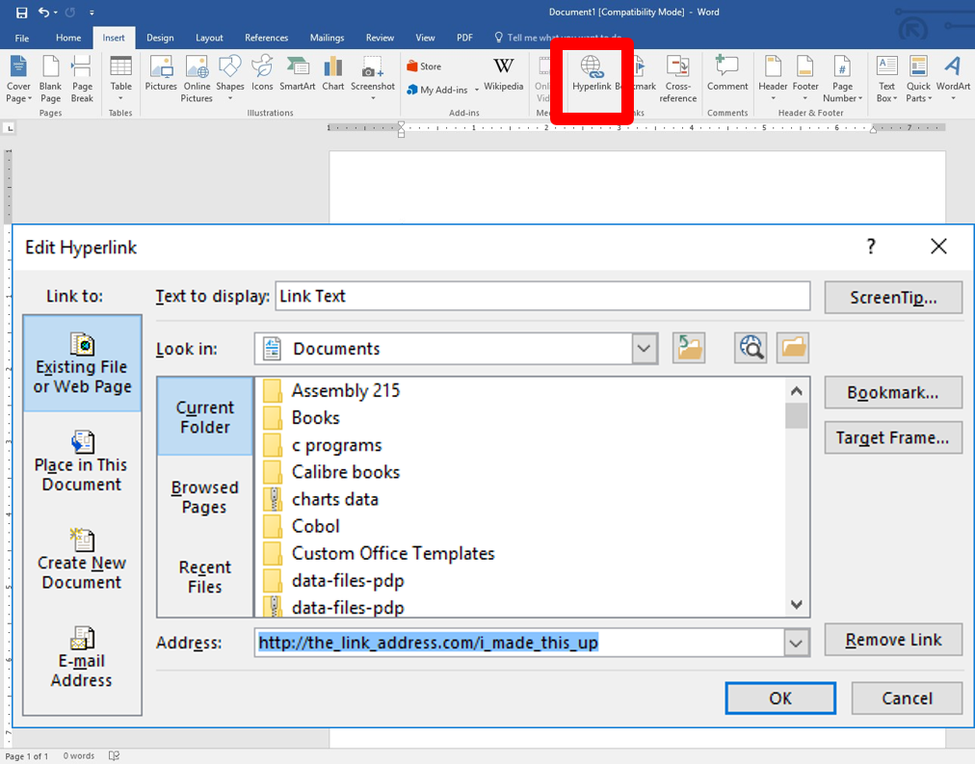
Insert Hyperlinks
Hyperlinks allow users to easily view other websites or documents.
Highlight the text that you wish to link.
Go to the Insert ribbon.
In the Links section, click the Hyperlink button.
Type in the display text and link address.
Click the OK button.

Slide 14
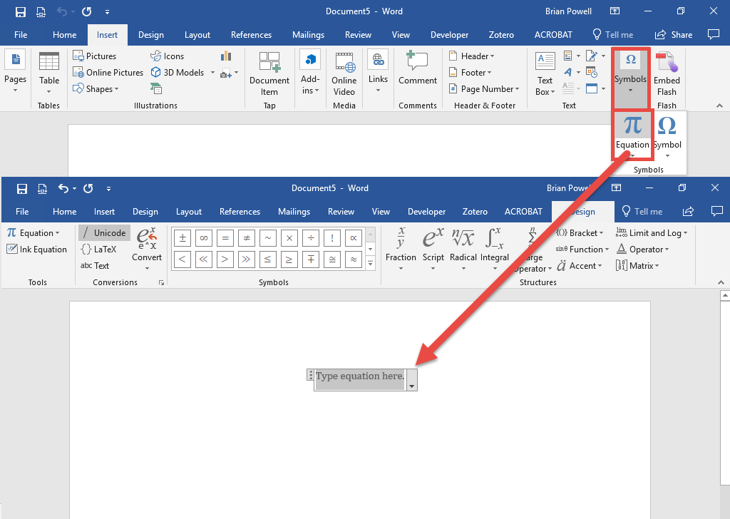
Use The Equation Editor
Equation Editor is used to embed mathematical equations in documents.
Go to the Insert ribbon.
In the Symbols section, click the Equation button to insert and empty equation.
Type in the equation, using features from the Equation Tools Design ribbon like fractions and scripts as needed.

Slide 15
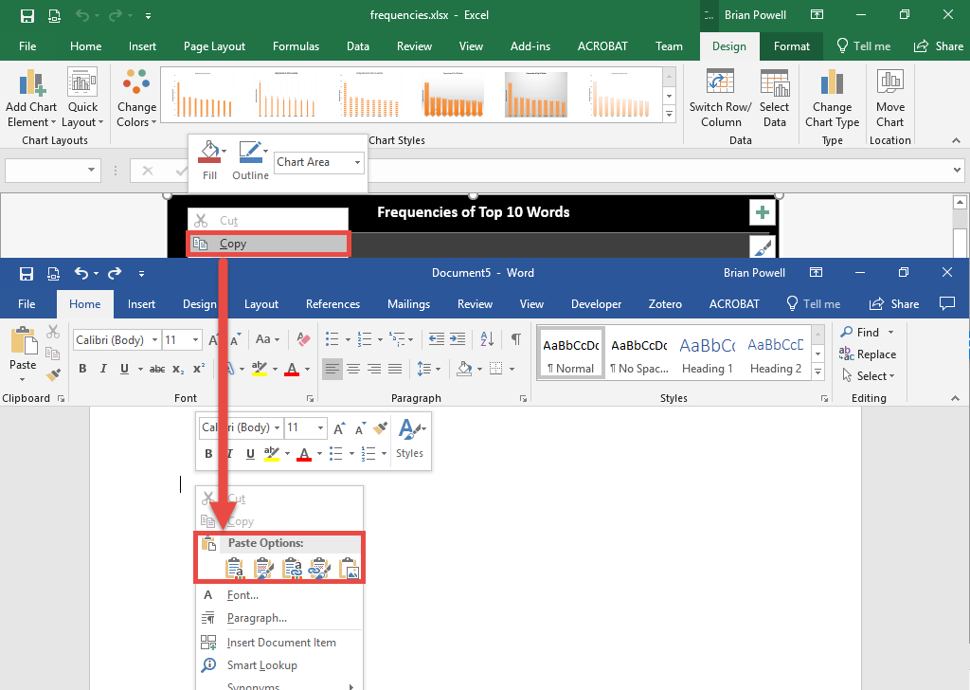
InSert Excel Charts
We can include charts from Excel in our slides to illustrate data.
Open the Excel workbook.
Right-click on blank area of the chart and choose Copy.
Open the PowerPoint presentation.
Click to select a content area.
Right-click and paste.

Slide 16
COMPUTER
SCIENCE 101

