Slide 1
Data Analysis: Online Scavenger Hunt Participation Project
Airplane Disasters Problem
Railroad Disasters Problem
WV Mining Disasters Problem

Slide 2
Topics Covered
Search using phrases
Restrict searches to a specific website
Restrict searches to a specific file type
Exclude results from a search
Search for images
Search for newspaper articles
Locate scholarly articles

Slide 3
Search Engines
Search engines are software systems which are designed to search for information on the Internet.
While Google, Yahoo, and Bing are the most popular search engines available for searching general information, there are also specialty search engines for searching academic research, vacation destinations, images, and much more.

Slide 4
Search using phrases
Using quotation marks around search phrases ensures that those phrases are included in your result.
For example, “airplane crash” only gives results containing this phrase

Slide 5
Restrict searches to a specific website
Most general search engines allow you to restrict searches to webpages and files within a specific website.
Use the search term site: followed by the domain of the website you wish to search
For example, if you want to search within the website of the NTSB, use site:ntsb.gov

Slide 6
Restrict searches to a specific Filetype
Most general search engines allow you to restrict searches to specific filetypes.
Use the search term filetype: followed by the extension of the filetype you wish to search for.
For example, if you want to search for PDF files, use filetype:pdf

Slide 7
Exclude results from a search
Most general search engines allow you to exclude specific websites from search results.
Use the search term -site: followed by the domain of the website you wish to exclude.
For example, if you want to exclude the Wikipedia website from your search results, use -site:wikipedia.org

Slide 8
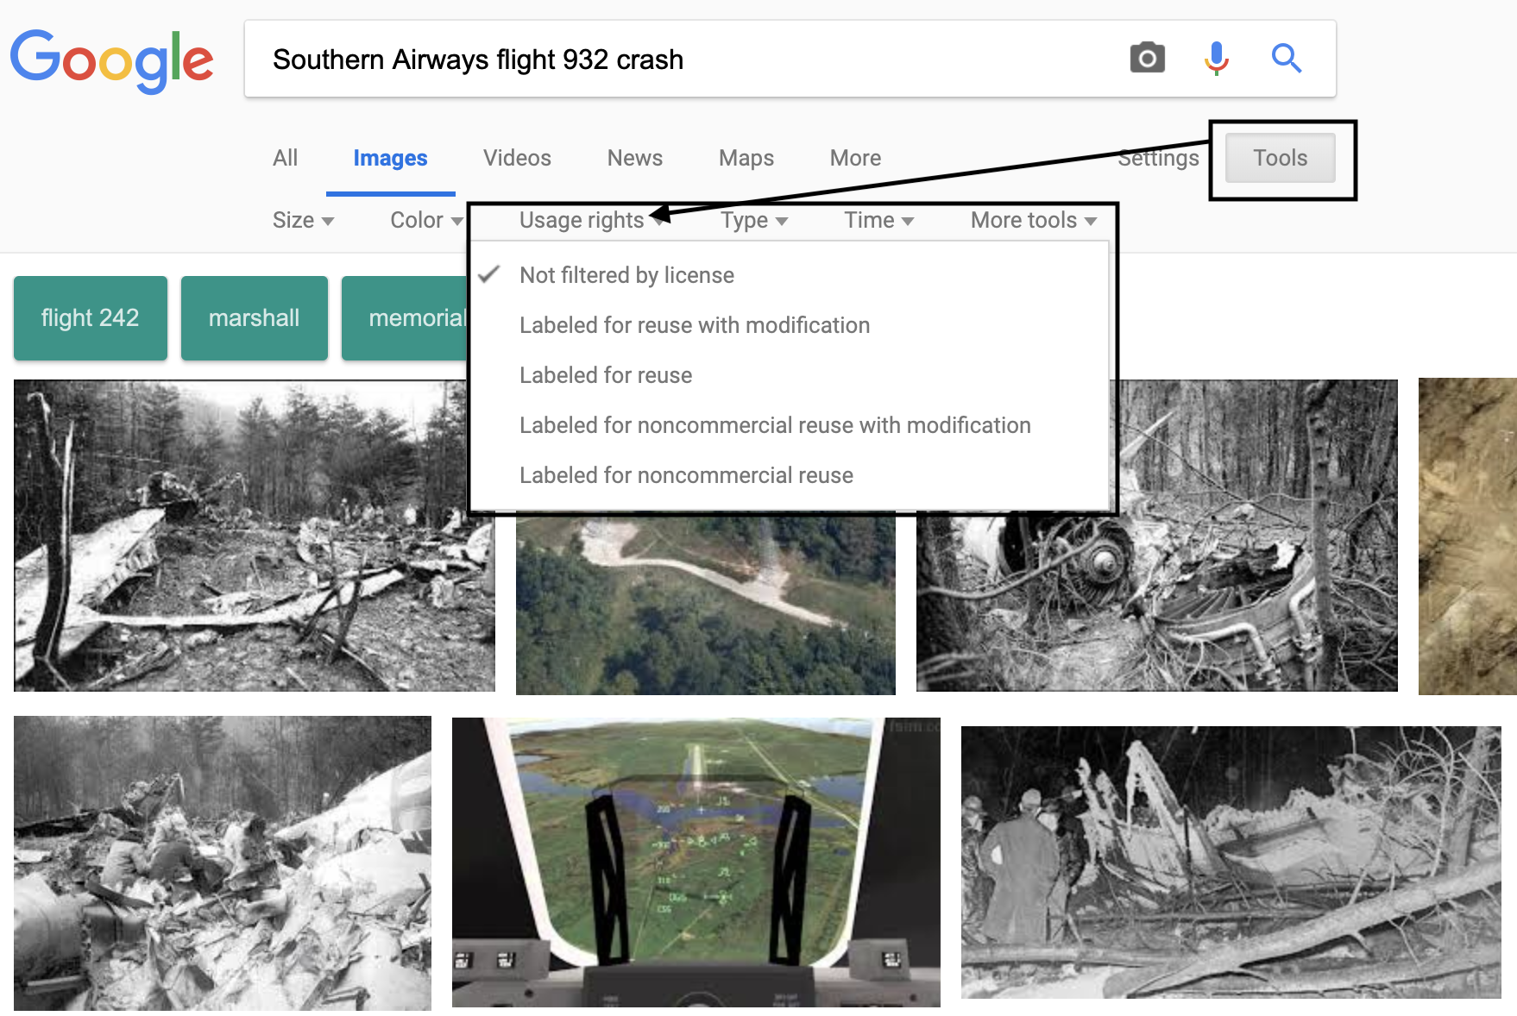
Search for Images
Image search engines, like Google Images, allow you search for images based on basic search terms.
For Google, search as you normally would, then click on the Images tab located on the search results page.
Be careful about copyrights when reusing images. Some engines allow you to filter by license.

Slide 9
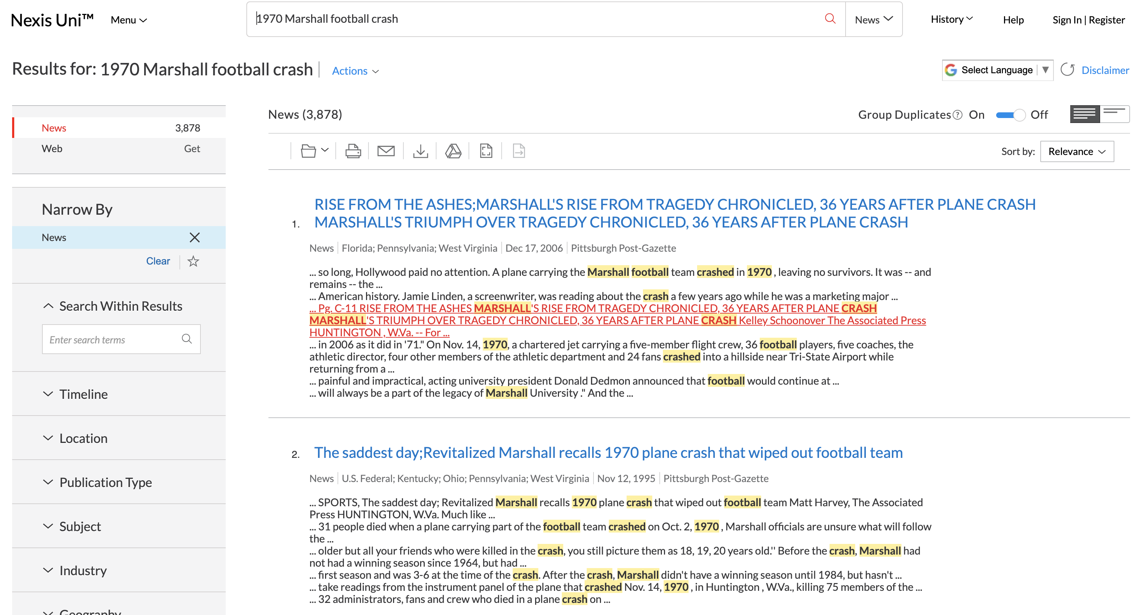
Search for Newspaper articles
LexisNexis Academic is a large commercial database containing historical newspaper articles from around the world.
In the Search in all News for box, enter your search terms and click Search.

Slide 10
Locate scholarly articles
Google Scholar is a search engine for scholarly articles in all research areas.
A search is conducted just like a regular google search, but results will only display scholarly articles
Links on the right side provide direct access to entire articles while main result links may only lead to article abstracts

